Slide 1
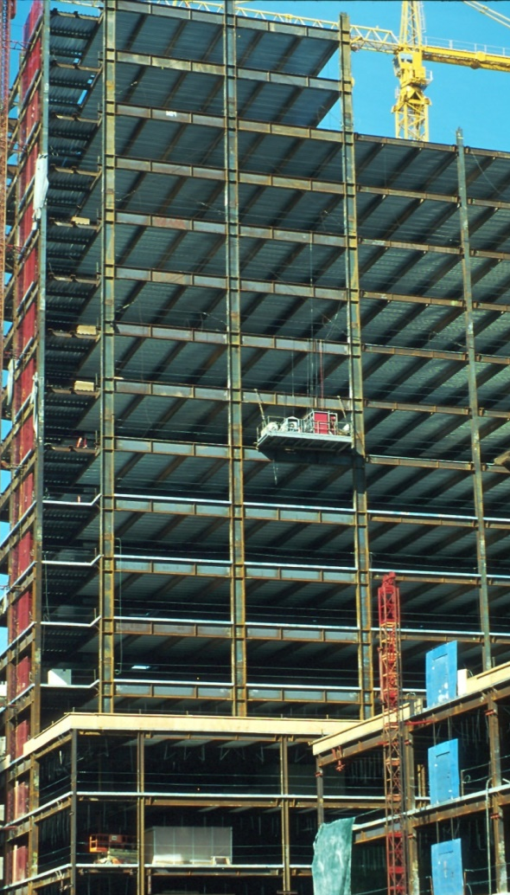
Design of Seismic-Resistant Steel Building Structures
2. Moment Resisting Frames
Prepared by:
Michael D. Engelhardt, PhD
University of Texas at Austin
Updated by:
Patricia Clayton, PhD
University of Texas at Austin
with the support of the
American Institute of Steel Construction
Version 2 – May 2020
Version 1 – March 2007
Notes:
This series of PowerPoint presentations covers the fundamentals of the design of seismic-resistant steel building structures. The primary focus of the material is on ductile detailing of steel structures for seismic resistance, rather than on calculation of lateral forces, dynamic analysis, or other general topics on earthquake engineering. The material is intended primarily for use at the graduate level, although many portions of the presentations are appropriate for undergraduates.
The presentations are closely tied to the 2016 AISC Seismic Provisions for Structural Steel Buildings (referred to herein as the AISC Seismic Provisions). The presentations discuss basic principles of the behavior of seismic response of steel structures, and show how these principles are treated in the AISC Seismic Provisions. The presentations are most effective if the students have a copy of the AISC Seismic Provisions. A free copy can be downloaded from the AISC website, at: www.aisc.org.
For basic steel design topics, the presentation refers to the 2016 AISC Specification for Structural Steel Buildings (herein referred to as the AISC Specification). Both the 2016 AISC Seismic Provisions and AISC Specification are written in the combined LRFD - ASD format. These PowerPoint presentations, however, present only the LRFD format. For seismic-resistant design, the LRFD format is preferable, in that it more closely follows the element capacity concepts used seismic design.
For code related seismic-design topics not covered in the AISC Seismic Provisions (seismic design categories, R-factors, seismic overstrength factors, etc.), the presentations refer to ASCE 7-16 - Minimum Design Loads for Buildings and Other Structures.
For questions, comments, corrections, or suggestions on these presentations, please contact:
Michael D. Engelhardt
Departments of Civil, Architectural and Environmental Engineering
University of Texas at Austin
1 University Station C1748
Austin, TX 78712-0275
Email: mde@mail.utexas.edu
Acknowledgments:
These presentations were prepared with support from the AISC Educator Career Enhancement Award. Overall coordination of this effort was provided by Fromy Rosenberg at AISC. The author gratefully acknowledges support provided by AISC and the coordination and oversight provided by Mr. Rosenberg.
The author also gratefully acknowledges contributions and review provided by the AISC Task Group for this project:
Mark Bowman - Purdue University
Steve Mahin - University of California at Berkeley
Brett Manning - PMB 200
Carol Pivonka - AISC
Larry Reaveley - University of Utah
Rafael Sabelli - Dasse Design, San Francisco
Tom Sabol - Englekirk & Sabol Consulting Engineers, Los Angeles
Chia-Ming Uang - University of California at San Diego
The module on Special Plate Shear Walls was prepared by Rafael Sabelli - Dasse Design, San Francisco

Slide 2
Design of Seismic-Resistant
Steel Building Structures
Introduction and Basic Principles
Moment Resisting Frames
Concentrically Braced Frames
Eccentrically Braced Frames
Buckling-Restrained Braced Frames
Special Plate Shear Walls
Notes:
This PowerPoint series is divided into 6 modules. This is the Module No.2 on: "Moment Resisting Frames."

Slide 3
2 – Moment Resisting Frames
Definition and Basic Behavior of Moment Resisting Frames
Beam-to-Column Connections: Before and After Northridge
Panel-Zone Behavior
AISC Seismic Provisions for Special Moment Frames
Notes:
These are the major topic areas to be covered in this module. The initial part of this module will discuss basic issues on the behavior and design of moment resisting frames. The latter part of the module will present key detailing requirements for moment resisting frames in the AISC Seismic Provisions.

Slide 4
2 – Moment Resisting Frames
Definition and Basic Behavior of Moment Resisting Frames
Beam-to-Column Connections: Before and After Northridge
Panel-Zone Behavior
AISC Seismic Provisions for Special Moment Frames
Notes:
We will begin this module with a description of the basic behavior of steel moment resisting frames.

Slide 5
Moment Resisting Frame (MRF)
Beams and columns with moment resisting connections; resist lateral forces by flexure and shear in beams and columns
Develop ductility by:
Flexural yielding of beams
Shear yielding of column panel zones
Flexural yielding of columns
Advantages
Architectural Versatility
High Ductility and Safety
Disadvantages
Low Elastic Stiffness
Notes:
Basic concepts of MRFs:
- and MRF is a rigid frame - beams rigidly attached to columns with moment resisting connections;
- resist lateral force by rigid frame action;
- dominant forces developed in frame members: flexure and shear;
- ductility in MRFS is achieved by yielding in selected frame elements, as shown in slide.

Slide 6
Moment Resisting Frame (MRF)
Notes:
A simple MRF - rectangular arrangement of columns and beams - with beams attached to columns with moment resisting connections.

Slide 7
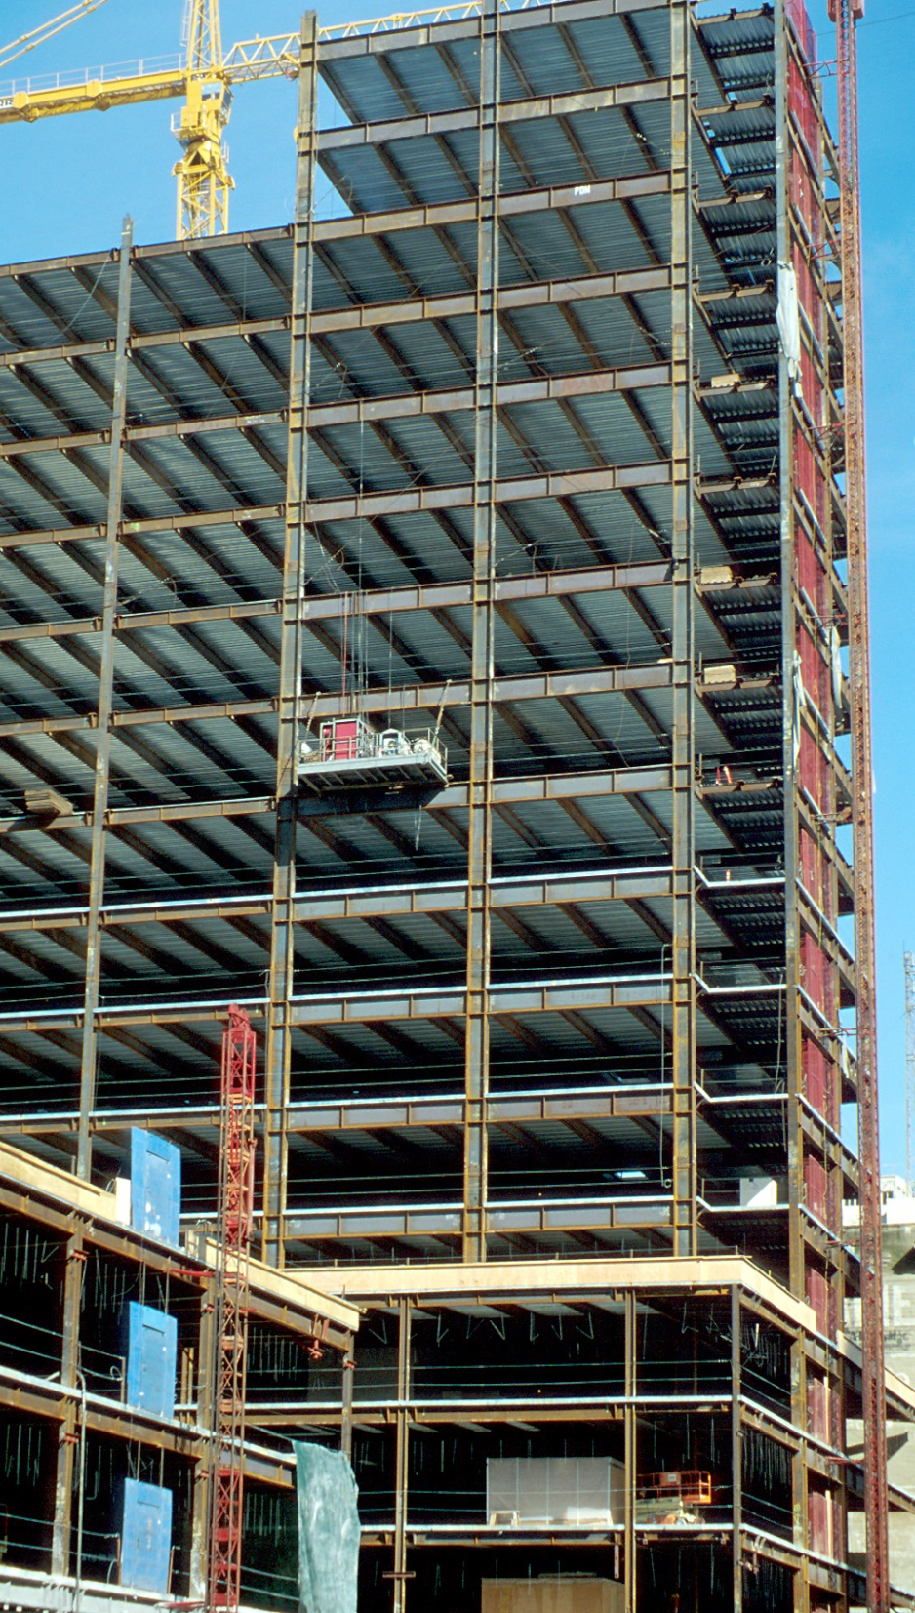
Notes:
An example of a steel MRF under construction in Oakland, California. Note that the MRFs are the two frames on the right (observe the deeper columns and beams in the MRFs).

Slide 8
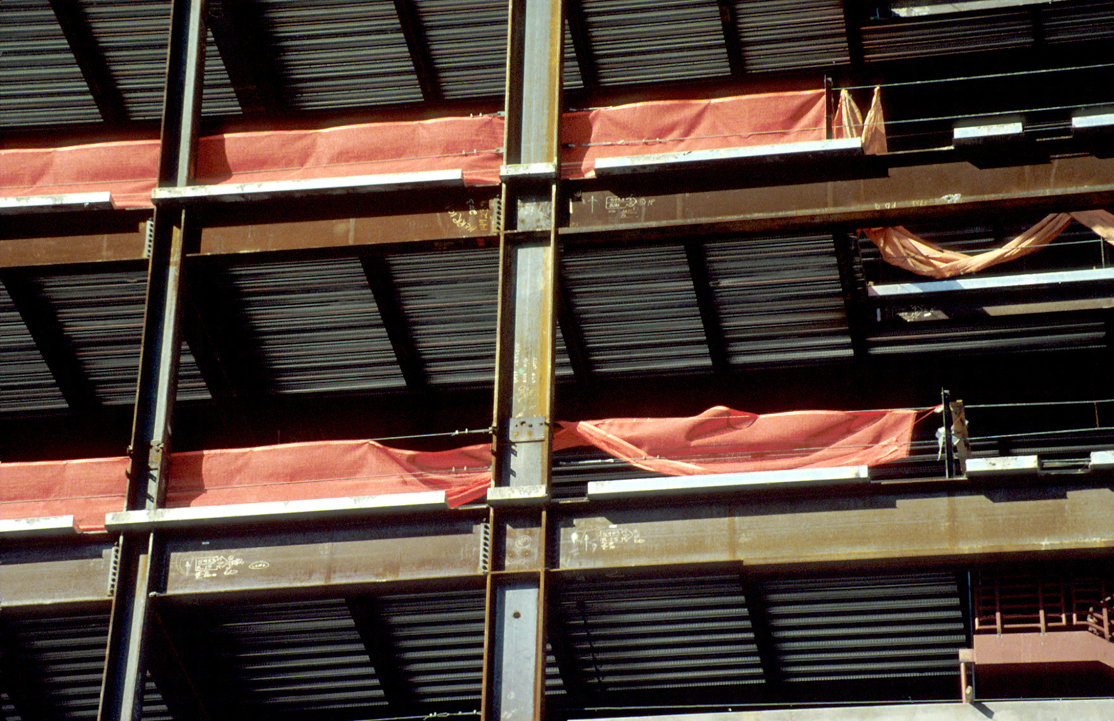
Notes:
A closer view of an MRF.

Slide 9
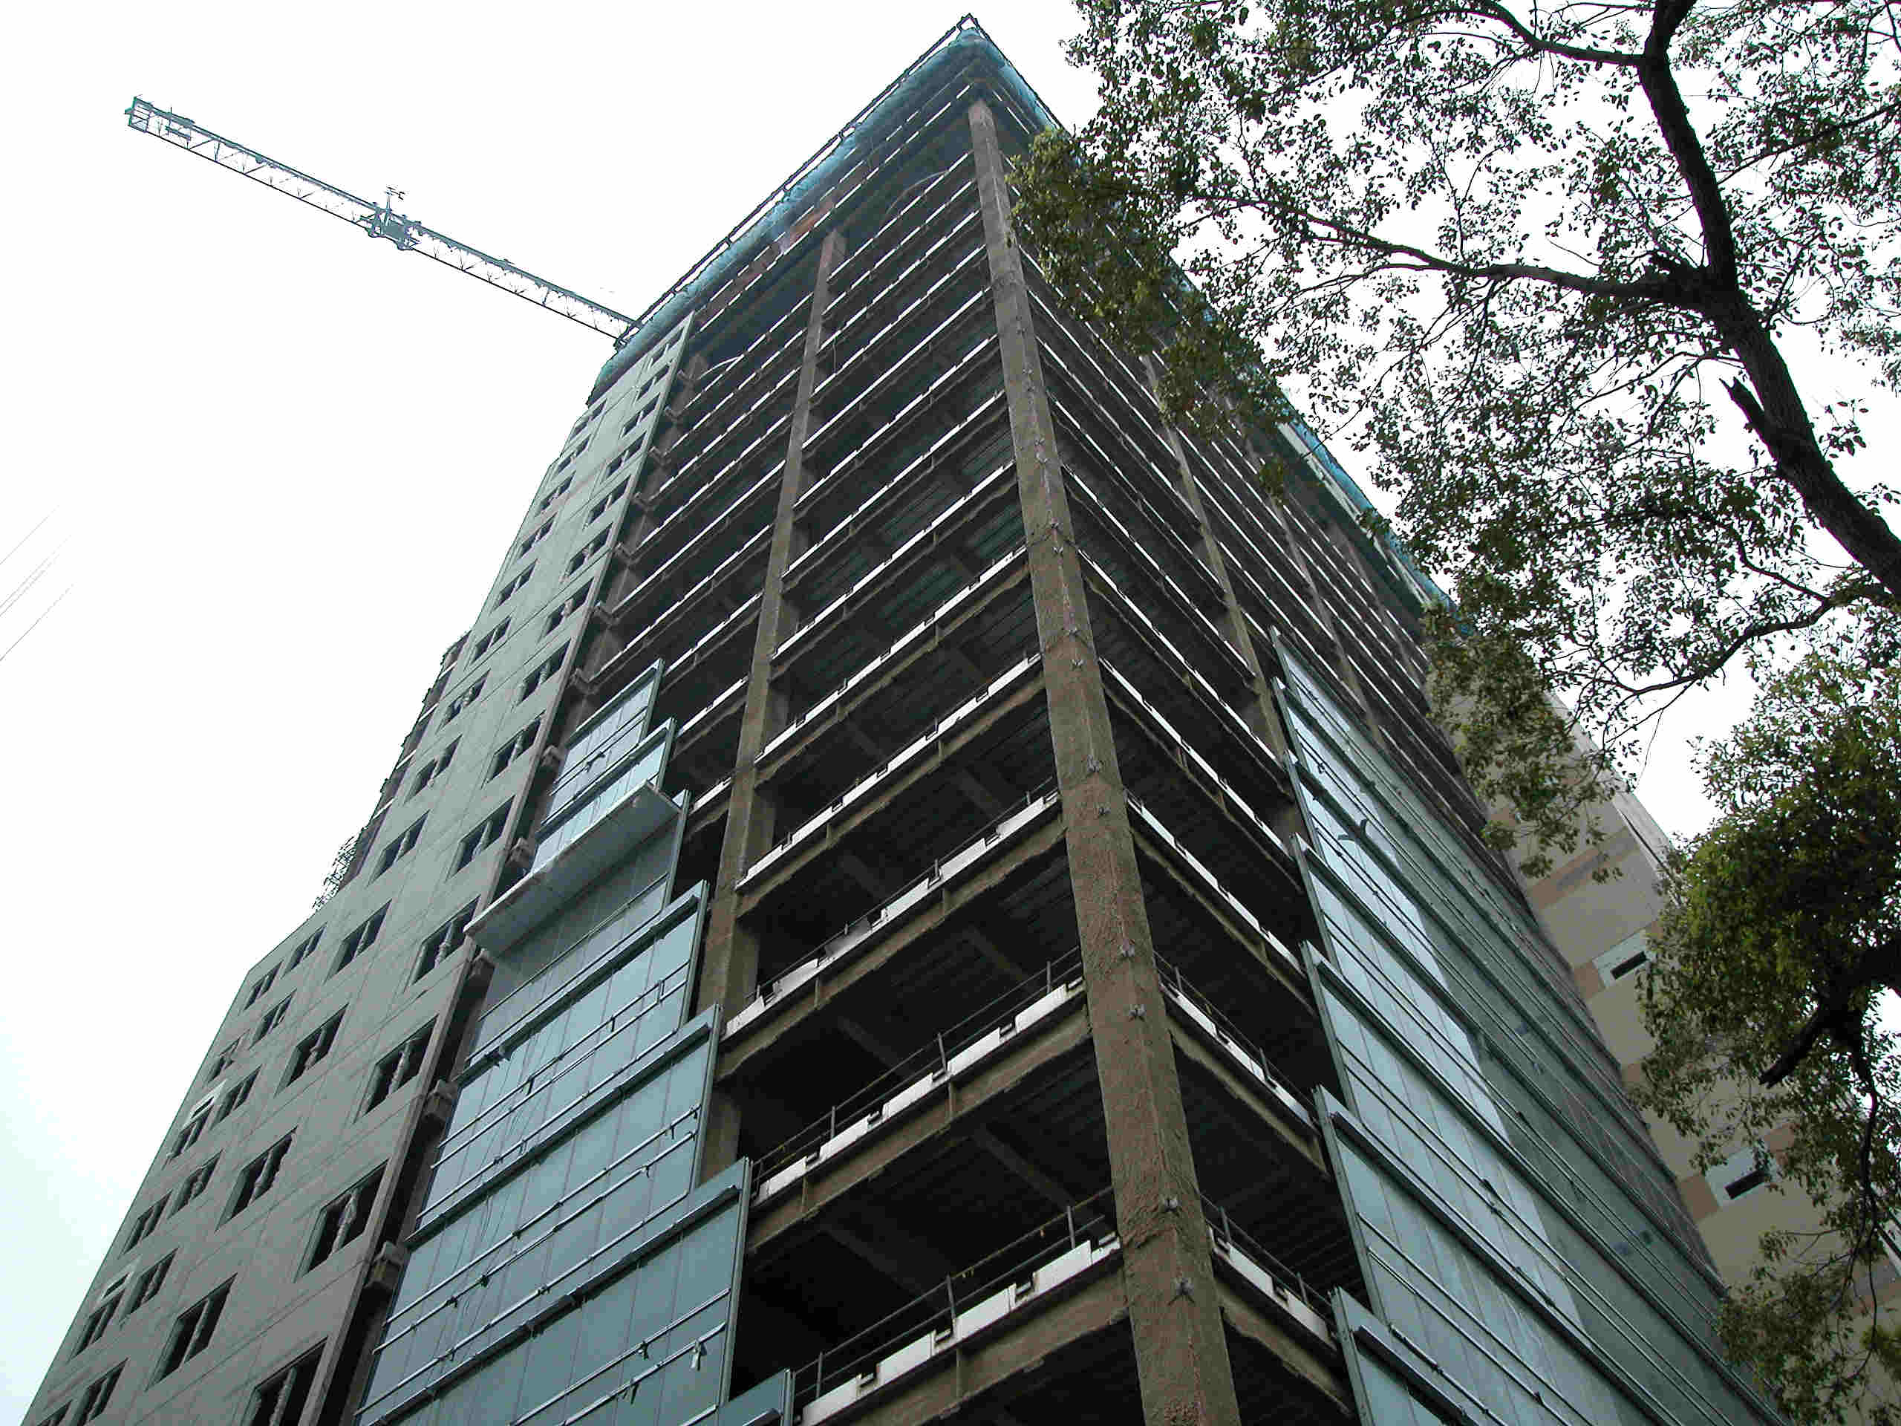
Notes:
An steel building under construction in Taipei, Taiwan. Perimeter frames are moment resisting. Columns are steel box columns.

Slide 10
Achieving Ductile Behavior
Understand and Control Inelastic Behavior:
Choose frame elements ("fuses") that will yield in an earthquake,
i.e. choose plastic hinge locations.
Detail plastic hinge regions to sustain large inelastic rotations prior to the onset of fracture or instability.
Design all other frame elements to be stronger than the plastic hinge regions.

Slide 11
Behavior of an MRF Under Lateral Load:
Internal Forces and Possible Plastic Hinge Locations

Slide 12
Notes:
Using a centerline model, this slide shows qualitatively the moment diagram in the beams and columns of an MRF under lateral load. Observe that maximum moment occur at the member ends. i.e. at the ends of beams and at the ends of columns. Thus, if flexural yielding occurs in an MRF, it is likely to occur at the ends of beams and columns.

Slide 13
M
V
Notes:
This slide shows the moment and shear diagrams for a column of an MRF under lateral load. This is not a centerline model of the frame, but rather includes the beam-column joint regions. Observe that the shear in the clear span portions of the columns is typically very small, and has little effect on the elastic or inelastic response of the frame. However, within the joint regions, the shear in the column is very high. Recall that shear is the rate of change of moment (V=dM/dx), i.e., the shear is the slope of the moment diagram. As seen above, there is a very high moment gradient in the joint region, resulting in very high shear. This high shear can result in shear yielding of the column in the beam-joint joint region.
The portion of the column within the beam-column joint region is called the column "panel zone."

Slide 14
Possible Plastic Hinge Locations
Panel Zone
(Shear Yielding)
Column
(Flexural & Axial Yielding)
Beam
(Flexural Yielding)
Notes:
Based on the typical distributions of moment and shear in the members of an MRF under lateral load, there are three locations where yielding might occur, .i., three possible plastic hinge locations. These are the locations of high moment or high shear.
1. Flexural yielding at the ends of the clear span portions of beams, i.e., plastic hinges in the beams.
2. Flexural yielding at the ends of the clear span portions of the columns, i.e., plastic hinges in the columns.
(Note: plastic hinges in the clear span portions of the column will typically involve yielding due to flexure + axial force - since columns may be carrying significant axial force in addition to large bending moments.
3. Shear yielding within the joint region of the columns, i.e., plastic hinges in the panel zones.
It is possible to control the location of the plastic hinges by controlling the relative strengths of the beam, column and panel zone. The plastic hinge will occur in the weakest element. In many practical cases, yielding may occur in more than one location, e.g. in the beams and in the panel zones.

Slide 15
Plastic Hinges
In Beams
Notes:
A plastic mechanism for an MRF with plastic hinges at the beam ends. Note that to form a complete mechanism, plastic hinges must also occur at the column bases (or column bases must be "pinned").

Slide 16
Plastic Hinges
In Column Panel Zones
Notes:
A plastic mechanism for an MRF with plastic hinges at column panel zones. Note that to form a complete mechanism, plastic hinges must also occur at the column bases (or column bases must be "pinned").

Slide 17
Plastic Hinges
In Columns:
Potential for Soft Story Collapse
Notes:
A plastic mechanism for an MRF with plastic hinges in the columns. Generally, this mechanism is undesirable because it may concentrate all inelastic action in a single story, and may result in a soft story collapse. We normally try to avoid this mechanism by enforcing "strong column - weak girder" design requirements. Such a requirement is included in the AISC Seismic Provisions for Special Moment Frames, and will be presented later.

Slide 18
Beam-to-Column Connections
Critical Detailing Area for Moment Resisting Frames
Design Requirement:
Frame must develop large ductility without failure of beam-to-column connection
Notes:
Plastic hinges in MRFS will occur in the region of the beam-column joint, i.e., at the beam ends, at the column ends, or in the panel zones. For any of these cases, very large force and deformation demands can occur at the beam-column connection.
One of the basic ductile detailing requirements for MRFs is that the frame should be able to develop large ductility without failure of the beam-column connection. This is a critical aspect of ductile detailing of seismic-resistant steel moment resisting frames.

Slide 19
2 – Moment Resisting Frames
Definition and Basic Behavior of Moment Resisting Frames
Beam-to-Column Connections: Before and After Northridge
Panel-Zone Behavior
AISC Seismic Provisions for Special Moment Frames
Notes:
Developing beam-column connection details that can survive an earthquake without failure has been one of the major challenges in MRF design over the last 40 to 50 years. Beam-to-column connections performed poorly in the 1994 Northridge Earthquake, leading to major changes in practice and in the AISC Seismic Provisions.
Because of the importance of beam-to-column connections, the following slides will examine what we have learned about these connections, both in laboratory testing and in actual earthquakes.
We will examine typical practices for beam-to-column connections, both before and after the 1994 Northridge Earthquake. This will ultimately lead us to an understanding of current design and construction practices, and current code requirements.

Slide 20
Moment Connection Design Practice Prior to 1994 Northridge Earthquake
Welded flange-bolted web moment connection widely used from early 1970’s to 1994
Notes:
Starting in the early 1970s, and continuing up through 1994, the most common connection detail used in seismic-resistant steel MRFS was the "welded flange - bolted web" connection.

Slide 21
Pre-Northridge Welded Flange – Bolted Web Moment Connection
Weld Access Hole
Beam Flange
Stiffener
Backup Bar
Column Flange
Notes:
Key characteristics of a typical welded flange - bolted web moment connection:
- Shear tab is shop-welded to column.
- Column stiffeners (more commonly called "continuity plates"), if required, are shop-welded to the column. Note that design practices and code requirements for continuity plates (the need for continuity plates, the required thickness of continuity plates, welding details to attach continuity plate to column web and flanges) have varied over the years.
- Beam is field bolted to the shear tab.
- Beam flanges are field welded to the column flange. The welds joining the beam flanges to column are single bevel CJP (complete joint penetration) groove welds. The grooves are oriented so that both the top and bottom flanges can be welded in a flat position (no overhead welding required). A backup bar and weld tabs are normally provided for each groove weld (weld tabs not shown above). The back-up bar forms the bottom of the groove, and weld tabs extend the groove beyond the outer edges of the beam flanges.
A weld access hole is cut in the beam web, both at the top and bottom flanges. At the top flange, the access hole permits placement of the back-up bar. At the bottom flange, the access hole permits placement of a groove weld within the center portion of the bottom weld.
In typical practice, the web connection (bolted shear tab) was designed for the shear in the beam.
In some cases, supplemental fillet welds may be placed at the top and bottom of the shear tab (see previous slide). These supplemental web welds were introduced in the 1988 Uniform Building Code, and were intended to permit the transfer of some moment through the web connection.

Slide 22
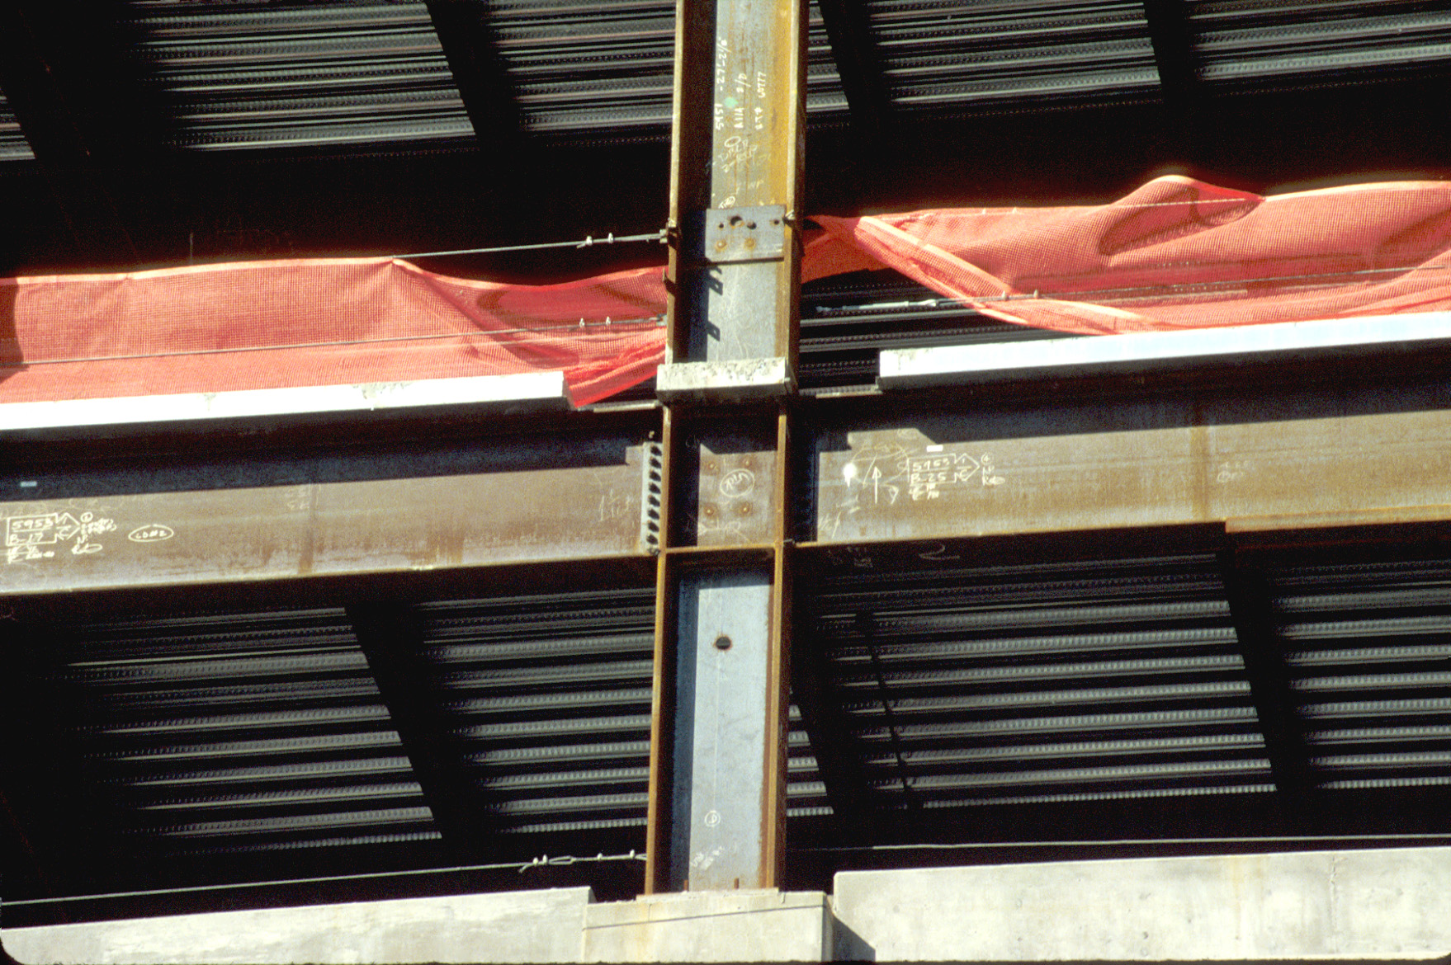
Notes:
A typical welded flange - bolted web moment connection.

Slide 23
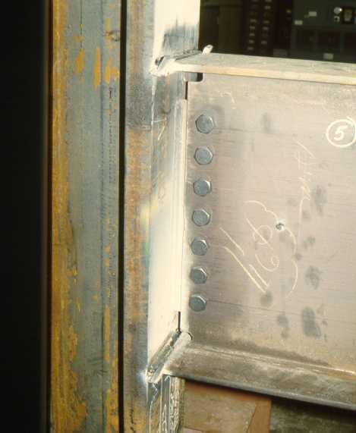
Notes:
Another example of a welded flange - bolted web moment connection (this is a laboratory test specimen). The shear tab is on the far side of the beam web.
The weld tabs at the top and bottom beam flanges are clearly visible.

Slide 24
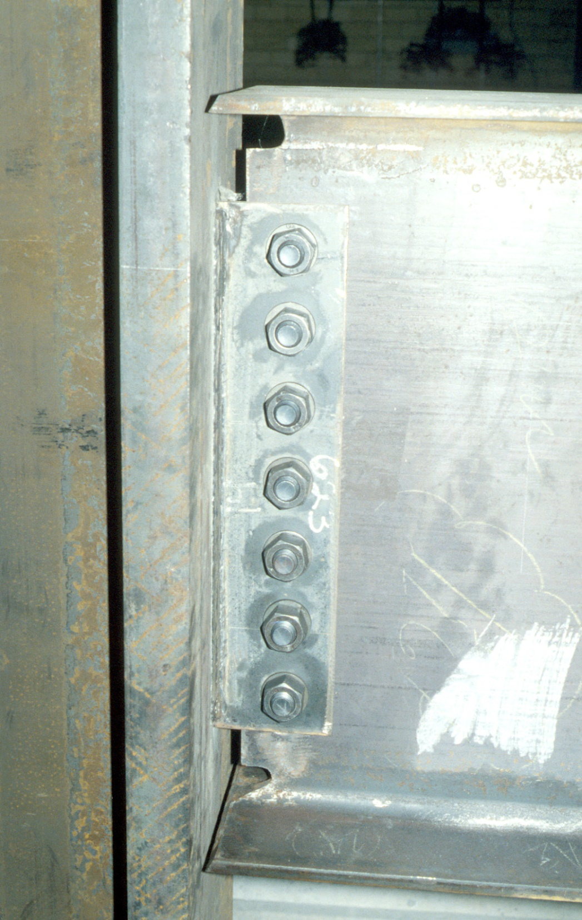
Notes:
The following series of slides shows typical stages in the construction of a welded flange - bolted web moment connection.
This slide shows the beam bolted to the shear tab, and ready for welding. Note that the beam end has been prepared with beveled flanges and weld access holes.

Slide 25
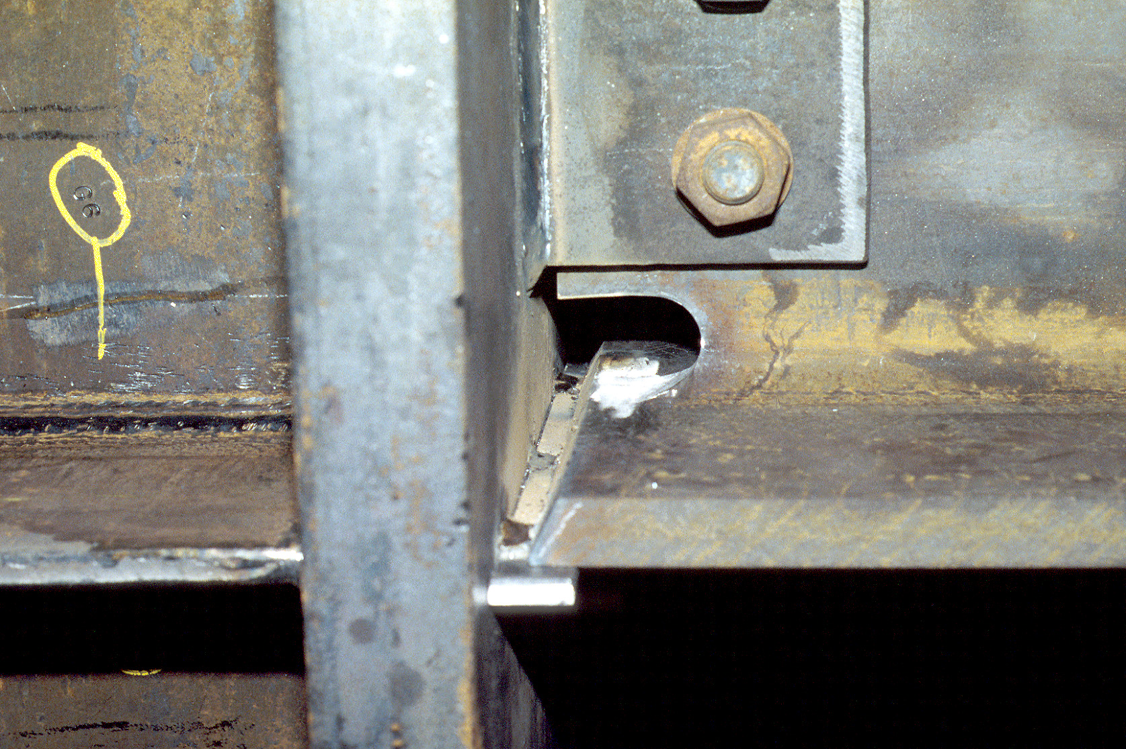
Notes:
Bottom flange - back-up tacked into place. Back-up bars extend beyond flange edges.
Tack welds should be placed inside of the groove, so that they are incorporated into the final weld.
Typical groove weld geometry: 3/8" root (gap between column face and bottom edge of beam flange) and 30-degree bevel on beam flange (30-degrees measured from a vertical line).

Slide 26
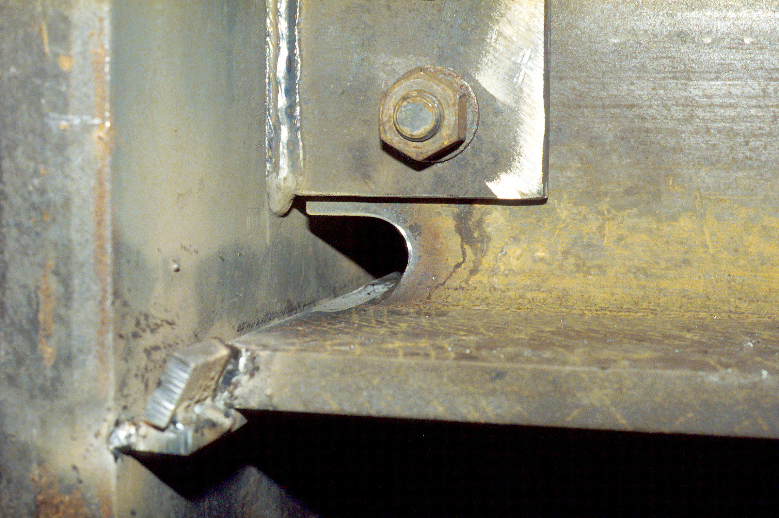
Notes:
Weld tabs tacked in place. Weld tabs extend groove geometry beyond the flange edges. This permits weld terminations (which normally contain defects) to be made outside of the beam flange.

Slide 27
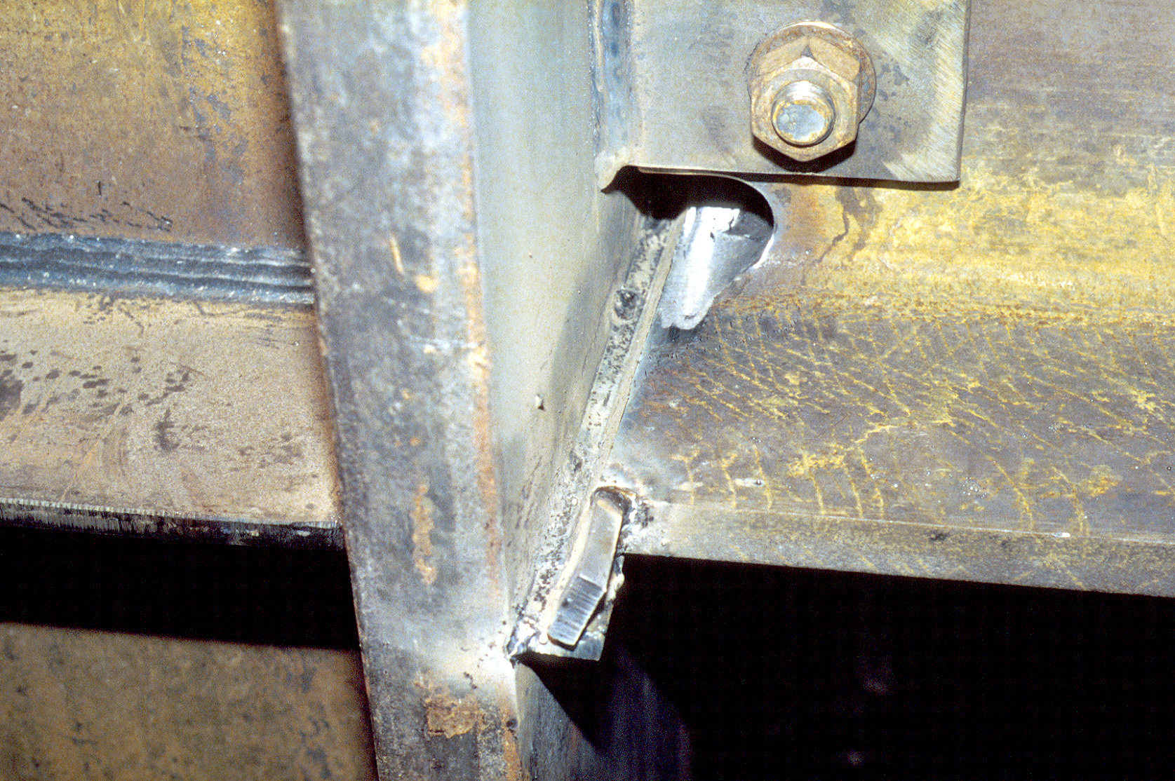
Notes:
The first weld pass has been placed inside of the groove (the "root" pass). To make this pass, the welder must interrupt the weld in the center portion of the flange, i.e., in the region of the weld access hole.
The beam flange groove welds are normally made in the field using the self-shielded flux-cored arc welding (FCAW) process. With this process, the electrode is a wire that is fed continuously from a reel (as opposed to a stick). The wire is hollow, and the flux is on the inside of the wire.
The self-shielded FCAW process was commonly used before the 1994 Northridge Earthquake, and is still the process typically used in current field welding practice.
Prior to the 1994 Northridge Earthquake, a common electrode used for these welds was classified (AWS classification) as E70T-4. The low fracture toughness of the weld metal deposited by this electrode was subsequently identified as an important contributing factor to the connection failures observed after the 1994 Northridge Earthquake.

Slide 28
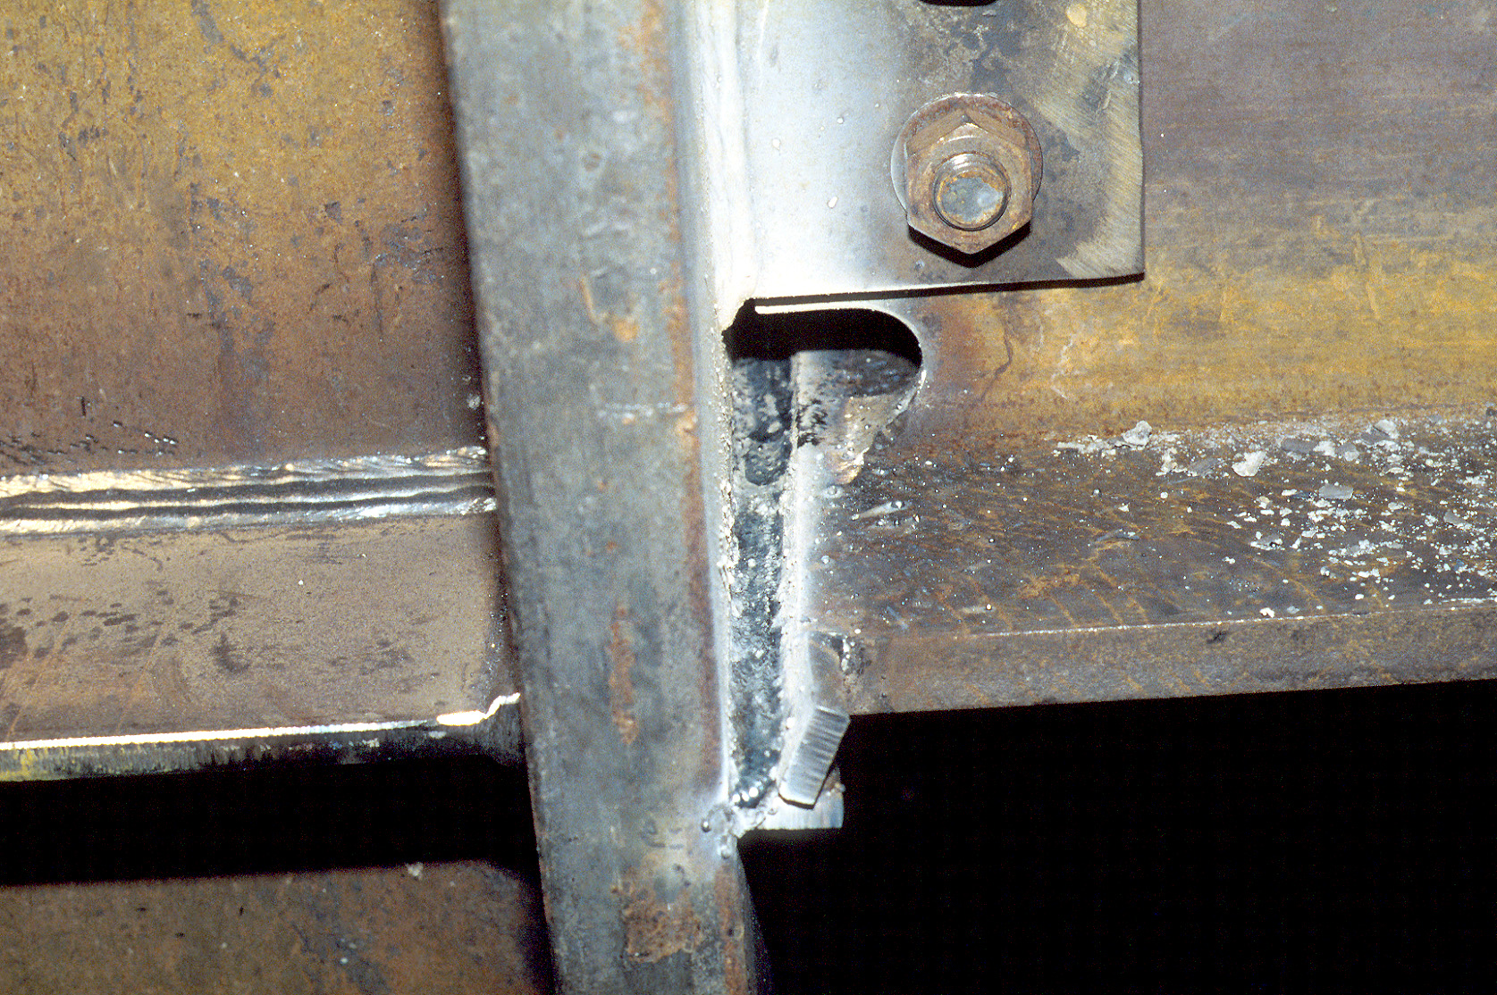
Notes:
Bottom groove continues to be filled with weld metal. Note that each weld pass is interrupted in the center portion of the flange, where the welder must weld from alternate sides of the beam web. The interruption of the weld passes in the middle portion of the flange (i.e the portion in the vicinity of the weld access hole) can lead to weld defects in this region.

Slide 29
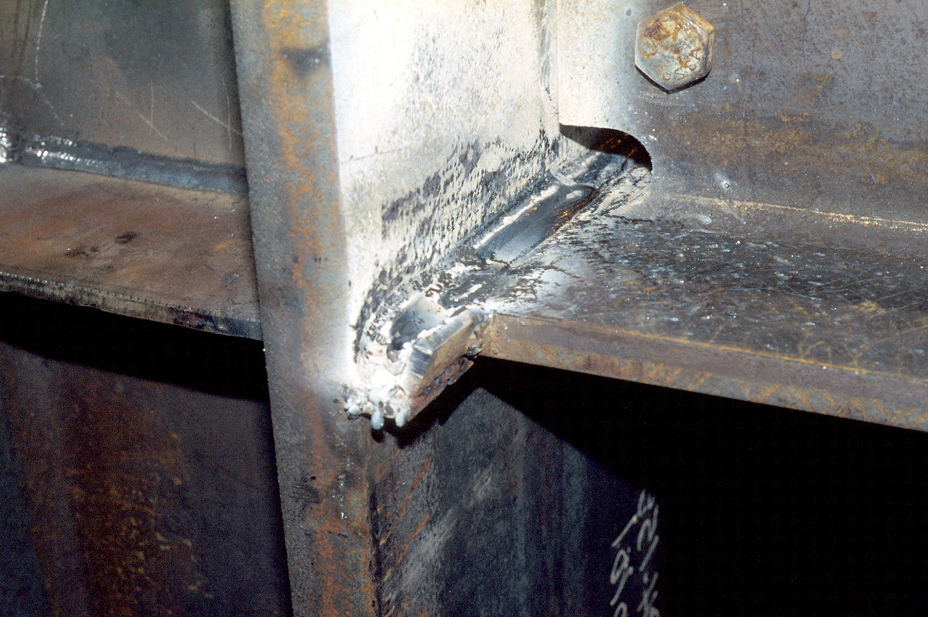
Notes:
Completed bottom flange groove weld. In pre-Northridge practice, the back-up bar and weld tabs were normally left in-place.

Slide 30
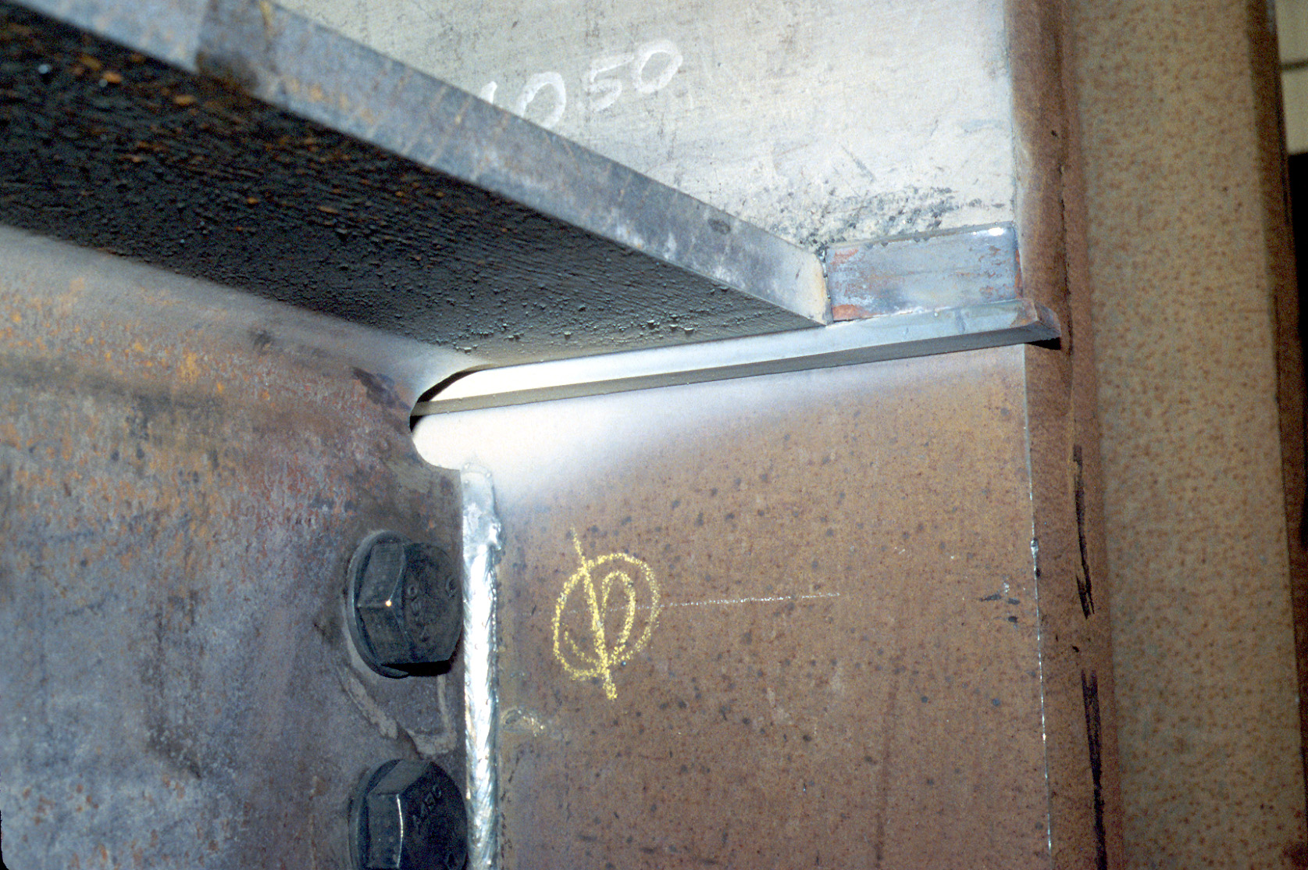
Notes:
Beam top flange, prior to welding. Back-up bar and weld tabs have been tacked into place. Note that the backup bar is continuous, and passes through the weld access hole.

Slide 31
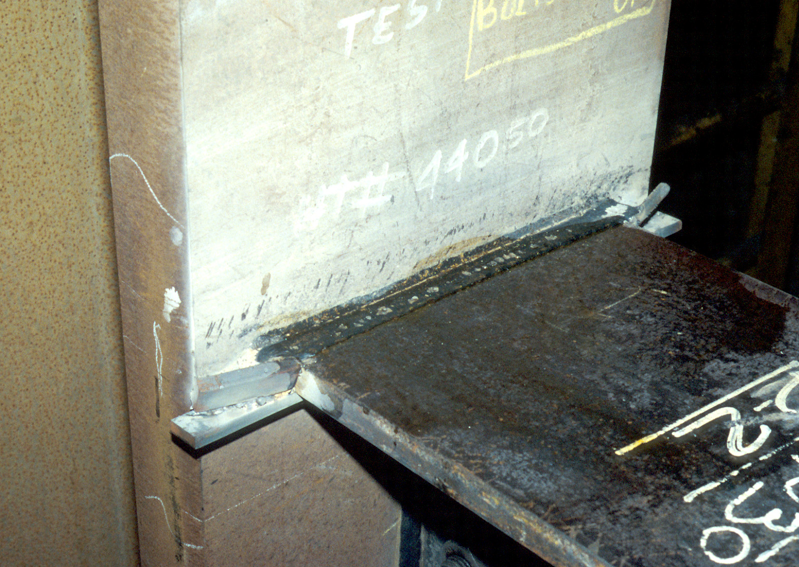
Notes:
Completed top flange grooved weld. For any given weld pass, the welder starts outside of the beam flange (in the region of the weld tab), welds continuously across the groove, and terminates the weld pass outside of the beam flange, at the opposite weld tab. Unlike the bottom flange weld, the top flange groove weld is not interrupted in the middle part of the flange (i.e, the beam web is not an obstruction at the top flange weld).

Slide 32
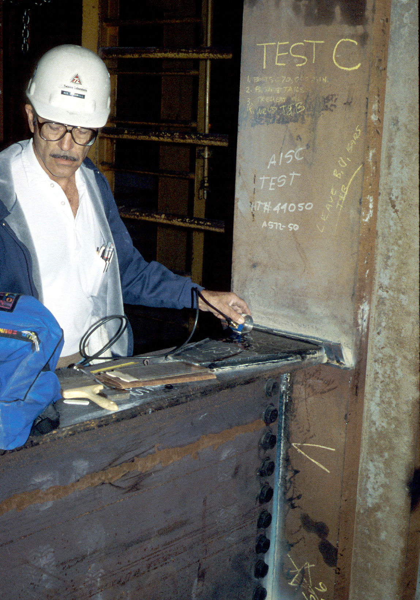
Notes:
Beam flange groove welds are normally examined after completion in the field by ultrasonic testing (UT). (This photo shows a moment connection with a cover plate).
With UT, a transducer sends a sound wave into the weld joint. If the wave encounters a defect, a portion of the wave is reflected back to the transducer. An experienced UT technician can interpret these signals to detect defects.

Slide 33
Experimental Data on “Pre-Northridge” Moment Connection
Typical Experimental
Setup
Notes:
The next series of slides will examine laboratory data on the performance of the pre-Northridge welded flange - bolted web connection under cyclic loading. This slide shows a typical experimental setup for testing a moment connection. A test specimen normally consists of a beam segment connected to a column segments. The ends of the column are held in place, and cyclic loads and deformations are applied to the end of the beam segment. The point of load application represents a point of inflection (zero moment) in the beam of a moment frame under lateral load.

Slide 34
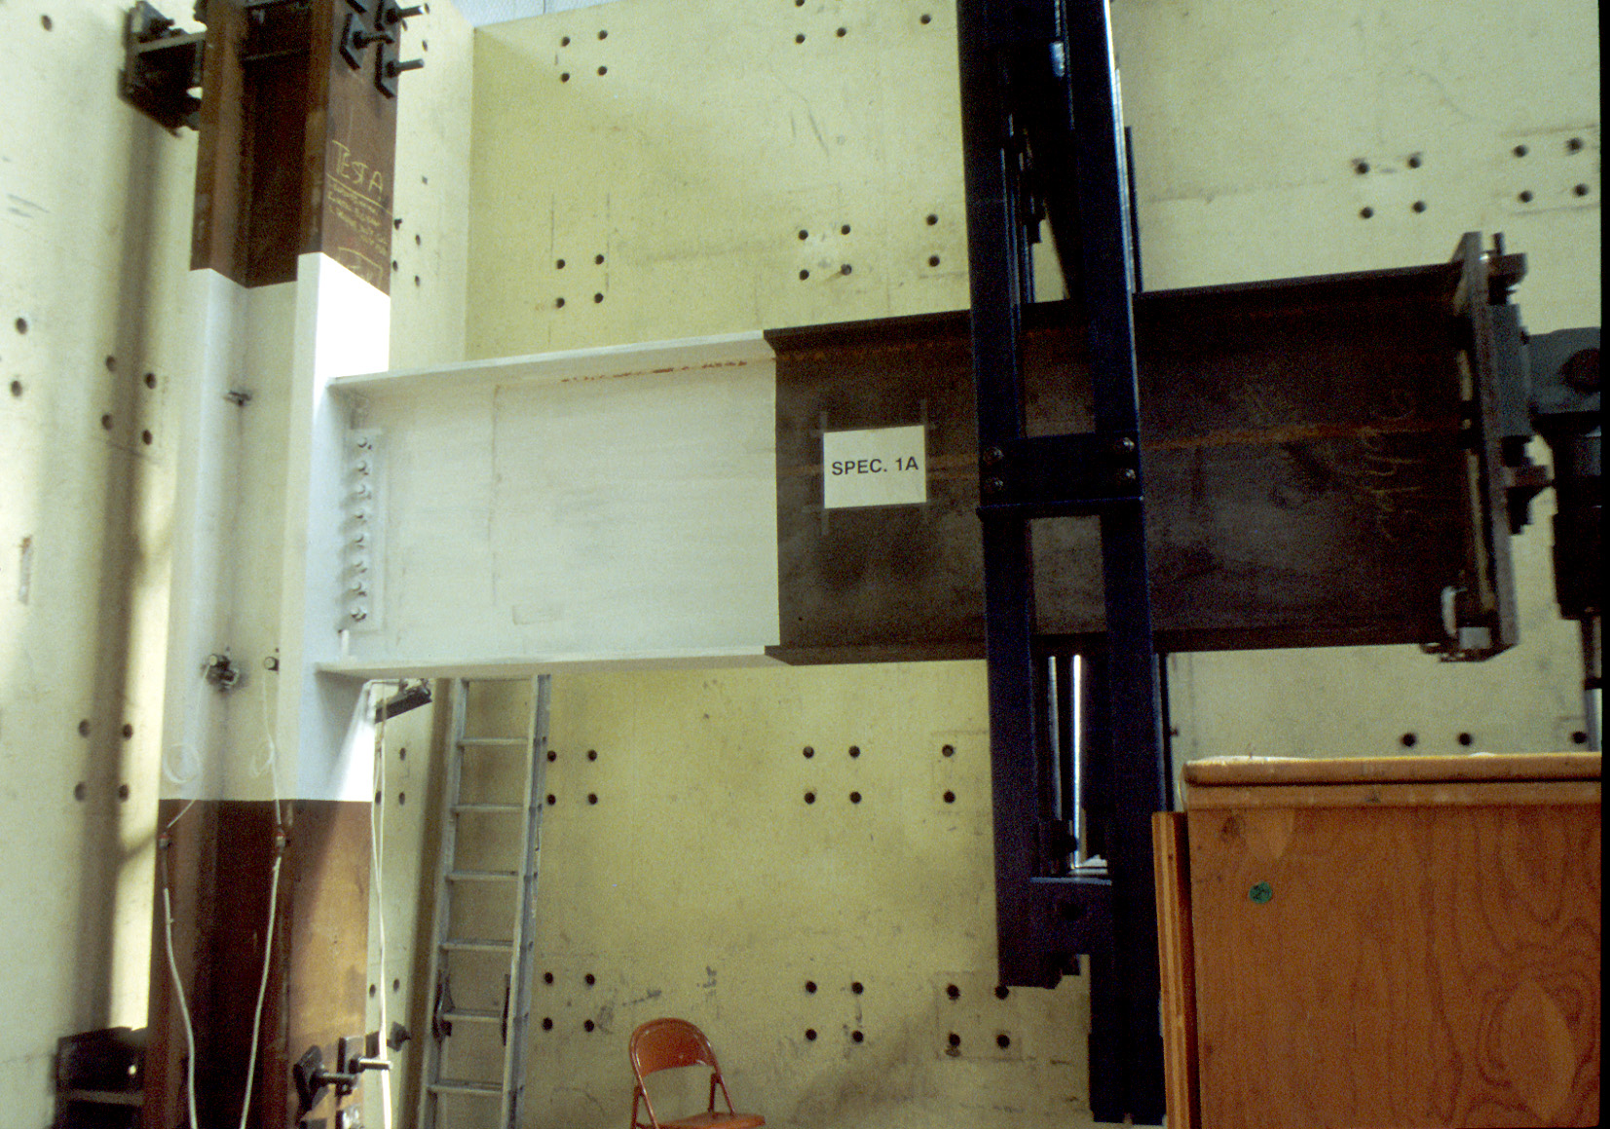
Notes:
A photo of a typical beam-column subassemblage in the laboratory. A hydraulic loading ram is located at the right end of the beam segment. A lateral brace is also provided near the end of the beam, to restrain lateral torsional buckling of the beam.
Note that the connection region is painted white, using "whitewash" (a mixture of lime and water). When steel yields, the large strains will cause the whitewash to fall off of the beam. The whitewash, therefore, provides an indication of where yielding has occurred.

Slide 35
Initial Tests on Large Scale Specimens
Tests conducted at UC Berkeley ~1970
Tests on W18x50 and W24x76 beams
Tests compared all-welded connections with welded flange-bolted web connections
Notes:
We will begin by examining a series of tests on the welded flange - bolted web moment connection, conducted at UC Berkeley in about 1970. These were the first large-scale cyclic loading tests conducted on this connection detail.
Tests were conducted using W18x50 and W24x76 beams.
Two different connection details were tested:
- an all-welded detail (beam flange and beam web are welded directly to the column flange, using CJP groove welds);
- welded flange - bolted web detail.
Reference:
Popov, E.P. and Stephen, R.M., "Cyclic Loading of Full Size Steel Connections." Bulletin No. 21, American Iron and Steel Institute (AISI), Washington DC, 1972.
Note: Drawing and photos in subsequent slides are from AISI Bulletin No. 21.

Slide 36
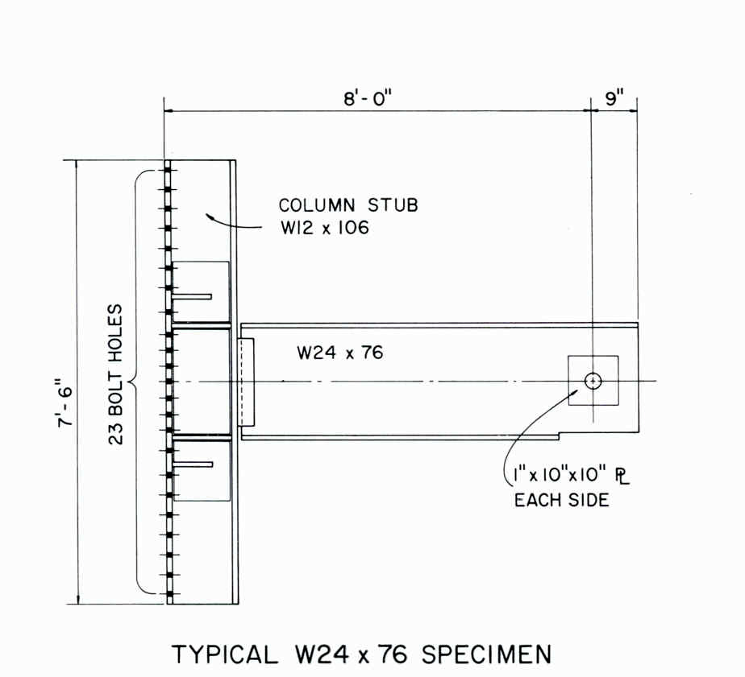
Notes:
A typical specimen.
Note that the entire back flange of the column was bolted to a support.

Slide 37
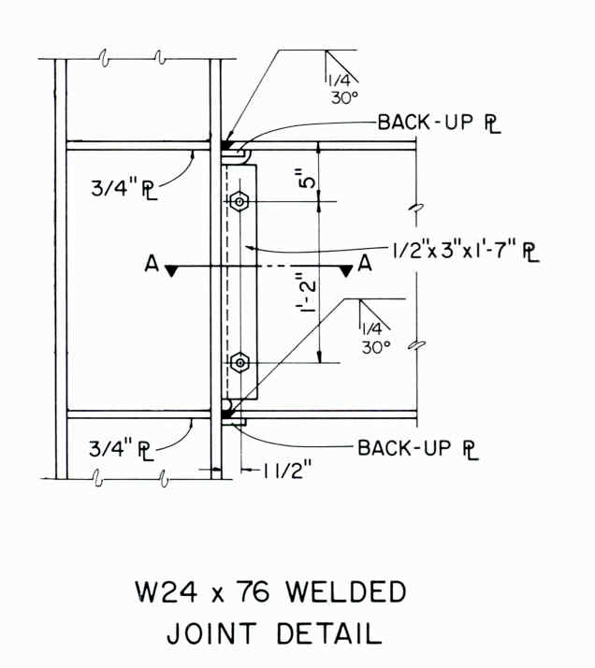
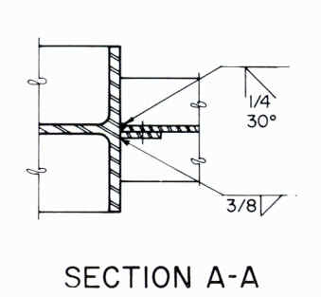
Notes:
The all-welded connection detail.
Beam flanges are welded to column using CJP groove weld.
Beam web is also welded to column flange using CJP groove weld (see section A-A). Shear tab serves as erection aid (holds beam in-place prior to welding) and also serves are a back-up bar for the groove weld.

Slide 38
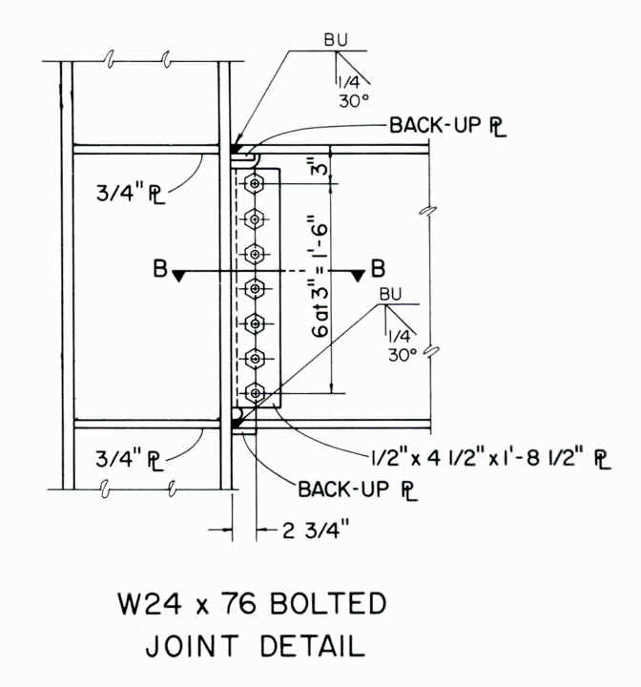
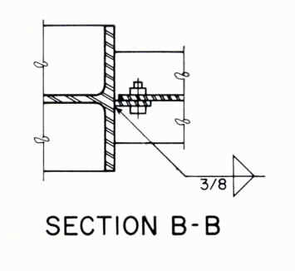
Notes:
Welded flange - bolted web detail.
Identical to all-welded detail on previous slide, except beam web is bolted to shear tab.

Slide 39
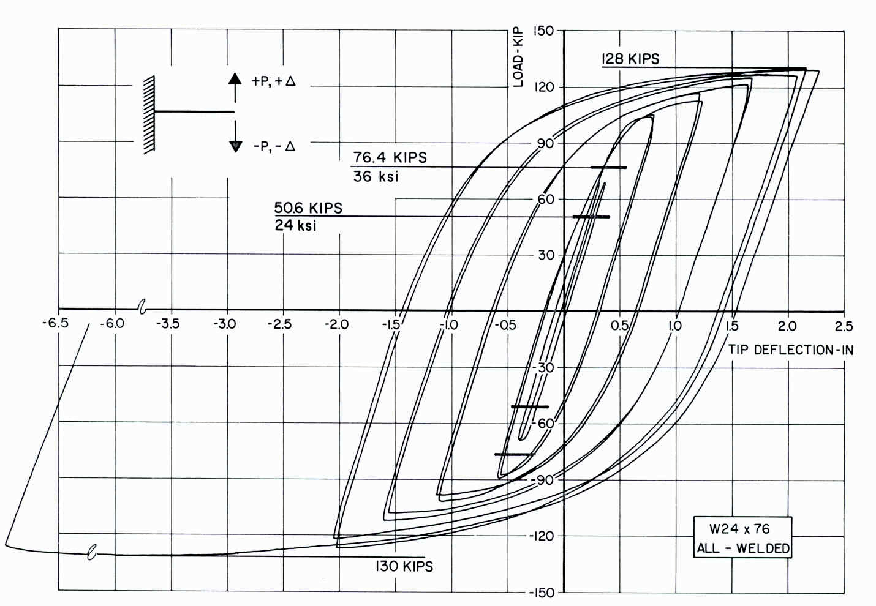
All-Welded Detail
Notes:
Cyclic loading response for all-welded connection with W24x76 beam. Connection permitted the beam to develop its full plastic strength, and maintain that strength through large cyclic inelastic deformations. Note that test was ended with one final large imposed displacement, to the stroke capacity of the hydraulic loading ram.
When test was terminated, there was no connection failure. This tested showed outstanding performance for the all-welded connection. That is, the connection permitted the beam to develop large cyclic ductility without failure of the connection.
Note that the final large half-cycle of loading shows some deterioration in beam strength. This is due to the development of local buckling in the beam.

Slide 40
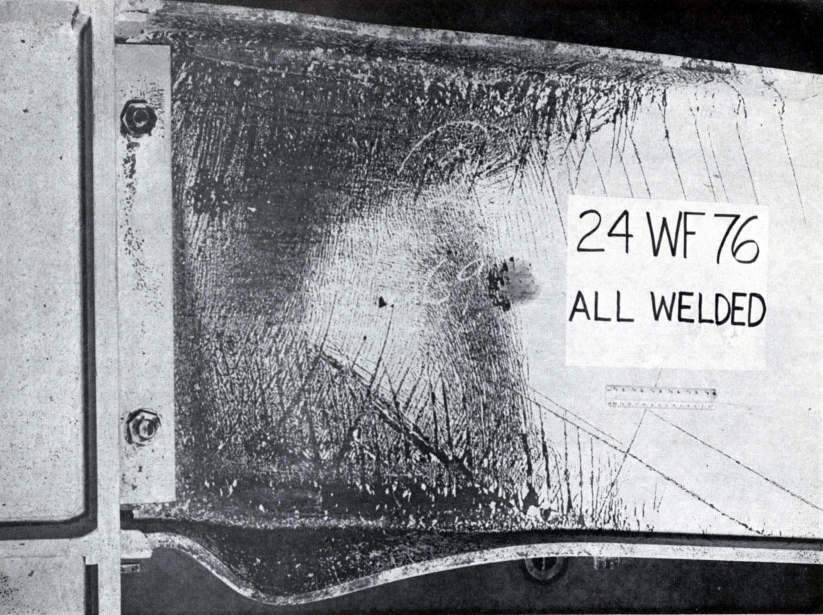
Notes:
Photo of all-welded connection specimen after testing. Dark areas (where whitewash has fallen off) indicate areas of yielding in the beam. This shows a classic plastic hinge yield pattern in a beam. Note that at the left end of the beam, yielding has occurred over the full depth of the cross-section. That is, the beam has developed a fully plastic cross-section.
This photo also clearly shows flange buckling in the bottom flange of the beam. Even though the flange buckling appears to be quite severe, it resulted in a very gradual loss of beam strength. The loss of beam strength in the final half-cycle of loading seen on the previous load-deflection plot is the result of this flange buckling.
The W24x76 beam used in this test is "seismically compact." Note that providing a seismically compact flange does not prevent flange buckling. It does, however, delay flange buckling until the beam develops its full plastic moment capacity and large cyclic ductility. Even after flange buckling initiates, strength degradation is gradual for a seismically compact section.

Slide 41
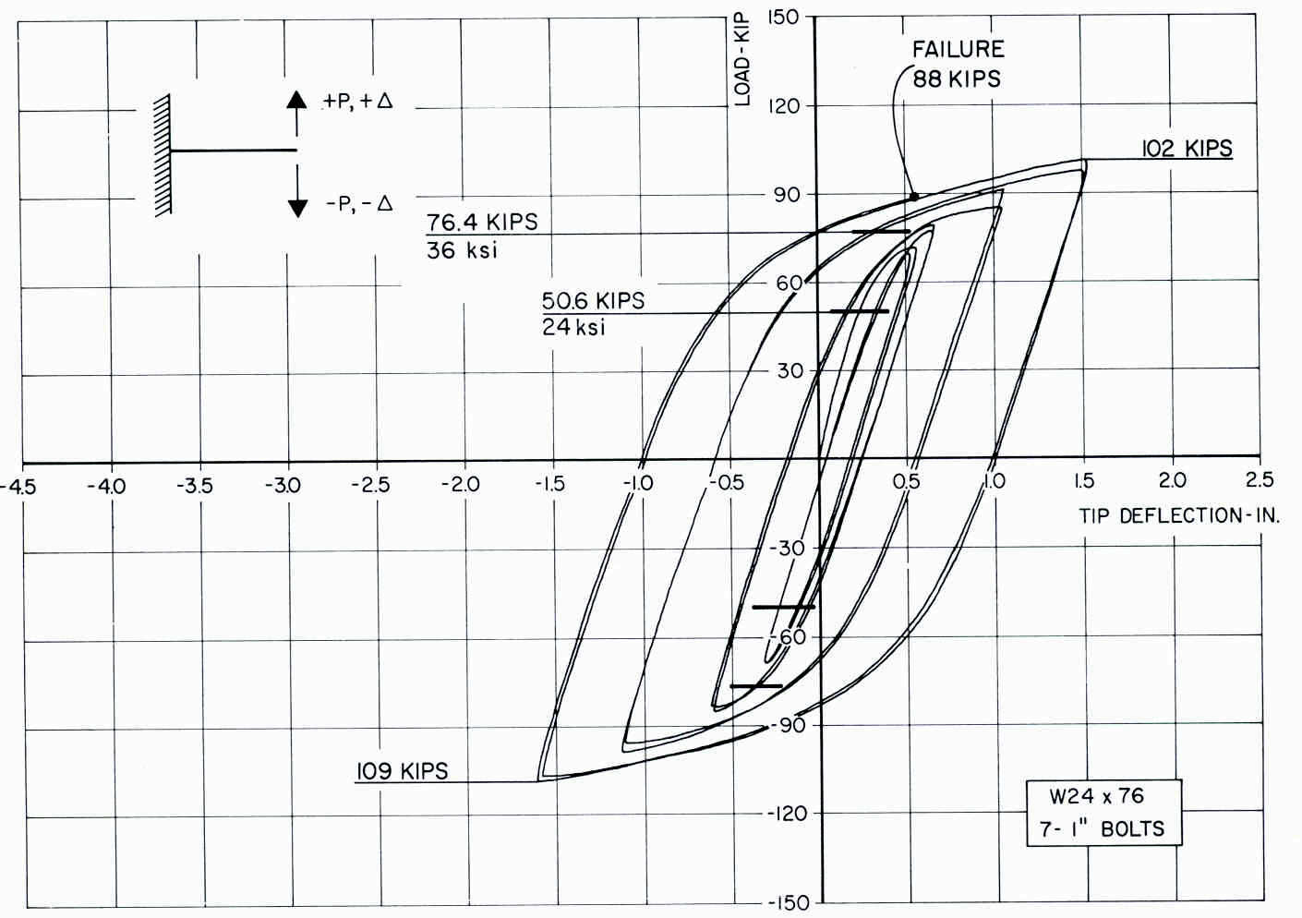
Welded Flange – Bolted Web Detail
Notes:
Cyclic loading response for W24x76 beam, with welded flange-bolted web connection. This connection permitted the beam to yield, and allowed the beam to develop moderate levels of ductility. However, in the specimen, connection failure (fracture) occurred after several cycles of loading.

Slide 42
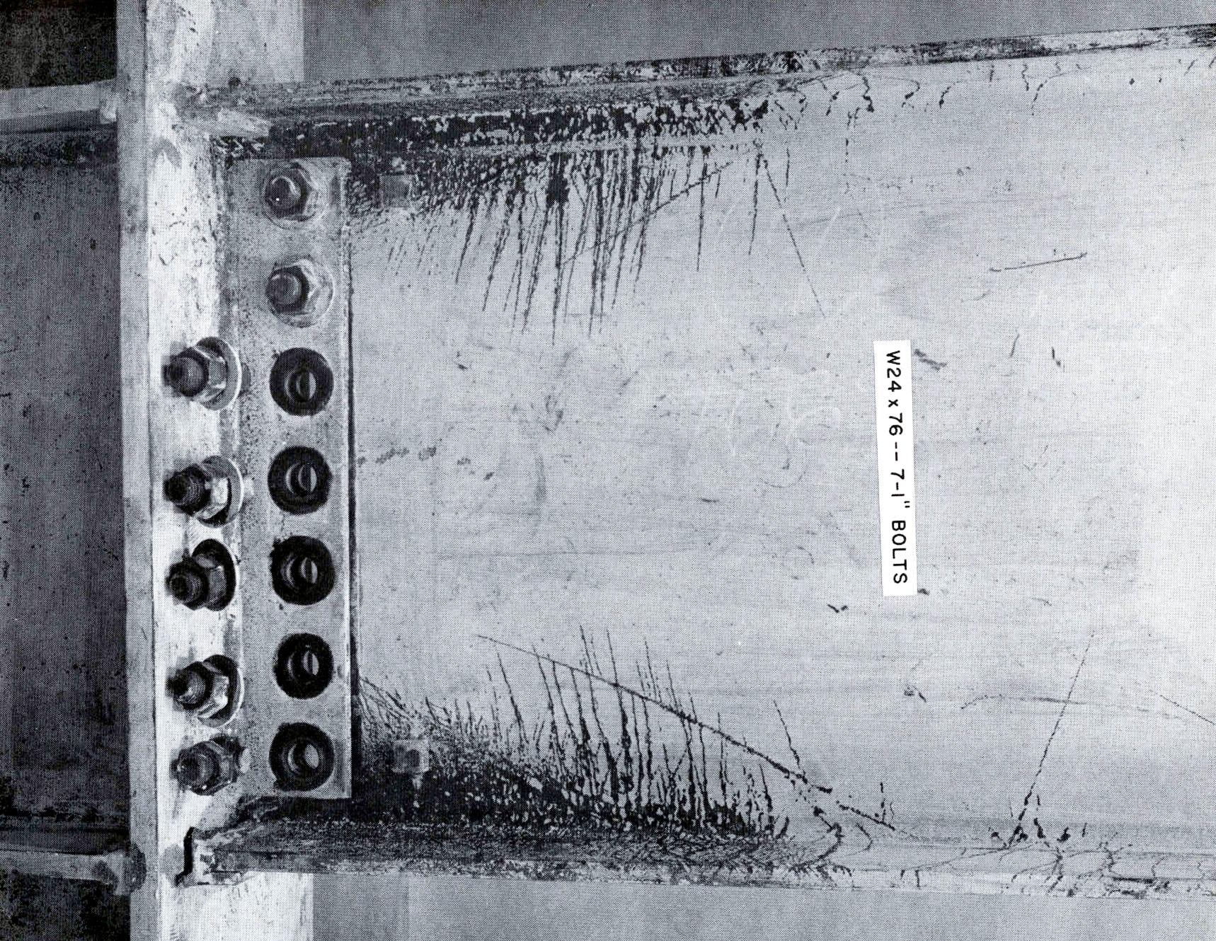
Notes:
Photo of welded flange - bolted web connection specimen after testing. Dark areas (where whitewash has fallen off) indicate areas of yielding in the beam. As compared to the all-welded specimen, little yielding occurred in the web of the beam. This suggests that the bolted web connection was not capable of transferring moment in the web portion of the beam, into the column.
Observe the fracture at the bottom beam flange groove weld. This fracture is near the interface between the weld and the column flange.
Note that the connection is considered to have failed once fracture occurs.
The occurrence of yielding is not "failure." In fact, yielding in the beam is the desired ductile response mode.

Slide 43
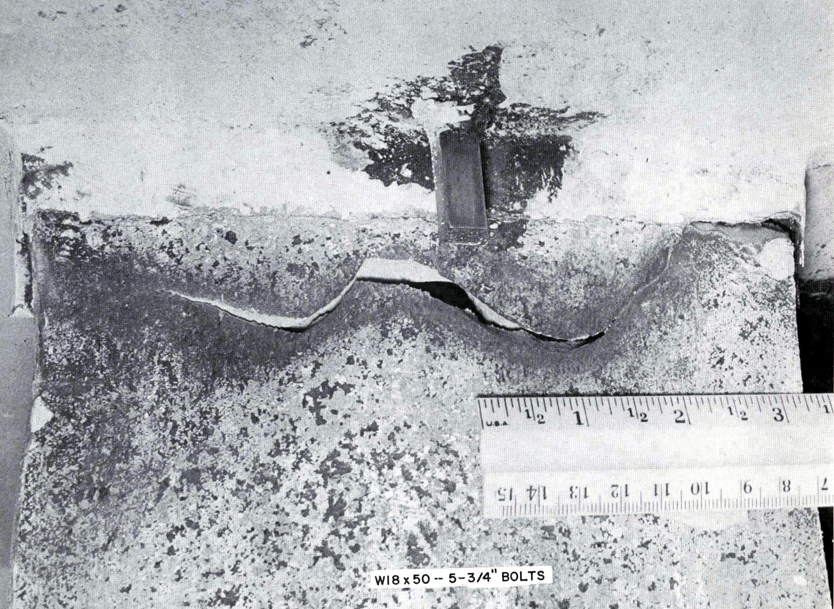
Notes:
Photo of a fracture beam flange: welded flange - bolted web connection with W18x50 beam.
The W18x50 beam specimens showed similar results to the W24x76 specimens. The all-welded detail showed excellent performance (no connection failure). The welded flange - bolted web detail failed (fracture) under cyclic loading, but did permit the beam to develop moderate levels of ductility prior to failure.

Slide 44
Observations from Initial UC Berkeley Tests
Large ductility developed by all-welded connections.
Welded flange-bolted web connections developed less ductility, but were viewed as still acceptable.
Notes:
Conclusion of UC Berkeley 1970 test series:
The all-welded connections showed outstanding performance. The beams developed large cyclic ductilities without connection failure.
The welded flange - bolted web connections allowed the beams to develop moderate levels of ductility prior to connection failure. Connection "failure" was the development of fractures in the vicinity of the beam flange groove welds.
Even though the welded flange - bolted web connections developed less ductility in the beams prior to connection failure (as compared to the all-welded detail), their performance was still considered to be acceptable. At this time (early 1970s), there was little information available on the level of ductility actually needed to survive a strong earthquake. Thus, deciding how much ductility is satisfactory in a connection test required a great deal of judgment.
After completion of this test series, the welded flange - bolted web connection detail became the de facto standard for beam-to-column connections in seismic-resistant steel moment frames. The welded flange - bolted web connection was used in a large number of moment frames, from the early 1970s up through the 1994 Northridge Earthquake.
The 1998 UBC (Uniform Building Code) was the first building code in the US to include comprehensive detailing requirements for seismic-resistant steel framing. For moment frames, the 1988 UBC required the use of the welded flange-bolted web moment connection. Prior to the 1988 UBC, the welded flange-bolted web connection was not required by code, but was nonetheless the de facto standard, as noted above.

Slide 45
Subsequent Test Programs
Welded flange-bolted web connections showed highly variable performance.
Typical failure modes: fracture at or near beam flange groove welds.
A large number of laboratory tested connections did not develop adequate ductility in the beam prior to connection failure.
Notes:
Following the initial UC Berkeley tests in the early 1970s, subsequent connection test programs were conducted in the 1980s and early 1990s.
These tests showed highly variable performance. Some specimens developed moderate levels of ductility prior to connection failure. In other tests, however, the connections failed while the beam was essentially still elastic,. i.e, zero ductility in the beams. In all cases, the connections failed by fractures in the vicinity of the beam flange groove welds. The next few slides show photos of typical specimens.
Some subsequent tests also showed rather poor performance even for all-welded connections.

Slide 46
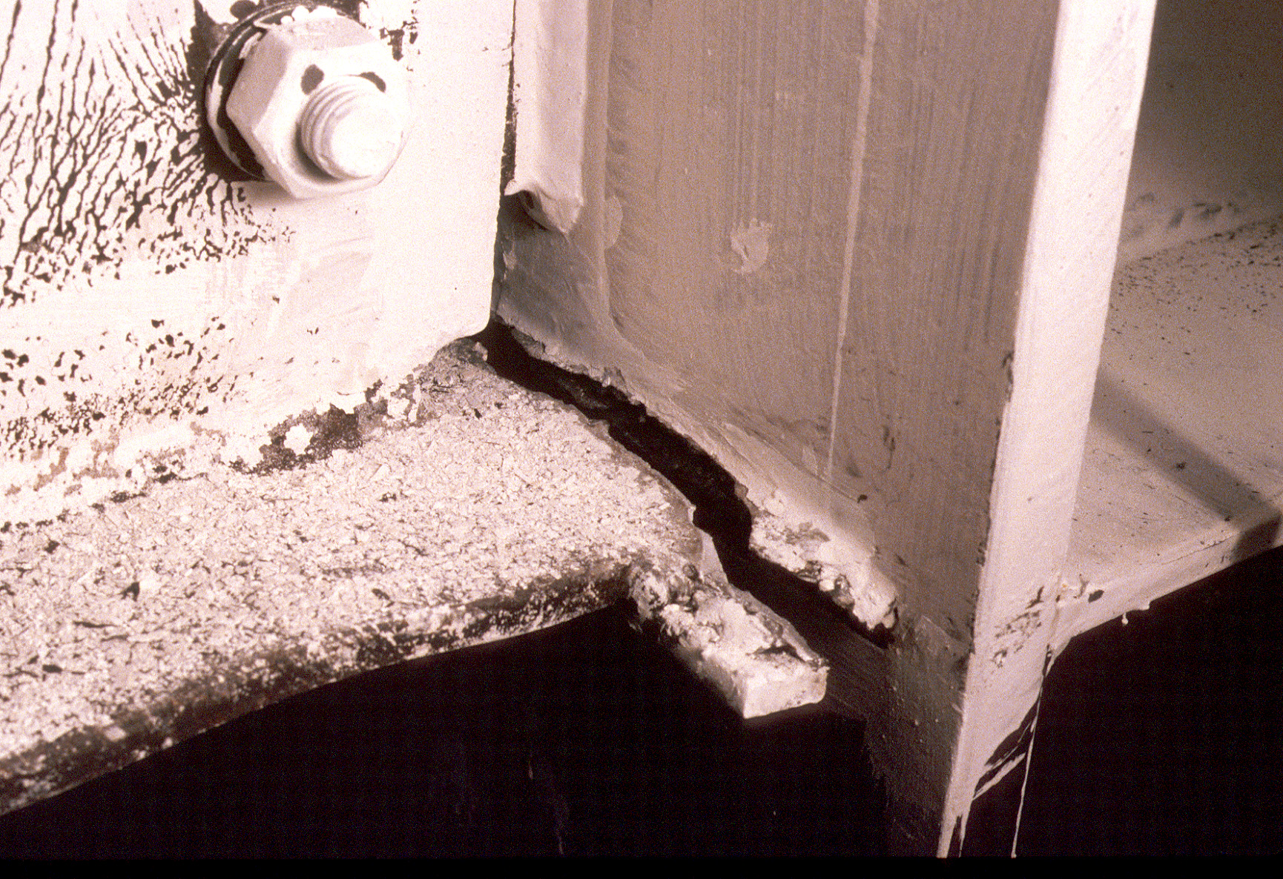
Notes:
Typical fracture at bottom beam flange groove weld, for test specimen with welded flange-bolted web connection. Fracture is near interface of groove weld and column flange.

Slide 47
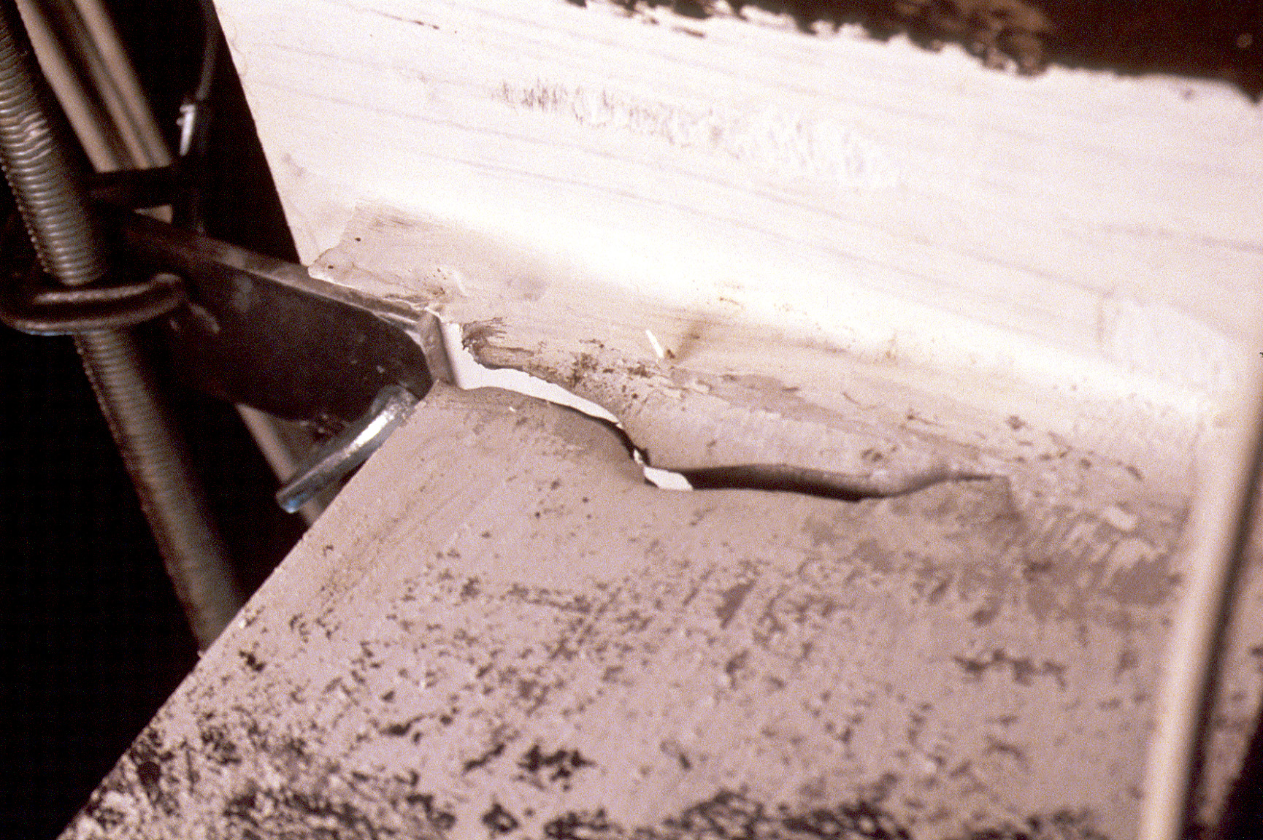
Notes:
Fracture at top flange of specimen with welded flange-bolted web connection. Fracture initiated at left edge of beam flange (at the weld-runoff region) propagated across beam top flange.

Slide 48
Notes:
Example of laboratory response of a pre-Northridge welded flange-bolted web connection. Connection failed before beam developed Mp, i.e., beam was still in elastic range. No ductility was developed in the beam prior to connection failure.
This illustrates the very poor behavior that was frequently exhibited by the pre-Northridge welded flange-bolted web connection.

Slide 49
Summary of Testing Prior to
Northridge Earthquake
Welded flange – bolted web connection showed highly variable performance
Many connections failed in laboratory with little or no ductility
Notes:
Looking at the tests conducted on the welded flange - bolted web detail prior to the 1994 Northridge Earthquake:
While some specimens showed good performance, many specimens showed very poor performance, with failure (fracture) of the connections occurring with little or no ductility in the beam. At this point, the reasons for the high variability and frequent poor performance of the welded flange - bolted web connection were not completely understood.
reference:
Engelhardt, M.D. and Hussain, A.S., "Cyclic-Loading Performance of Welded Flange-Bolted Web Moment Connections," Journal of Structural Engineering, ASCE, Vol 119, No. 12, December 1993.

Slide 50
1994 Northridge Earthquake
Widespread failure of welded flange - bolted web moment connections
Notes:
In the 1994 Northridge Earthquake, widespread failure of welded flange-bolted web connections was observed. Before we look at these connection failures, a brief look at this earthquake.

Slide 51
1994 Northridge Earthquake
January 17, 1994
Magnitude = 6.8
Epicenter at Northridge - San Fernando Valley
(Los Angeles area)
Fatalities: 58
Estimated Damage Cost: $20 Billion
Notes:
Basic facts on the 1994 Northridge Earthquake. The earthquake occurred in the Los Angeles area, and affected an area similar to that affected by the 1971 San Fernando Earthquake.

Slide 52
Northridge - Ground Accelerations
Sylmar: 0.91g H 0.60g V
Sherman Oaks: 0.46g H 0.18g V
Granada Hills: 0.62g H 0.40g V
Santa Monica: 0.93g H 0.25g V
North Hollywood: 0.33g H 0.15g V
Notes:
Some typical peak horizontal and vertical accelerations recorded at selected locations. These indicate very strong ground shaking at these locations.
Besides damage to steel moment frame buildings, the Northridge Earthquake caused severe damage to many structures. The following slides show a few examples.

Slide 53
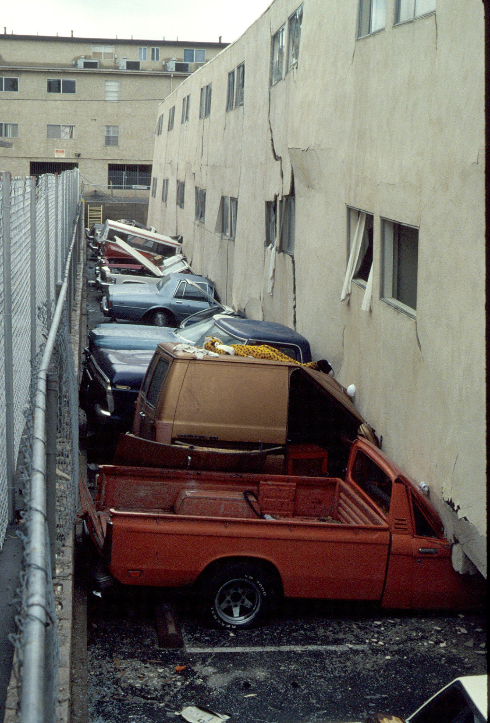
Notes:
Collapse of first story of a wood framed apartment building.

Slide 54
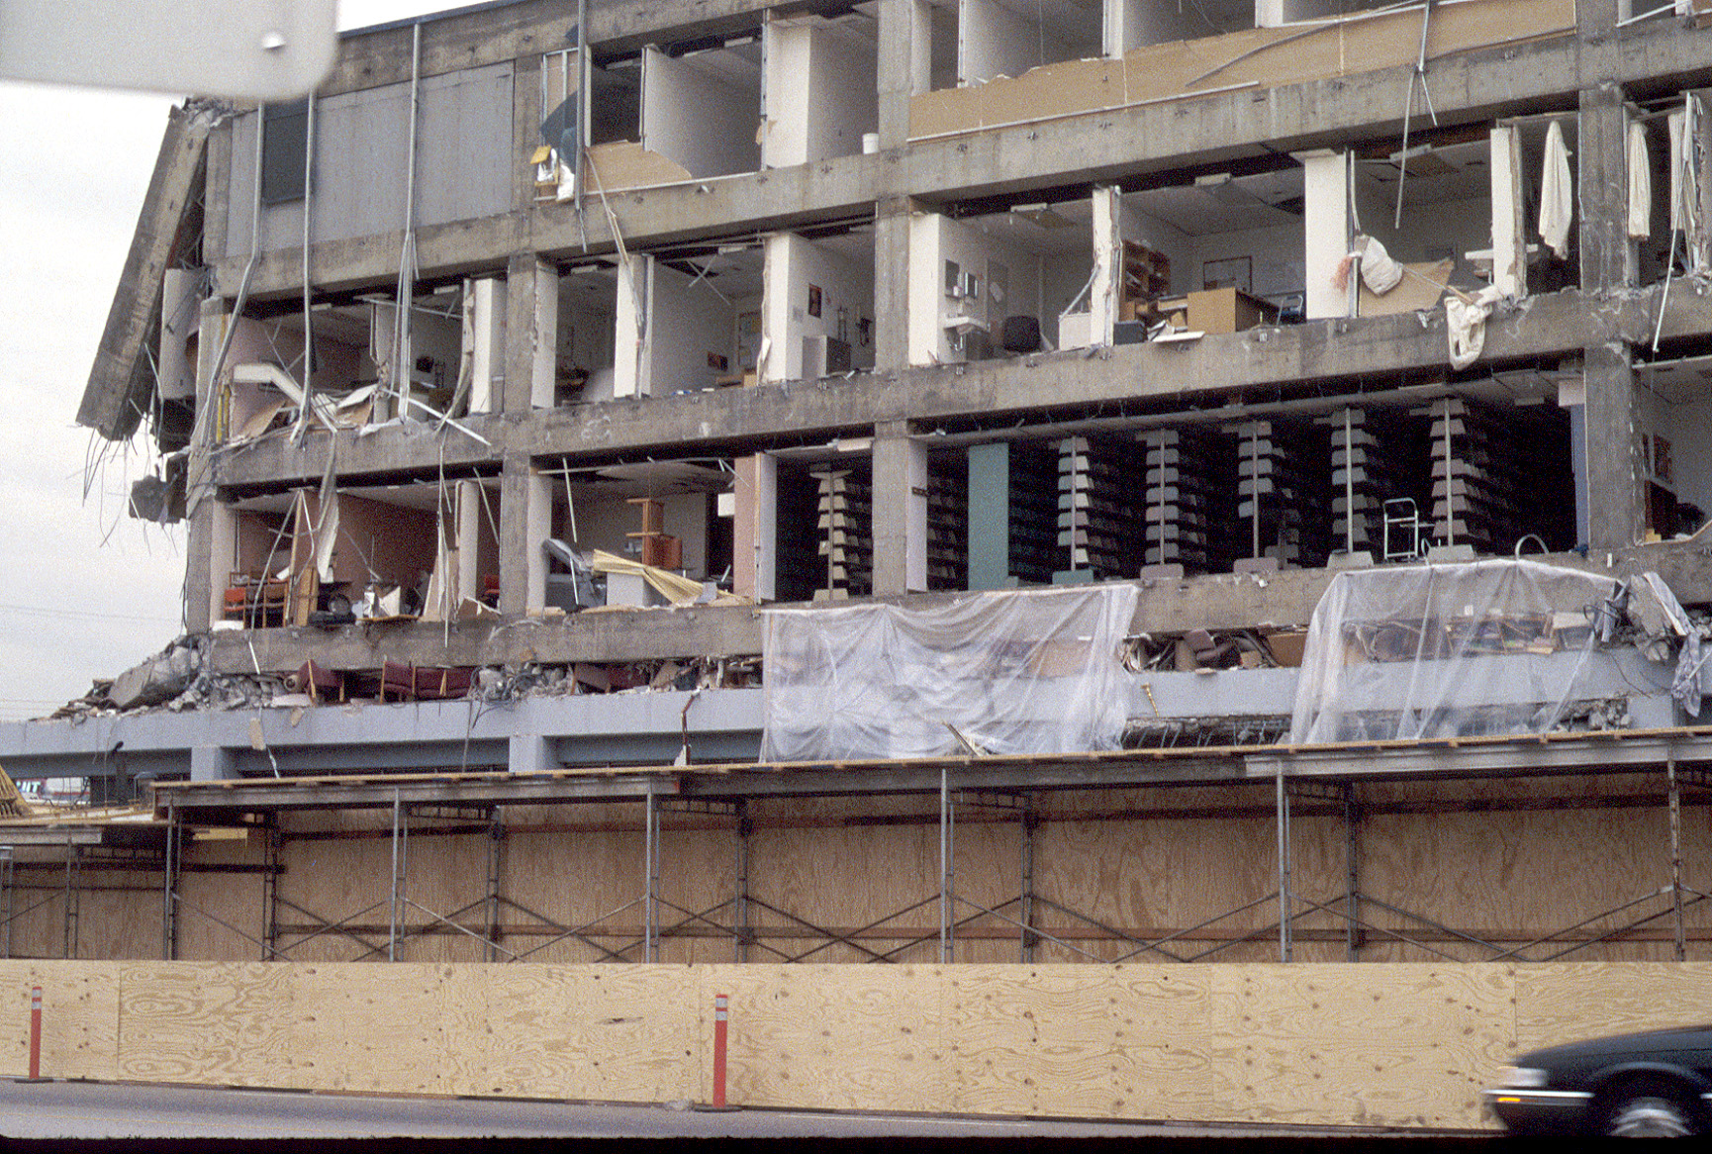
Notes:
Severe damage to an older nonductile reinforced concrete frame building. Note that an entire story has collapsed (location of arrow).

Slide 55
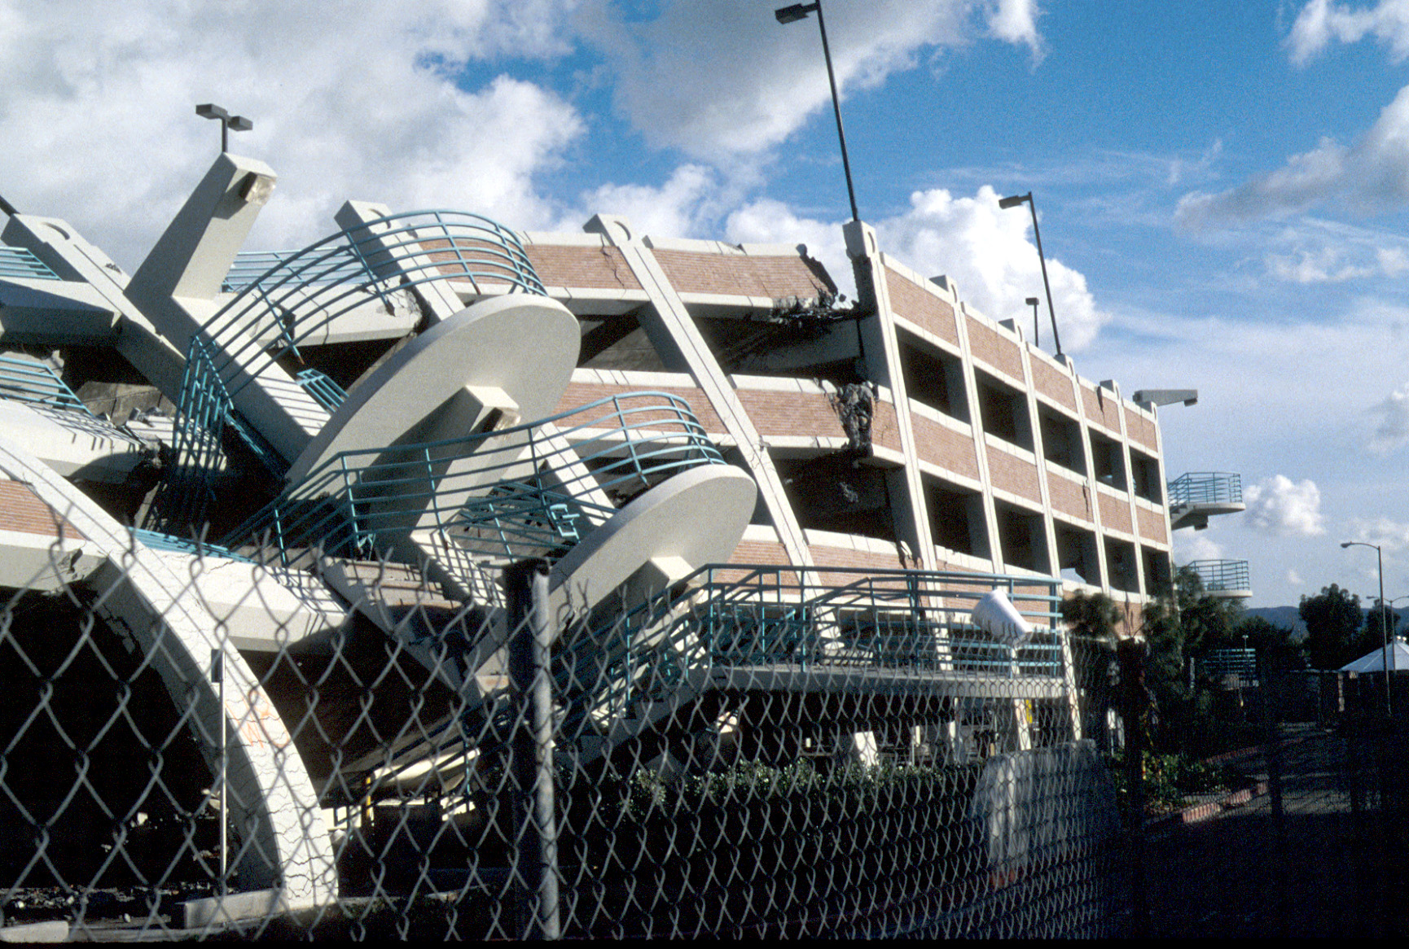
Notes:
Severe damage to a modern parking garage.

Slide 56
Damage to Steel Buildings in the Northridge Earthquake
Large number of modern steel buildings sustained severe damage at beam-to-column connections.
Primary Damage: Fracture in and around beam flange groove welds
Damage was largely unexpected by engineering profession
Notes:
Next, let's look at examples of damage observed in steel moment frame buildings.

Slide 57
Damage Observations:
Steel Moment Connections

Slide 58
Pre-Northridge Welded Flange – Bolted Web Moment Connection
Weld Access Hole
Beam Flange
Stiffener
Backup Bar
Column Flange
Notes:
This slide provides a reminder of the key features of the welded flange-bolted web connection. Note that a majority of fractures observed at connections after the Northridge earthquake were in the vicinity of the beam bottom flange groove weld.
The next series of slides illustrates typical fractures.

Slide 59
Notes:
Many fractures were observed near the interface of the groove weld and the face of the column.

Slide 60
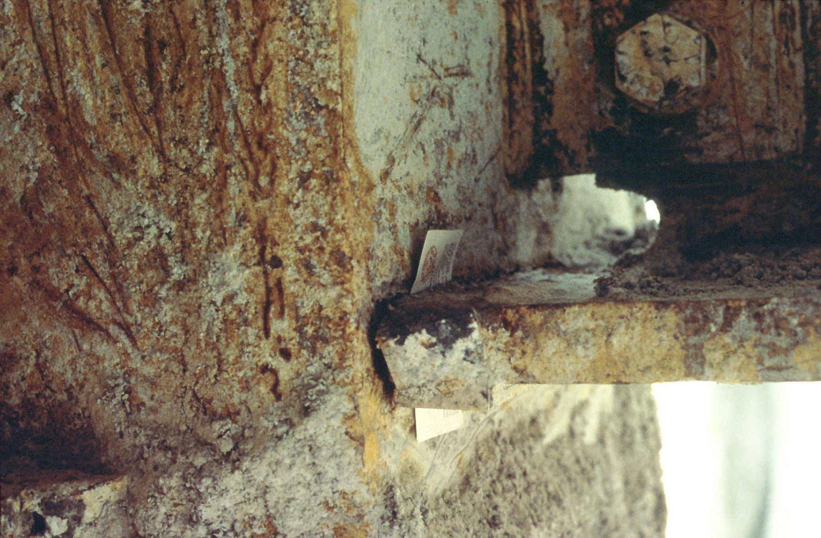
Notes:
Example of fracture near interface of groove weld and face of column. The business card highlights the location of the fracture.
This is a steel box column. The "rough" surface of the steel is where fireproofing material was removed.

Slide 61
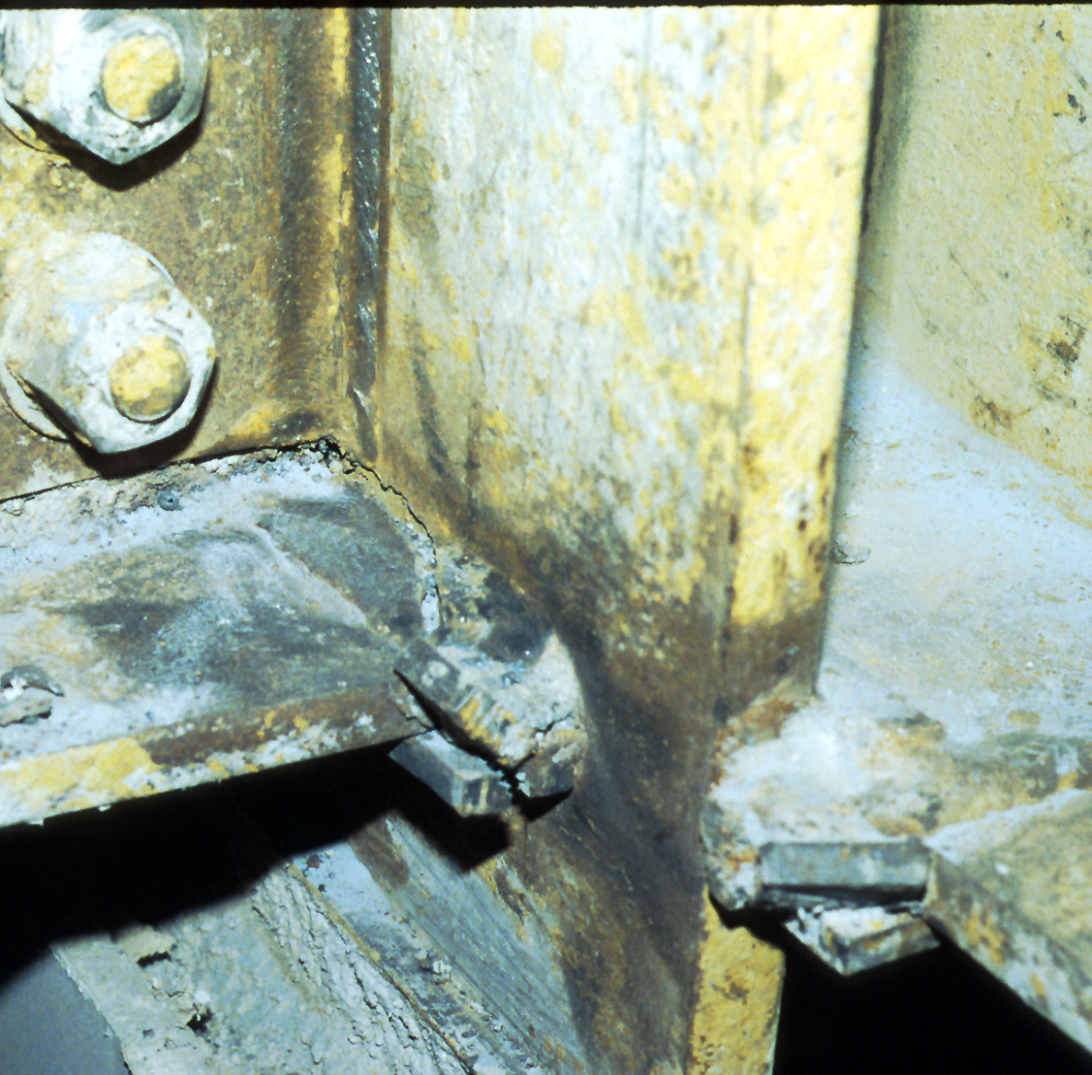
Notes:
Another example of a fracture near the interface of the groove weld and face of column. This fracture likely initiated in the center portion of the flange weld.

Slide 62
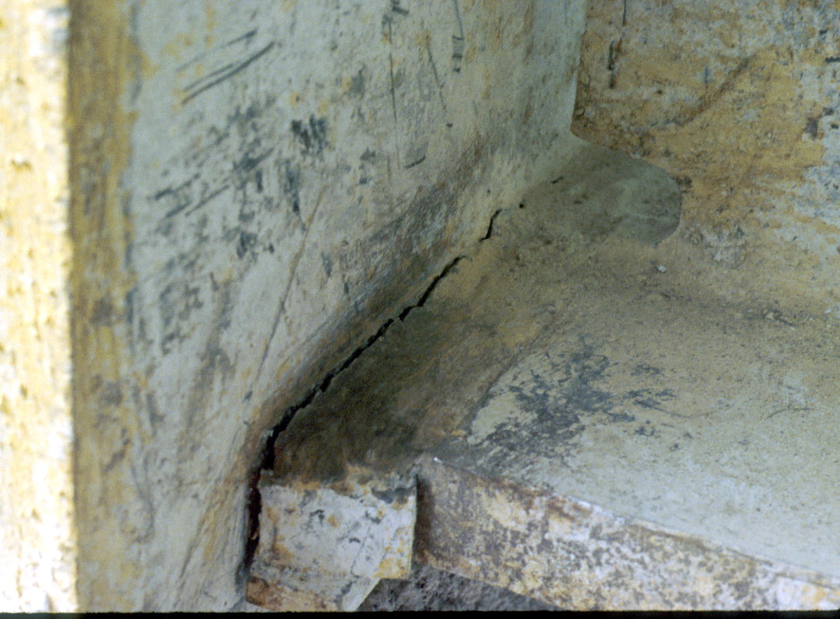
Notes:
Another example of a fracture near the interface of the groove weld and face of column.
Note that weld tab is improperly oriented. The weld tabs should be extending the groove geometry, not "damning" off the groove. When the weld tab is oriented as shown in this figure, there is a highly likelihood of weld defects at the outer edges of the weld.
This improperly oriented weld tab was likely not the primary cause of this fracture. However, the presence of this improperly oriented weld tab suggests "sloppy" welding practices and inadequate inspection. A welding inspector should not permit this.

Slide 63
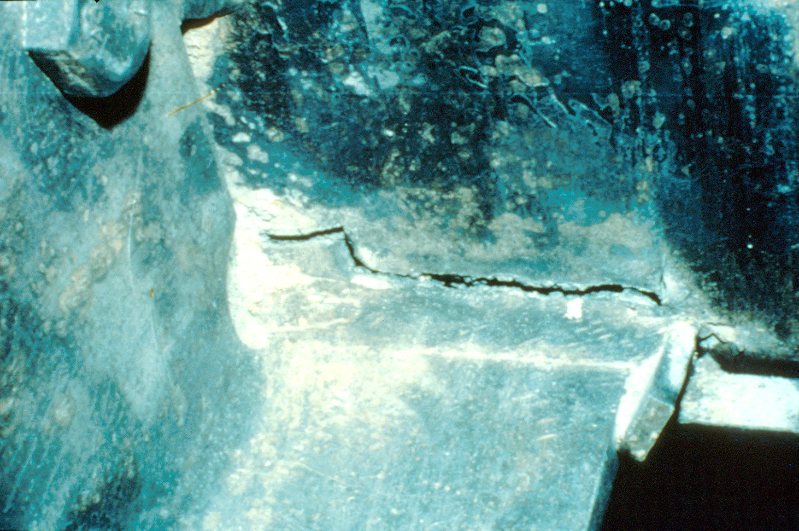
Notes:
Another example of a fracture near the interface of the groove weld and face of column.
Also, this is another example of improperly oriented weld tabs.

Slide 64
Notes:
Another type of fracture observed after Northridge:
Fracture initiates near root of groove weld, and propagates into the column flange. The fracture ends within the column flange.

Slide 65
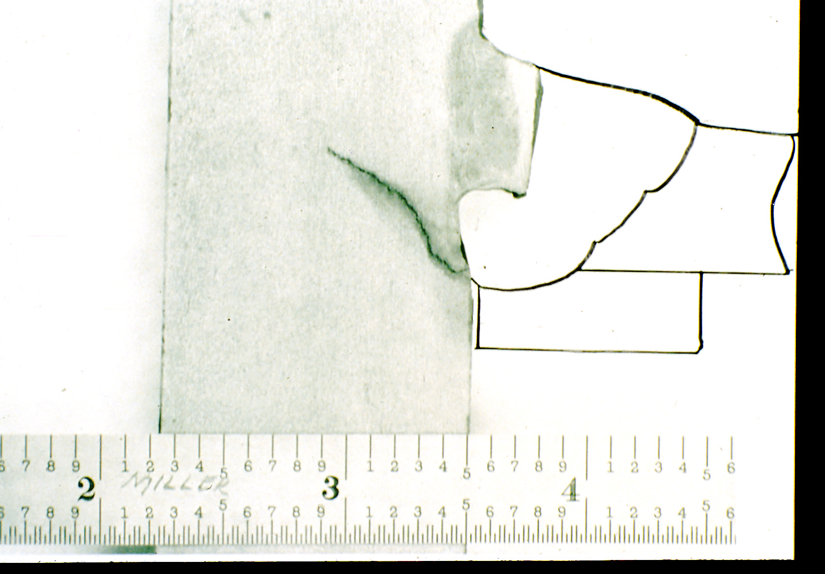
Notes:
An example of a fracture that propagated into column flange.
Slide courtesy of Duane Miller - Lincoln Electric Company.

Slide 66
Notes:
Another type of fracture observed after Northridge:
Fracture initiates near root of groove weld, and propagates into the column flange. Fracture emerges from column flange a short distance above weld. A portion of the column flange is pulled out. This type of fracture was sometimes described a as "divot" failure. (A "divot" of column flange material is pulled out).

Slide 67
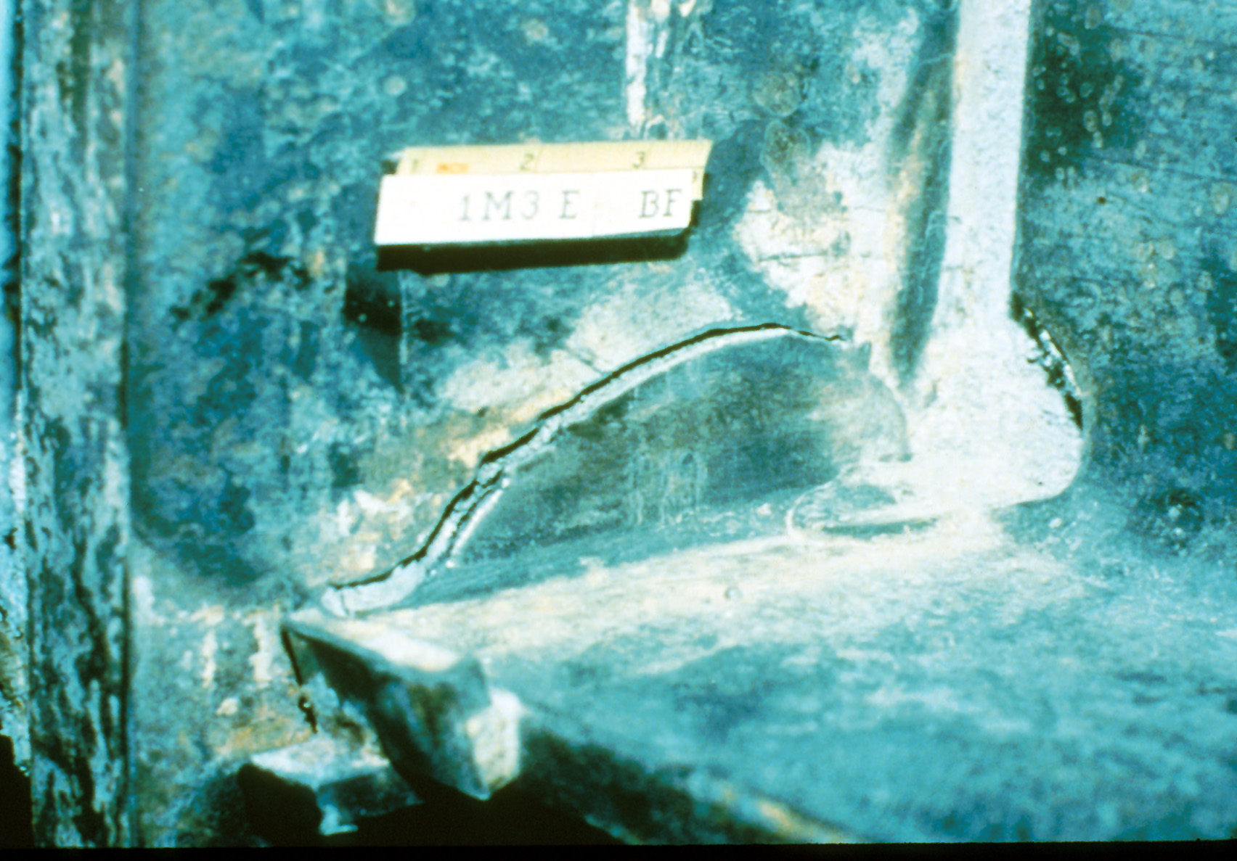
Notes:
Example of divot type fracture.

Slide 68
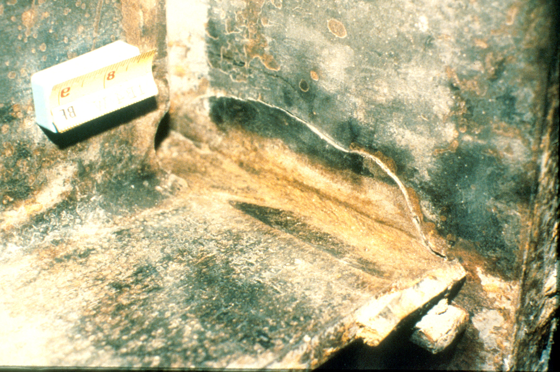
Notes:
Another example of a divot type fracture.

Slide 69
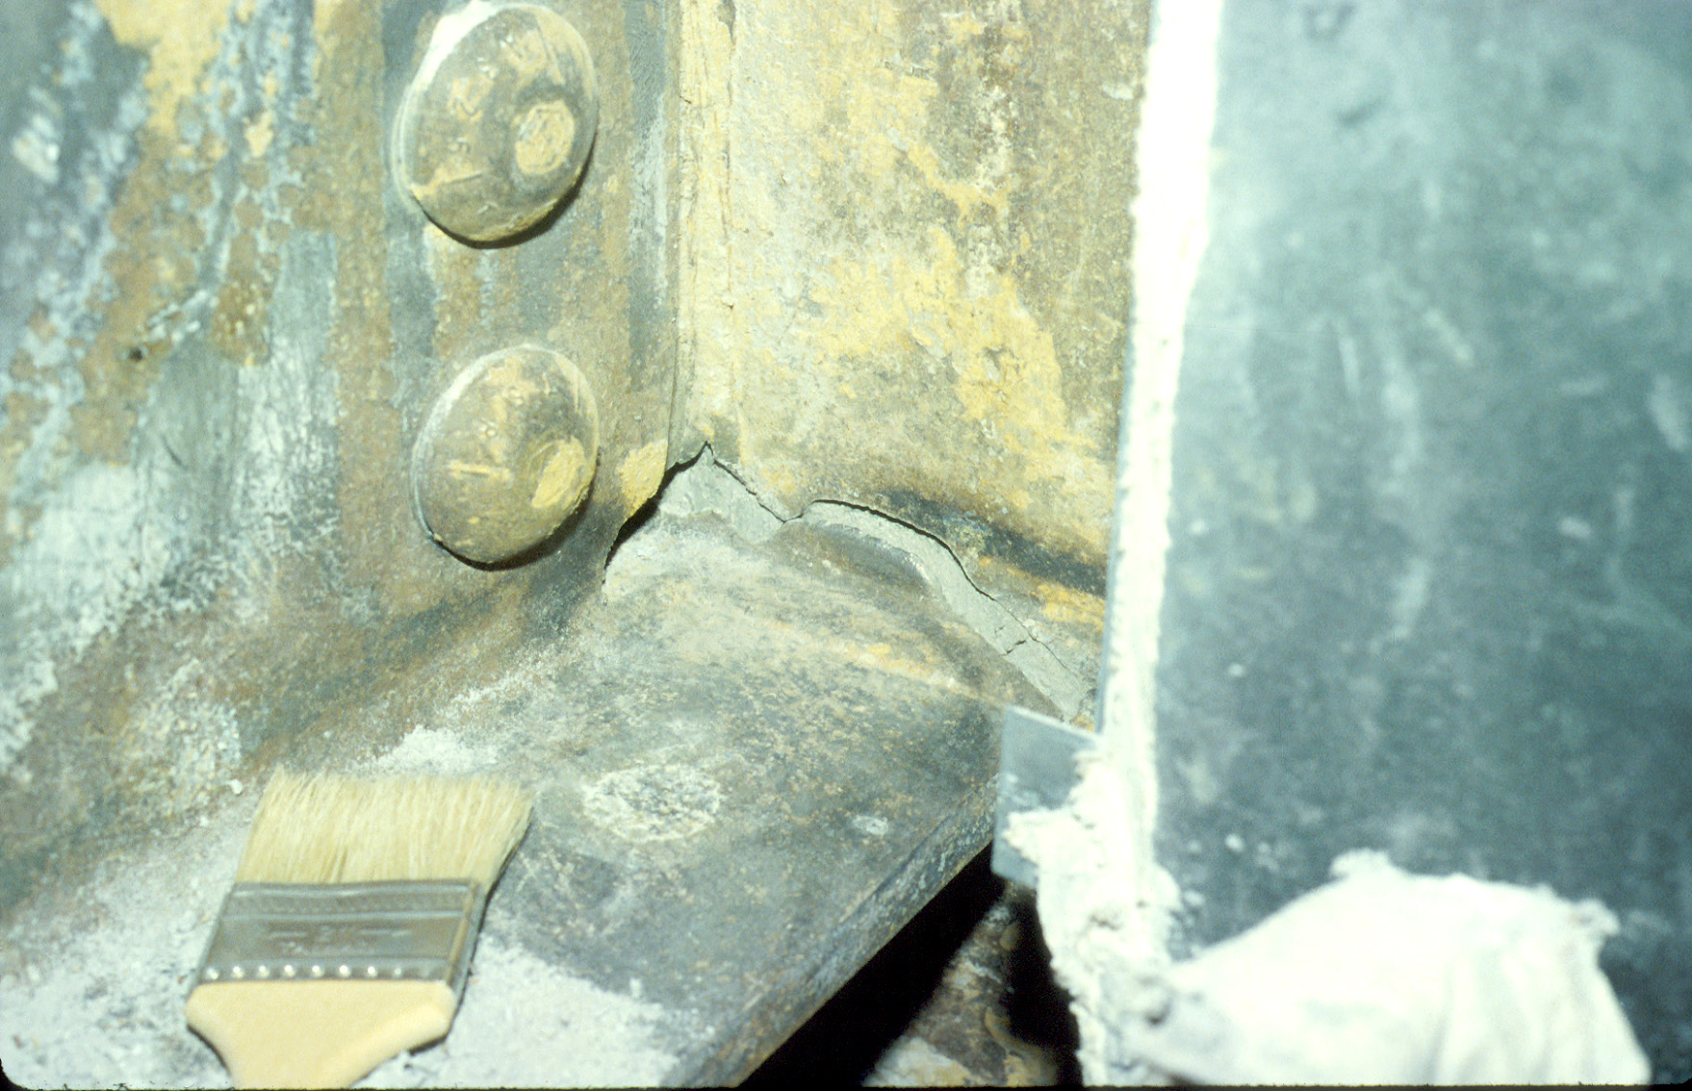
Notes:
Another example of a divot type fracture.

Slide 70
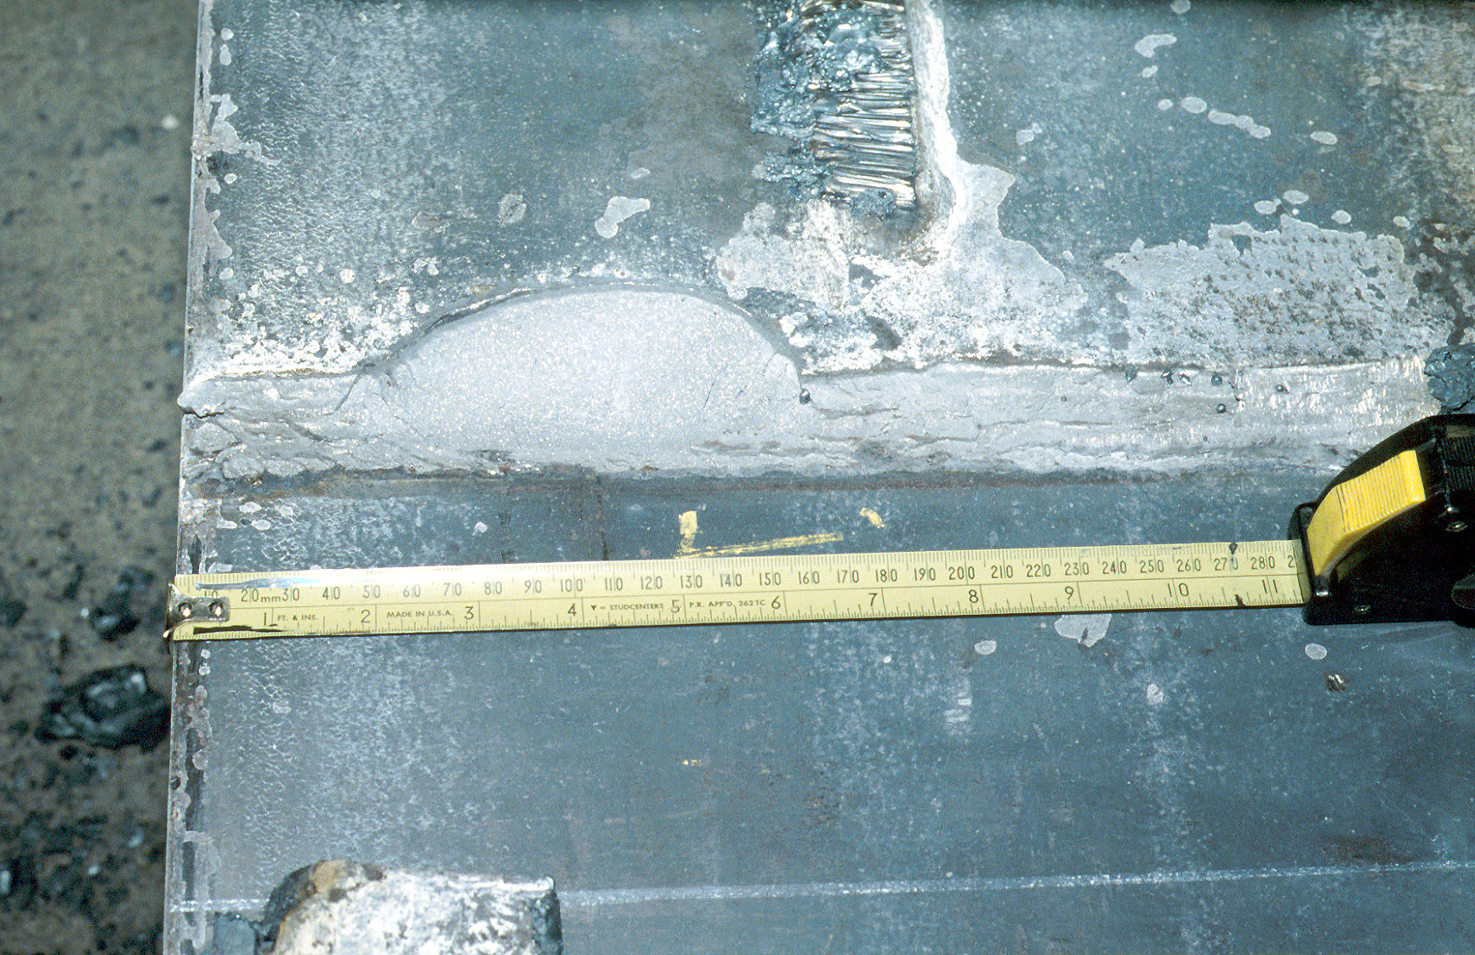
Notes:
Another example of a divot type fracture.
This photo is from a laboratory test specimen, tested after the Northridge Earthquake as past of the FEMA-SAC program (described later). This photo is looking at the face of the column flange, in the vicinity of the beam bottom flange groove weld (beam was removed for this photo). Observe the "divot" of column flange material that was pulled out.

Slide 71
Notes:
Another type of fracture observed after Northridge:
Fracture initiates near root of groove weld, and propagates across the column flange.

Slide 72
Notes:
Another type of fracture observed after Northridge:
Fracture initiates near root of groove weld, and propagates across the column flange and continues into web of column.
In a few instances, fractures propagated across the full width of the column.

Slide 73
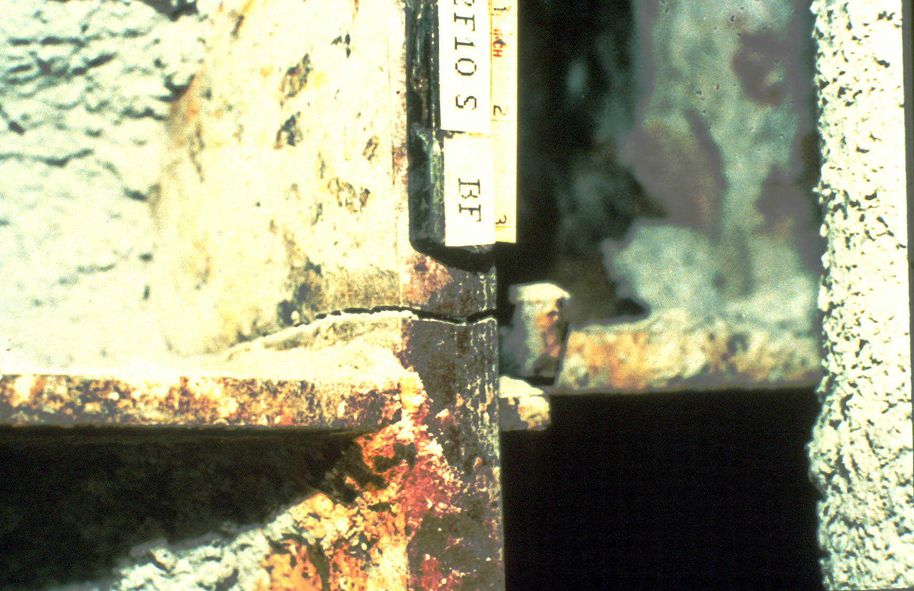
Notes:
Column flange fracture.

Slide 74
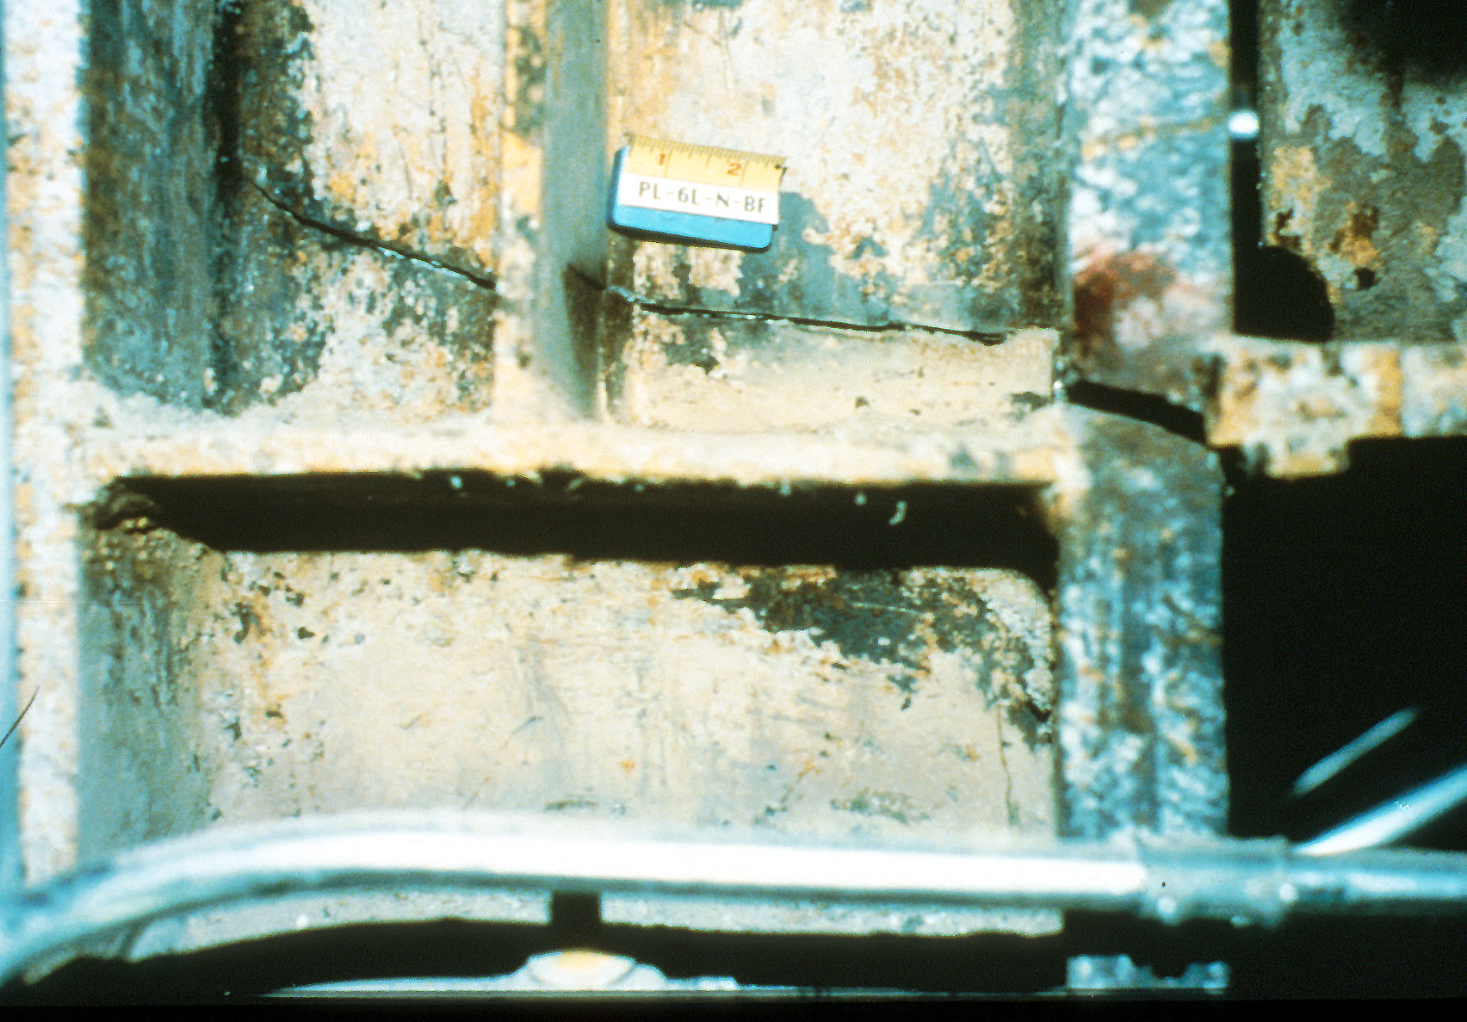
Notes:
Fracture of column flange, and portion of column web. Fracture arrested at far end of column web.

Slide 75
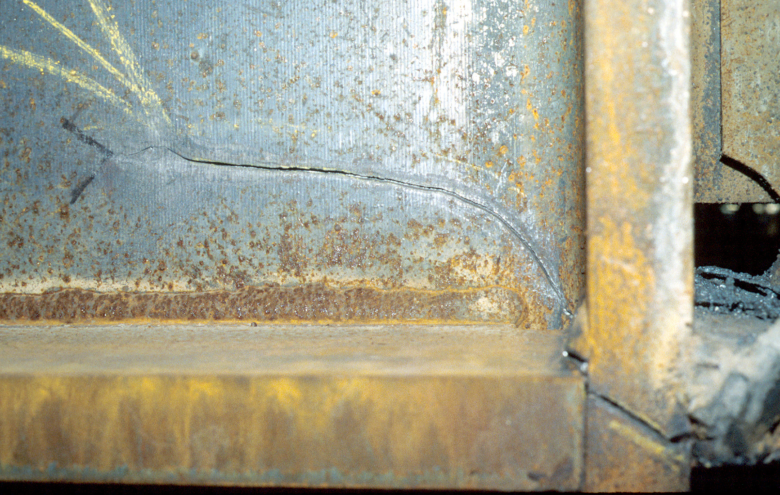
Notes:
Fracture of column flange, and portion of column web.

Slide 76
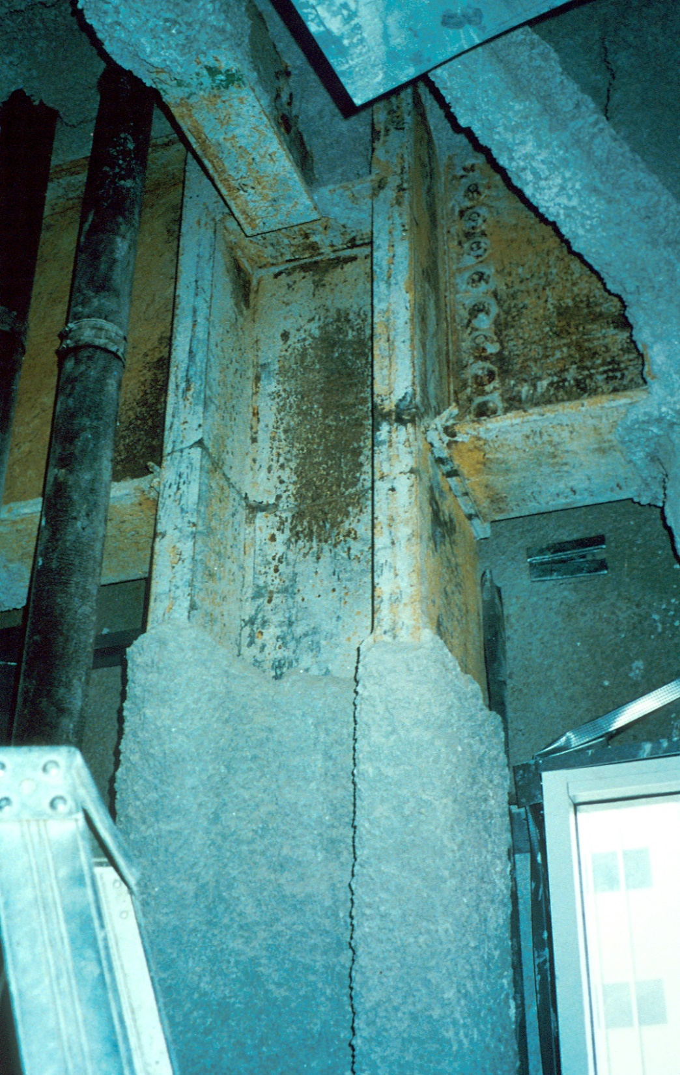
Notes:
Fracture across full width of column.

Slide 77
Damage Observations
A large number of steel moment frame buildings suffered connection damage
No steel moment frame buildings collapsed
Typical Damage:
  fracture of groove weld
  “divot” fracture within column flange
  fracture across column flange and web
Notes:
Summary of damage observations in steel moment frame buildings after the Northridge Earthquake.
Note that no steel moment frame buildings collapsed, despite extensive connection damage.

Slide 78
Observations from Studies of Fractured Connections
Many connections failed by brittle fracture with little or no ductility
Brittle fractures typically initiated in beam flange groove welds
Notes:
Subsequent studies of the Northridge Connection failures revealed two key points-
1. Many connections likely failed by a brittle fracture mechanism, while the beams were still in the elastic range of behavior. So, like many previous laboratory tests, these actual connections showed poor performance.
2. Fractures frequently initiated at the root of the beam bottom flange groove weld, and then propagated in various directions.

Slide 79
Response to Northridge Moment Connection Damage
Nearly immediate elimination of welded flange - bolted web connection from US building codes and design practice
Intensive research and testing efforts to understand causes of damage and to develop improved connections
  AISC, NIST, NSF, etc.
  SAC Program (FEMA)
Notes:
Following the discovery of widespread connection failure after the Northridge Earthquake:
1. Emergency building code changes were enacted that eliminated the welded flange-bolted web connection as the prescriptive connection for moment frames.
2. A large number of research and testing efforts were initiated to study the failures. These efforts were directed towards understanding the causes of the failures, and for developing improved connection design and construction practices to avoid such failures in future earthquakes. Intensive research efforts continued for a period of about ten years following the earthquake.
Research and testing efforts were sponsored by numerous public and private agencies and groups, including:
AISC (American Institute of Steel Construction), NIST (National Institute of Standards and Technology), NSF (National Science Foundation) and many others.
However, the largest study by far was sponsored by FEMA (Federal Emergency Management Agency) and managed by the "SAC Joint Venture."
SAC was a joint venture of three organizations:
Structural Engineers Association of California (S);
Applied Technology Council (A)
California Universities for Research in Earthquake Engineering (C).
SAC was created for the purpose of managing the FEMA program on steel moment frame investigations. The SAC-FEMA program was active from 1994 through about 2001.
Note that following the 1995 Kobe Earthquake, damage was also observed at steel moment connections in Japan. Consequently, in addition to the intensive research efforts underway in the US, the 1995 Kobe Earthquake initiated extensive research efforts in Japan. Subsequently, a great deal of moment frame research was conducted in many other countries besides the US and Japan.
All in all, because the 1994 Northridge and 1995 Kobe Earthquakes, there was an extensive world-wide research effort on steel moment frames that was unprecedented in scope and depth, and ultimately provided an enormous amount of information on the behavior of steel moment frame systems and connections.

Slide 80
Causes of Moment Connection Damage in Northridge
Welding
Connection Design
Materials
Notes:
Much of the post-Northridge research was aimed at understanding the causes of the connection failures observed after the earthquake. While some of these issues are still somewhat controversial, the following slides describe some of the key factors that may have contributed to the connection failures.
These contributing factors are divided into three broad categories:
1. factors related to welding;
2. factors related to connection design;
3. factors related to material properties (for structural steel).

Slide 81
Causes of Moment Connection Damage in Northridge
Welding Factors
Low Fracture Toughness of Weld Metal
Poor Quality
Effect of Backing Bars and Weld Tabs
Notes:
Three welding related factors, as listed in the slide, were identified as contributing to the connections failures. Each of these is discussed in greater detail in the following slides.

Slide 82
Weld Metal Toughness
Most common Pre-Northridge welding electrode (E70T-4) had very low fracture toughness.
Typical Charpy V-Notch: < 5 ft.-lbs at 700°F
(7 J at 210°C)
Notes:
As described earlier, the most common electrode used for making beam flange groove welds prior to the Northridge Earthquake us classified as an E70T-4 electrode.
Tests on weld metal after the earthquake revealed that the weld metal often had very low levels of fracture toughness. Fracture toughness is normally measured indirectly with the Charpy V-Notch (CVN) test. In this test, a sample of weld metal is prepared with a machined notch. The specimen then impacted by a swinging hammer, and the energy absorbed by the specimen is measured.
CVN tests on samples of E70T-4 weld metal often showed CVN values less than 5 ft-lbs at room temperature. This low CVN value suggested that the welds were very prone to brittle fracture.

Slide 83
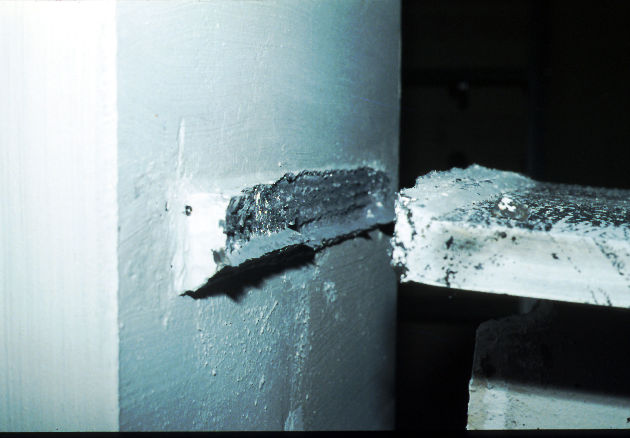
Notes:
This slide is a photo of a moment connection specimen tested shortly following the Northridge Earthquake. At this point, poor welding quality was suspected to be a primary cause of the connection failures, rather than inadequate fracture toughness of the weld metal.
This welded flange - bolted web specimen was constructed using the E70T-4 electrode. However, it was constructed under very close scrutiny to assure high quality welding. Further, backing bars and weld tabs were removed after welding was completed. This specimen, therefore, represented a welded flange - bolted web moment connection with very high quality welding.
Despite the high quality welding, this specimen failed by brittle fracture of the beam flange weld, prior to development of significant ductility in the beam.
This specimen illustrated the importance of weld metal toughness in the performance of the connection. That is, even with high quality welding, premature failure of the connection is possible by brittle fracture of the weld, if the weld metal has low fracture toughness.
Thus, while poor welding workmanship may have contributed to some of the connection damage observed after Northridge, this specimen (and many other similar specimens) showed that improving welding quality, by itself, would not be adequate. Using weld metal of improved fracture toughness is also needed.
Reference:
Engelhardt, M.D., Sabol, T.A., Aboutaha, R.S., and Frank, K.H., "An Overview of the AISC Northridge Moment Connection Test Program," Proceedings: AISC National Steel Construction Conference, San Antonio, Texas, pp. 4-1 to 4-22, May 17-19, 1995.

Slide 84
Welding Quality
Many failed connections showed evidence of poor weld quality
Many fractures initiated at root defects in bottom flange weld, in vicinity of weld access hole
Notes:
As just noted, even with high quality welding, the welded flange-bolted web connection may still show poor performance due to low fracture toughness of the weld metal. However, it was also clear that a number of failed connections showed evidence of poor quality welding.
Investigations of failed connections after Northridge often showed that fractures initiated at a lack of penetration or lack of fusion defect at the root of the bottom flange groove weld, in the vicinity of the weld access hole. This is the location where the welder must interrupt the groove weld, and where defects are likely to occur.

Slide 85
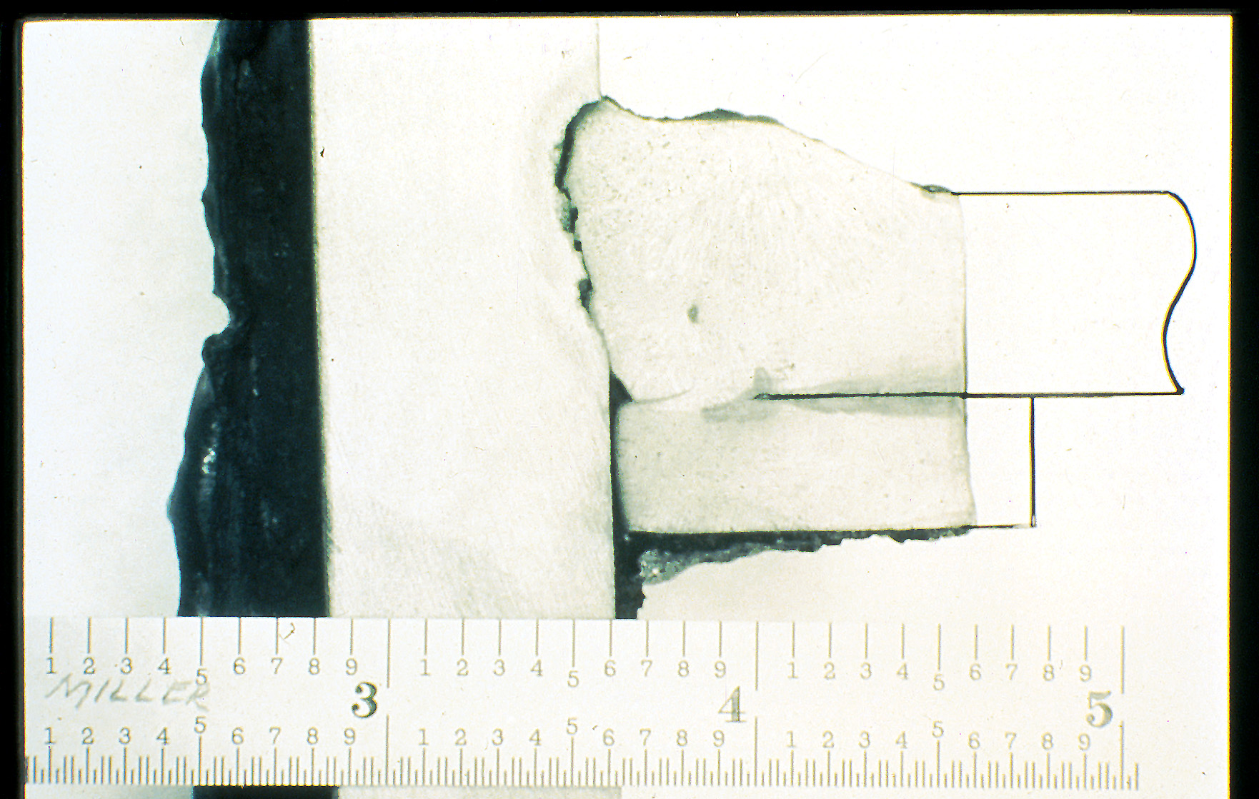
Notes:
Photo showing a lack of penetration defect (arrow) at root of groove weld. In the presence of low toughness weld metal, this defect may be sufficient to initiate brittle fracture.
Photo courtesy of Duane Miller - Lincoln Electric Company

Slide 86
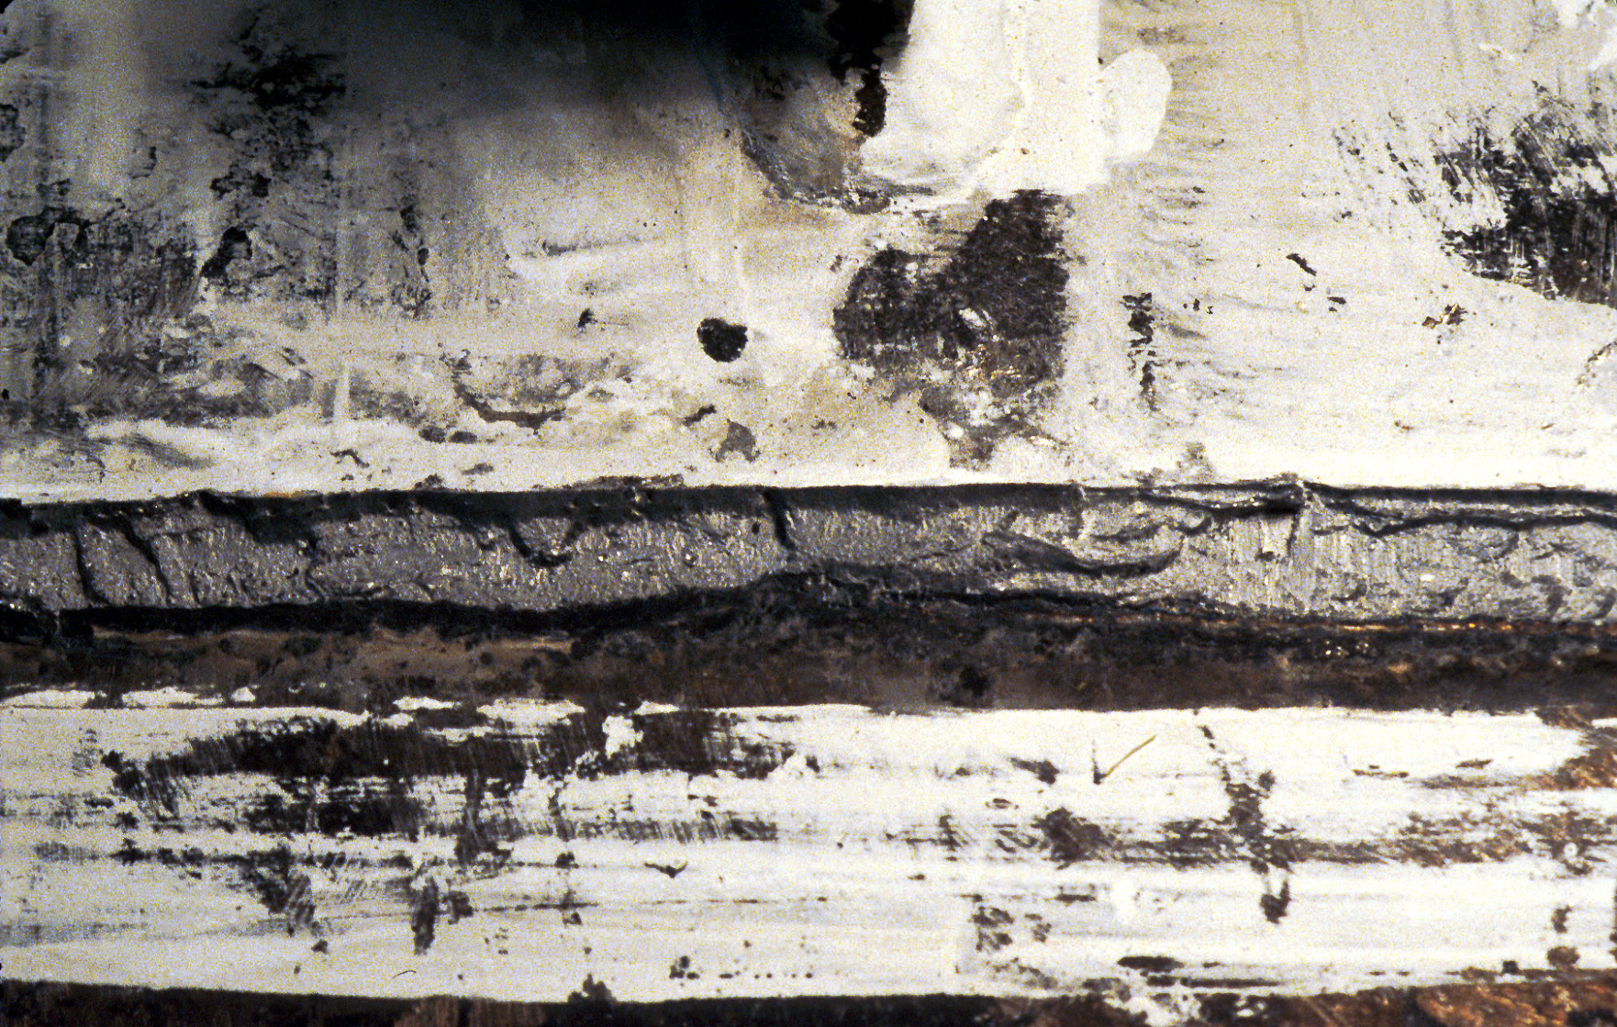
Notes:
This photo is from a laboratory specimen. The photo is looking at the face of the column, after fracture at the beam bottom flange weld. The beam has been removed.
The fracture surface seen in the column flange follows the location of the bottom flange weld (the base of the shear tab is visible near the top of the photo). The arrow is pointing to a large lack of fusion defect, i.e., a location where the weld metal never fused with the column base metal. Note that the defect is located in the middle part of the beam flange groove weld; in the vicinity of the weld access hole.
This specimen was fabricated by a commercial structural steel fabricator; and the welds were untrasonically tested and approved by a commercial testing laboratory. Despite care taken in fabrication and inspection of the weld, this large defect still occurred and went undetected by UT testing. This defect, in the middle portion of the bottom flange weld, is in a region that is difficult to weld and inspect. The beam web interferes both with welding and ultrasonic testing.
The basic detailing of the welded flange-bolted web connection resulted in an area (middle portion of bottom flange weld) where welding and inspection were both difficult. This resulted in a high likelihood of an undetected weld defect in this area.

Slide 87
Weld Backing Bars and Weld Tabs
Backing Bars:
  Can create notch effect
  Increases difficulty of inspection
  Weld Tabs:
  Weld runoff regions at weld tabs contain numerous discontinuities that can potentially initiate fracture
Notes:
The third welding factor that may have contributed to the observed connection failures was the pre-Northridge practice of leaving back-up bars and weld tabs in-place after welding.
Leaving the backing bar in place can cause two problems. First, the backing bar can act as a stress riser, causing a stress concentration at the weld. In the presence of low toughness weld metal, this stress riser may be sufficient to initiate a brittle fracture. Research has shown that the stress riser effect of the back-up bar is more severe at the bottom flange weld than at the top flange.
The second potential problem with leaving the back-up bar in-place is that it may increase the difficulty in inspecting the weld. The back-up bar can increase difficulty in interpreting UT signals, since it introduces additional surfaces for reflection of the UT wave. Further, leaving the back-up in place precludes visual inspection of the weld root. Inspection problems created by the back-up bars are likely more significant at the bottom flange weld, due to the high likelihood of a root defect in the region of the weld access hole.
Leaving the weld tabs (and associated weld runoff regions) in-place can also be problematic. The runoff regions are where the weld starts and stops are located, and often contain a large number of defects and discontinuities. Although the weld runoff regions are outside the beam flange, some stress still flows through these regions from the beam flange to the column flange. When this stress encounters discontinuities in the weld runoff regions, a fracture can be initiated.

Slide 88
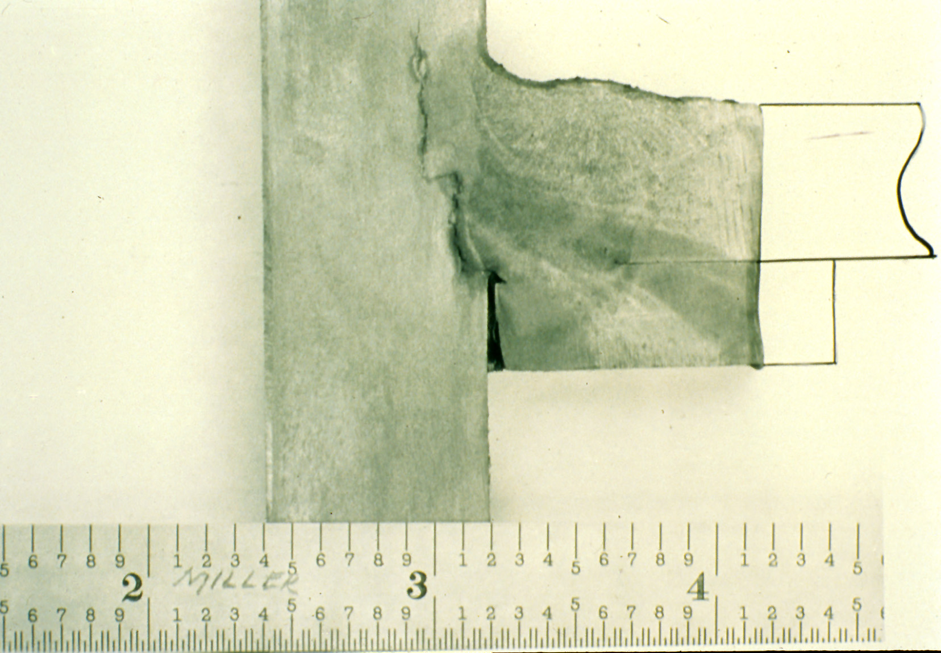
Notes:
This photo shows a fracture initiated at the root of the beam flange groove weld, and then propagating into the column flange. The gap left between the back-up bar and face of column acts as a stress riser that can initiate this type of fracture.
Note that the fracture within the column flange shows evidence of lamellar tearing.
Photo courtesy of Duane Miller - Lincoln Electric Company.

Slide 89
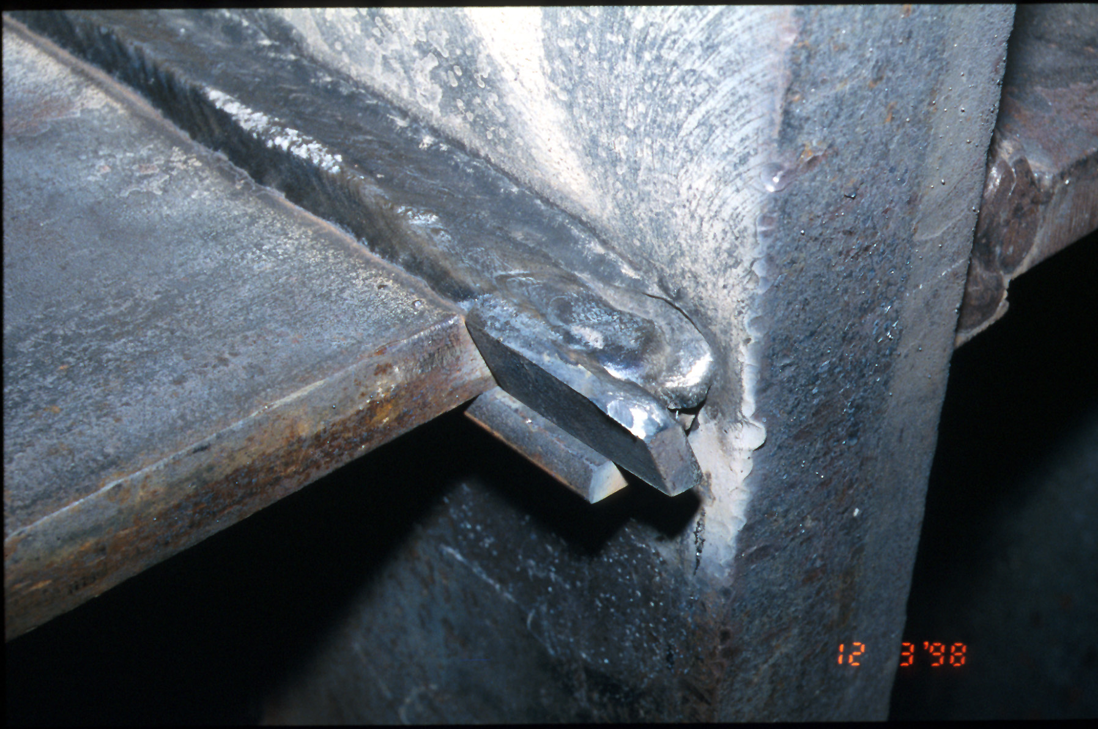
Notes:
Photo of weld runoff region at outer edge of beam flange groove weld. This runoff region is where the welder starts and terminates weld passes, and normally contains defects and discontinuities.

Slide 90
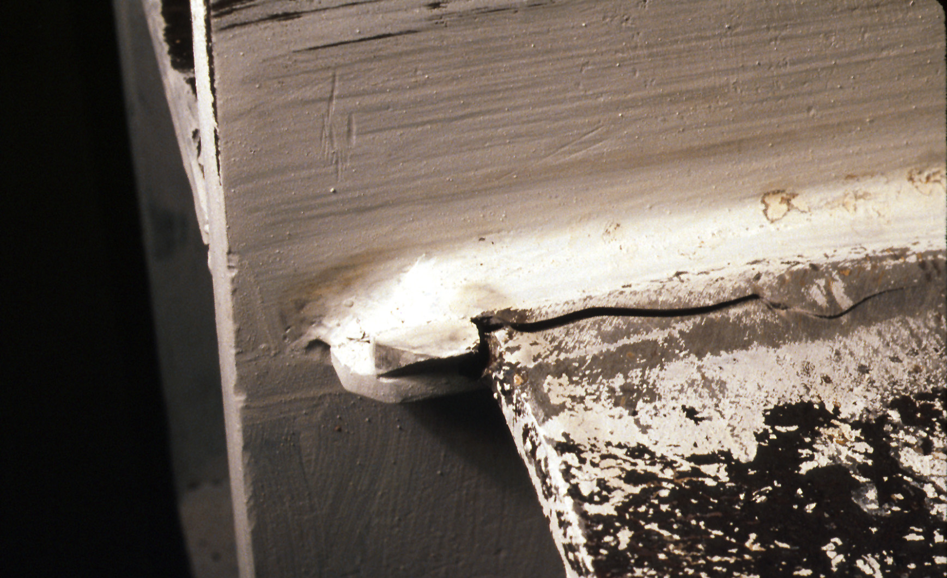
Notes:
Fracture initiating at out edge of beam flange, in the vicinity of the weld tab.

Slide 91
Causes of Moment Connection Damage in Northridge
Design Factors
Stress/Strain Too High at Beam Flange Groove Weld
Inadequate Participation of Beam Web Connection in Transferring Moment and Shear
Effect of Weld Access Hole
Effect of Column Flange Bending
Other Factors
Notes:
In addition to welding related factors, there were also likely a number of design related factors that contributed to the connection damage observed after Northridge. A number of design and detailing features of the welded flange-bolted web connection served to produce very high levels of stress and strain at the beam flange groove welds. These factors include:
- inadequate participation of bolted beam web connection in transferring moment and shear from the beam to the column;
- stress concentrations introduced by the presence, geometry and finish of the weld access holes;
- local bending of the column flange;
- other factors, such as presence of composite floor slab (increases stress at bottom flange).

Slide 92
F_{u}
F_{y}
Flange Stress
M_{p}
Increase in Flange Stress Due to
Inadequate Moment Transfer Through Web Connection
Notes:
At the beam-column connection, the beam flange welds are much stiffer than the bolted web connection. As a result, much of the bending stress in the web of the beam will flow to the beam flanges at the connection. The effect is illustrated qualitatively in this slide. If the moment in the beam is M_{p}, then stress levels over the depth of the beam should be on the order of F_{y}. However, because of the presence of the bolted web connection, the bending stress in the web of the beams flows to the stiffer beam flange welds. This, while the beam flange stress is only F_{y} a distance away form the weld, the stress may approach, or even exceed, F_{u} immediately adjacent to the welds.
Thus, the use of the bolted web connection serves to increase beam flange stresses in the vicinity of the groove welds. These high stress levels can increase the likelihood of weld failure (especially in the presence of weld defects and low toughness weld metal). However, even if high quality, high toughness welds are provided, these high stress levels can cause fracture of the beam flange base metal.

Slide 93
V_{flange}
Increase in Flange Stress Due to Shear in Flange
Notes:
Just as the bolted web connection is ineffective in transferring bending moment, it can also be ineffective in transferring shear. From a design point of view, we typically assume the bolted web connection to transfers the beam shear to the column. However, because the flange welds are much stiffer than the bolted web connection, some of the beam shear is transferred through the beam flanges and beam flange welds. This serves to further increase stress levels on the beam flange and beam flange groove weld.
Shear in the beam flanges add shear stress to the beam flange and can also add a secondary bending stress in the flange. This secondary bending stress is qualitatively illustrated by this slide. If one views the beam flange as a short cantilever, the beam flange shear, V_{flange}, produces a bending stress distribution as shown on the slide. These secondary bending stresses are in addition to the primary bending stresses in flange.
When the primary bending stress in the bottom flange is tension (the critical case for fracture), the secondary bending stress (shown in the slide) adds additional tension on the bottom side of the flange, and adds compression on the top side of the flange (thereby reducing overall tension on the top side). Thus, at the beam bottom flange, the tensile stress will be very high on the bottom side. These very high stress levels will also occur at the root of the bottom flange groove weld.
At the top flange of the beam, the directions of primary and secondary bending stress are reversed. That is, when the primary bending stress at the top flange is tension, the secondary bending stress tends to decrease the tension on the bottom side of the top flange, and increases the tension stress at the top side of the top flange. Consequently, the stress at the root of the top flange groove weld will be smaller than at the root of the bottom flange groove weld.
In summary, shear carried by the beam flanges produce shear stresses and secondary bending stresses in the beam flanges. These secondary bending stresses increase the overall stress level at the root of the beam bottom flange weld, and tend to decrease the overall stress level at the root of the beam top flange groove weld. Or, in other words, the root of the bottom flange weld is more critical than the root of the top flange weld. Unfortunately, the likelihood of a weld defect is higher at the root of the bottom flange weld.

Slide 94
Stress Concentrations:
Weld access hole
Shear in flange
Inadequate flexural participation of web connection
Notes:
The presence of the weld access hole also introduces a stress concentration. The severity of this stress concentration depends on the size and shape of the access hole, as well as on the finish of the cut (smoothness or roughness of the cut).
In summary, many of the design and detailing features of the welded flange-bolted web moment connection served to produce very high stress levels in the beam flanges and in the beam flange groove welds. These very high stress levels, combined with the likely presence of weld defects (particularly at the bottom flange weld near the access hole), combined with low toughness weld metal, led to a high likelihood of brittle fracture.

Slide 95

Notes:
This photo shows fracture at the top flange of a moment connection test specimen. For this specimen, the flange welds were made using an electrode that produced weld metal with improved fracture toughness. Further, back-up bars and weld tabs were removed after completion of the welds, to minimize any detrimental effects from these items. In this specimen, the high toughness - high quality weld did not fail. Nonetheless, the base metal immediately adjacent to the weld fractured, as a result of the very high levels of stress and stress concentration in this area.
Thus, in developing improved moment connections, simply improving the welds (high toughness weld metal, remove back-up bars and weld tabs, provide good quality and quality control) may not be adequate. The connection configuration must also be changed to reduce the high levels of stress and stress concentration in the beam flanges, immediately adjacent to the beam flange groove welds.

Slide 96
Causes of Moment Connection Damage in Northridge
Material Factors (Structural Steel)
Actual yield stress of A36 beams often significantly higher than minimum specified
Notes:
The final item that may have contributed to the connection failures in the Northridge Earthquake is the fact that the actual yield stress of structural steel can be significantly higher than minimum specified values.
At the time of the Northridge Earthquake (as well as for many years preceding the earthquake), most moment frame beams were typically specified to be of A36 steel. The minimum specified yield stress for A36 is 36 ksi. However, in many cases, the actual yield stress of A36 is much higher than 36 ksi. Often, the actual yield stress of A36 steel is in excess of 50 ksi.
Because of the higher actual yield stress values for A36 steel, stress levels in the beam flanges and at the beam flange groove welds will also be higher when the beam yields in an earthquake. This serves to further elevate stress levels on the beam flange groove welds when the beam forms a plastic hinge.
The Northridge connection damage highlighted the importance of using realistic material properties in seismic design.

Slide 97
Strategies for Improved Performance of Moment Connections
Welding
Materials
Connection Design and Detailing
Notes:
The previous slides discussed the various factors that may have played a role in the Northridge moment connection failures. The following slides will look at various strategies for achieving improved performance of moment connection in earthquakes. These strategies will examine factors related to welding, to structural steel, and to connection design and detailing.

Slide 98
Strategies for Improved Performance of Moment Connections
Welding
Required minimum toughness for weld metal:
  Required CVN for all welds in SFRS:
  20 ft-lb at 0°F
  Required CVN for Demand Critical Welds:
  20 ft-lb at -200°F and 40 ft-lb at 700°F
Notes:
As described earlier, low fracture toughness of weld metal was identified as an important contributing factor to the Northridge connection failures. Consequently, in current practice, there is a minimum required toughness for weld metal. Toughness requirements are specified in terms of CVN (Charpy V-Notch) values.
Shown in the slide are the CVN requirements in the 2016 AISC Seismic Provisions. Although the fracture of beam flange groove welds in moment frame connections motivated these weld toughness requirements, it was recognized that weld toughness is desirable in all welded connections, in all types of seismic resistant steel frames (moment frames, braced frames, EBFs, etc).
Thus, these requirements (specified in Section A3.4 of the AISC Seismic Provisions) apply not only to moment frames, but to any type of seismic-resistant steel frame.
Note that the beam flange groove welds in moment connections are considered to be "demand critical.“
Note: The requirements shown on this slide are for 70ksi and 80ksi filler metals. For 90ksi filler metal, the required CVN for all welds is 25 ft-lbs at -20degF, and the required CVN for Demand Critical Welds is 20ft-lbs at -20degF and 40ft-lbs at 50degF.

Slide 99
Strategies for Improved Performance of Moment Connections
Welding
Improved practices for backing bars and weld tabs
  Typical improved practice:
    Remove bottom flange backing bar
    Seal weld top flange backing bar
    Remove weld tabs at top and bottom flange welds
Greater emphasis on quality and quality control
(AISC Seismic Provisions – Chapter J)
Notes:
An additional strategy for improved moment connection performance is improved practices for back-up bars and weld tabs. In typical current practice, the weld tabs and weld runoff regions are removed at both the top and bottom flange groove welds. Further, the bottom flange back-up bar is removed. The top flange back-up bar is normally left in-place, but is seal welded to the face of the column (see following slides).
There has also been recognition of the need for better welding quality control. Chapter J of the 2016 AISC Seismic Provisions provides guidance and minimum requirements for welding quality control.

Slide 100

Notes:
This is a bottom flange weld in a typical pre-Northridge moment connection. The weld was made using a low-toughness electrode, and the back-up bar and weld tabs were left in-place.

Slide 101

Notes:
This is a bottom flange weld in a typical improved post-Northridge moment connection. The weld was made using an electrode that meets specified CVN requirements. The weld tabs and weld runoff regions have been removed, and the areas ground smooth.
The back-up bar has been removed. After removal, the root of the weld can be visually inspected, and any observed defects can be removed. A small reinforcing fillet weld is then placed at the bottom of the groove weld to fill in areas of the groove weld that were removed, and to provide a smooth contour that minimizes stress concentrations at the base of the groove weld.

Slide 102

Notes:
This is a top flange weld in a typical pre-Northridge moment connection. The weld was made using a low-toughness electrode, and the back-up bar and weld tabs were left in-place.

Slide 103

Notes:
This is a top flange in a typical improved post-Northridge moment connection. As with the bottom flange weld, the top flange weld was made using an electrode that meets specified CVN requirements. The weld tabs and weld runoff regions have been removed, and the areas ground smooth.
The back-up is not typically removed at the top flange, in post-Northridge practice. The likelihood of a weld defect is less at the top flange, because the weld is easier to place and to ultrasonically test. Further, as described earlier, the stress levels at the root of the top flange weld is expected to be lower than at the bottom flange weld. Further, cutting out the top flange back-up bar in the region of the weld access hole poses difficulties, and may result in damaging the beam base metal in this region.
Thus, the top flange back-up bar is left in place. However, a small fillet weld (usually 5/16" leg size) is placed between the back-up bar and the face of the column, as shown in the slide. This weld serves to reduce the stress riser effect of the back-up bar.

Slide 104
Strategies for Improved Performance of Moment Connections
Materials (Structural Steel)
Introduction of “expected yield stress” into design codes
Expected Yield Stress = R_{y} F_{y}
F_{y} = minimum specified yield strength
R_{y} = 1.5 for ASTM A36
= 1.1 for A572 Gr. 50 and A992
(See AISC Seismic Provisions - Section A3 for other values of R_{y})
Notes:
An additional strategy for improved connection performance is more explicit recognition of realistic material properties of structural steel in the design process, and better control of yield stress variability.
To provide more explicit recognition of the fact that the actual yield stress of steel often exceeds the minimum specified value, the AISC Seismic Provisions introduced (in the 1997 edition) the concept of "expected yield stress." The expected yield stress, specified in Section A3 of the 2016 AISC Seismic Provisions, provides an estimate of the mean yield stress for a particular grade of steel (see discussion on Module 1).
Although the Northridge moment frame connection failures motivated the concept of "expected yield stress," this concept is now used in in many areas of seismic-resistant design of steel frames.

Slide 105
Strategies for Improved Performance of Moment Connections
Materials (Structural Steel)
Introduction of ASTM A992 steel for wide flange shapes
ASTM A992
Minimum F_{y} = 50 ksi
Maximum F_{y} = 65 ksi
Minimum F_{u} = 65 ksi
Maximum F_{y} / F_{u} = 0.85
Notes:
As a result of the Northridge moment connection failures, the steel industry in the US introduced ASTM A992 steel. A992 provides the same minimum specified yield stress and tensile strength as A572 Grade 50. However, A992 places an upper bound on yield stress (F_{y} cannot exceed 65 ksi), and also places an upper bound of 0.85 on the yield ratio (F_{y}/F_{u}). Lower values of yield ratio (i.e. a large gap between F_{y} and F_{u}) is desirable for ductile behavior.

Slide 106
Strategies for Improved Performance of Moment Connections
Connection Design
Improved Weld Access Hole Geometry
Notes:
As described earlier, many of the design and detailing features of the welded flange-bolted web moment connection result in very high stress levels in the beam flanges and in the beam flange groove welds. Consequently, one of the strategies for improved connection performance is to modify some of the design and detailing features of the connection to reduce stress levels at the beam flange groove welds.
The presence of the weld access hole introduces a stress concentration. The severity of this stress concentration depends on the size and shape of the access hole. Research was conducted in the SAC-FEMA program to identify an improved weld access hole geometry that would minimize this stress concentration.

Slide 107

Improved Weld Access Hole
See AWS D1.8 - Structural Welding Code – Seismic Supplement for dimensions and finish requirements
Notes:
This diagram illustrates the recommended size and geometry for the weld access hole.

Slide 108

Notes:
This photo shows the improved weld access hole.
Photo courtesy of Jim Ricles - Lehigh University.

Slide 109
Strategies for Improved Performance of Moment Connections
Connection Design
Development of Improved Connection Designs and Design Procedures
  Reinforced Connections
  Proprietary Connections
  Reduced Beam Section (Dogbone) Connections
  Other SAC Investigated Connections
Notes:
In addition to developing an improved weld access hole geometry, a wide variety of new moment connection designs have been developed since the Northridge Earthquake. The following slides will illustrate a number of improved moment connection designs.

Slide 110

Notes:
Shortly after the Northridge Earthquake, a number of "reinforced connections" were developed and used in practice. The cover-plated connection was used in many buildings in 1994 and 1995. In this connection, the beam flanges are reinforced with cover plates, The cover plates are fillet welded to the beam flanges. The combined beam flange and cover plate is then groove welded to the face of the column. The cover plates, in effect, strengthen the connection and reduce stress levels in groove weld and in the beam flanges in the region adjacent to the groove welds.

Slide 111

Notes:
This photo shows a cover plated connection tested in the laboratory. Note the formation of a plastic hinge in the beam (as indicated by flaking of the whitewash), in the region near the tips of the cover plates. This specimen, like many other cover plated specimens, permitted the development of large levels of ductility in the beam, without failure of the connection.
Cover plated connections (combined with improved welding practices) permitted connection performance that was much improved compared to the pre-Northridge connection. Ultimately, however, this connection proved costly to construct, and although much more reliable than the pre-Northridge connection, still exhibited occasional poor performance in the laboratory.
Reference:
Engelhardt, M.D. and Sabol, T.A., “Reinforcing of Steel Moment Connections with Cover Plates: Benefits and Limitations,” Engineering Structures, Vol. 20, No. 6, pp. 510-520, 1998.

Slide 112

Notes:
This shows another method used to reinforce moment connections. For this connection, large ribs are welded to the beam flanges and to the face of the column. Like cover plates, the ribs serve to make the connection much stronger than the beam, and to force plastic hinge formation away from the face of the column.

Slide 113

Notes:
A laboratory test of a rib-reinforced moment connection. This specimen developed very large beam ductility without connection failure.

Slide 114

Notes:
This photo shows another reinforcement scheme: addition of a haunch at the bottom flange (some connections provided haunches at both the top and bottom flanges).
A variety of reinforcing schemes were developed, tested, and used in buildings in the initial years following the Northridge Earthquake. While these reinforced connections generally showed very good performance in the laboratory, but were costly to construct.

Slide 115

Notes:
An alternative moment connection that came into use after the Northridge earthquake was the reduced beam section (RBS) connection, sometimes called the "dogbone" connection. The RBS forces yielding and hinge formation to occur within the reduced section of the beam and limits the moment the can be developed at the face of the column. By reducing demands on the beam flange groove welds and the surrounding base metal regions, the RBS reduces the possibility of fractures occurring in this vulnerable region. The RBS plays a role similar to that of connection reinforcement schemes such as cover plates, ribs and haunches. Both the RBS and connection reinforcement move the plastic hinge away from the face of the column and reduce inelastic deformation demands in the vicinity of the beam flange groove welds. Connection reinforcement often requires welds that are difficult and costly to make and inspect. These problems are lessened with the RBS, which is relatively simpler to construct. The smaller moment generated at the face of the column for an RBS connection also offers some advantages in satisfying strong column-weak beam requirements and in minimizing column doubler plate requirements.
The goal in connection design in moment frames is to provide a connection that is stronger than the beam. This can be accomplished either by strengthening the connection (as with reinforced connections) or by weakening the beam (as with the RBS).
The RBS has become one of the most common moment connection details used in current practice.

Slide 116

Notes:
This is a photo of an RBS connection specimen after testing. Note that yielding and plastic hinge formation id concentrated within the reduced section of the beam, as intended.
More details of the RBS will be provided later in this module.

Slide 117
Proprietary Connections
Notes:
Several proprietary (patented) connection designs have been developed since the Northridge Earthquake. Two of these proprietary connection design, which have seem considerable use in actual buildings will be illustrated. These are the side-plate connection and the slotted web connection.

Slide 118

SidePlate® Connection
Notes:
The "side plate" connection is a proprietary connection that sandwiches the beam and column between two side plates, as shown. The beam flanges are not welded directly to the column flanges, as in most other moment connection designs. Rather, stress is transferred form the beam flanges to the column flanges through the side plates.
Further information is available at: http://www.sideplate.com/

Slide 119

SlottedWebTM Connection
Notes:
The slotted web connection is a proprietary connection that provides slots that separate the beam flanges from the beam web, in the connection region. The slots serve to significantly reduce stress concentrations in the beam flanges and beam flange groove welds.
Further information is available at: http://www.slottedweb.com/

Slide 120

Cast Bolted Bracket
Connection
(previously the Kaiser Bolted Bracket® Connection)
Notes:
The Cast Bolted Connection (previously known as the Kaiser Bolted Bracket Connection) is a proprietary connection made of cast high-strength steel brackets fastened to the beam and column. The brackets are bolted to the column and can either be bolted or welded to the beam.
Further information is available at: https://www.castconnex.com/

Slide 121

ConXtech® ConXL™ Connection
Notes:
The ConXtech ConXL connection is a proprietary connection that provides beam and column collar assemblies that provide a bi-axial connection between wide-flange beams and an HSS or built-up box column. The beam is shop-welded to the collar flange assembly, and the remainder of the connection is field bolted.
Further information is available at: https://www.conxtech.com/

Slide 122


Simpson Strong-Tie® Strong Frame® Connection
Notes:
The Simpson Strong-Tie Strong Frame connection is a proprietary connection, where Yield Link™ structural fuses are used to concentrate yielding. These Yield Links are modified T-stub connections with reduced sections, which are bolted to the beam and column flanges. Cover plates prevent buckling in the Yield Links, such that they can yield in compression and tension. The connection intentionally does not reach the full plastic moment of the beam due to the reduced yielding area in the Yield Links.
Further information is available at: www.strongtie.com

Slide 123
Connections Investigated Through
SAC-FEMA Research Program

Slide 124

Reduced Beam Section
Notes:
Although the RBS was investigated and tested prior to the SAC-FEMA program, further investigations were conducted under this program to further identify the capabilities and limitations of this connection, as well as to refine design requirements.

Slide 125

Welded Unreinforced Flange - Bolted Web
Notes:
The Welded Unreinforced Flange - Bolted Web (WUF-B) was investigated at the University of Michigan under the SAC-FEMA program. This is similar to the pre-Northridge connection, except that improved welding practices are employed (high toughness weld metal, improved practices for back-up bars and weld tabs) and the improved weld access hole is specified. With these improvements, the WUF-W was capable of developing limited ductility in the beam, prior to connection failure. Although likely not adequate for the high ductility demands in Special Moment Frames, this connection may be adequate for lower ductility demands, such as in Intermediate and Ordinary Moment Frames.

Slide 126


Welded Unreinforced Flange - Welded Web
Notes:
The Welded Unreinforced Flange - Welded Web (WUF-W) was investigated at Lehigh University under the SAC-FEMA program. This is an all-welded connection. Both beam flanges as well as the beam web are welded to the face of the column. The beam web is welded to the column flange using a CJP groove weld, but also include supplemental fillet welds to the shear tab. Like all other improved moment connections, the WUF-W employs improved welding practices (high toughness weld metal, improved practices for back-up bars and weld tabs) and uses the improved weld access hole. Tests at Lehigh University, and subsequent tests at University of Minnesota showed that the WUF-W provides excellent performance, allowing the beams to develop ductility levels suitable for use in Special Moment Frames.

Slide 127

Free Flange Connection
Notes:
The Free Flange connection was developed and tested at the University of Michigan under the SAC-FEMA program. In this connection, the beam web is cut away in the region adjacent to the column. The beam flanges are therefore "free" in the connection region. The connection also features a very heavy welded shear tab. This connection showed excellent performance in a limited number of tests. In these tests, the beams developed ductility levels suitable for use in Special Moment Frames.

Slide 128

Welded Flange Plate Connection
Notes:
The Welded Flange Plate connection was investigated at the University of California at Berkeley, under the SAC-FEMA program. This connection is similar to the cover plated connections described earlier, with one significant difference. In the cover plated connections used immediately following the Northridge earthquake, both the beam flange and cover plate were groove welded to the face of the column. In the SAC Welded Flange Plate connection, only the cover plates are welded to the face of the column. This results in the need for heavier cover plates, but avoids some problems associated with welding the combined beam flange and cover plate to the column. The Welded Flange Plate also showed good performance in a limited number of tests.

Slide 129


Bolted Unstiffened End Plate
Photo courtesy of Tom Murray
Virginia Tech
Notes:
Two types of end plate connections were investigated at Virginia Tech University under the SAC-FEMA program. These were the Bolted Unstiffened End Plate (shown here) and the Bolted Stiffened End Plate (shown on the next slide). Both types showed good performance in testing, and detailed design procedures were developed. End plate connections are commonly used in Metal Building Systems, and are sometimes used in industrial construction (refinery structures, power plants, etc). Note that end plate connections require no field welding.

Slide 130

Bolted Stiffened End Plate

Slide 131


Bolted Flange Plate
Notes:
The Bolted Flange Plate was investigated at the University of Illinois under the SAC-FEMA program. This connection, like the end plate, requires no field welding. This connection showed promising performance in a limited number of tests.

Slide 132

Double Split Tee
Notes:
The Double Split Tee was investigated at Georgia Tech University under the SAC-FEMA program. This connection is all-bolted in the field. The connection showed good performance in limited testing, and design procedures were developed. This connection is typically treated as a semi-rigid connection, for which the effects of connection flexibility must be included in the overall frame analysis.

Slide 133
Results of SAC-FEMA Research Program
Recommended Seismic Design Criteria for Steel Moment Frames
FEMA 350
Recommended Seismic Design Criteria for New Steel Moment-Frame Buildings
FEMA 351
Recommended Seismic Evaluation and Upgrade Criteria for Existing Welded Steel Moment-Frame Buildings
FEMA 352
Recommended Postearthquake Evaluation and Repair Criteria for Welded Steel Moment-Frame Buildings
FEMA 353
Recommended Specifications and Quality Assurance Guidelines for Steel Moment-Frame Construction for Seismic Applications
Notes:
The SAC-FEMA program resulted in a large number of research reports. The program also produced four design oriented documents that provide detailed guidance for designers and building code officials. The four design guideline documents are listed on this slide. These documents are available for free (in hardcopy or pdf download) from FEMA. Pdf versions can also be downloaded for free from the AISC website (www.aisc.org).

Slide 134

FEMA 350
Notes:
FEMA 350: "Recommended Seismic Design Criteria for New Steel Moment-Frame Buildings," was one of the most important outcomes from the SAC-FEMA program. This document, published in 2000, provides guidance on many issues related to the design of moment frame buildings. Included in FEMA 350 are descriptions of the nine moment connection details just described (RBS, WUF-B, WUF-W, free flange, etc). Included are recommended design procedures, recommended limits of usage, etc. These moment connection details are called "prequalified" connections in FEMA 350. The intent is that these connections, when used within the specified limits, could be used without the need for further testing or verification.
In 2005, AISC released a new standard: "Prequalified Connections for Special and Intermediate Steel Moment Frames for Seismic Applications," Standard ANSI/AISC 358-05. AISC 358, in effect, replaced FEMA 350 for "prequalified" moment connections. Nonetheless, FEMA 350 contains a great deal of useful design information for steel moment frames, and still serves as a valuable reference. The current version of this standard is ANSI/AISC 358-16.
This completes our initial discussion on moment connections. We will see more on moment connections later, when we look at specific requirements for moment connections in the 2016 AISC Seismic Provisions.

Slide 135
2 – Moment Resisting Frames
Definition and Basic Behavior of Moment Resisting Frames
Beam-to-Column Connections: Before and After Northridge
Panel-Zone Behavior
AISC Seismic Provisions for Special Moment Frames
Notes:
Another important aspect of understanding ductile detailing of steel MRFs is develop an understanding of the behavior of the column panel zone regions. Some basic definitions and ideas on panel zone behavior are discussed in the next section of this module.

Slide 136
Column Panel Zone
Column Panel Zone:
- subject to high shear
- shear yielding and large
shear deformations possible
(forms “shear hinge”)
- provides alternate yielding
mechanism in a steel moment
frame
Notes:
Before looking at moment frame requirements in the AISC Seismic Provisions, we will discuss some background on the behavior of the column panel zone regions of steel moment frames.
As discussed earlier in this module, the panel zone (the portion of the column within the beam-column joint region) is subject to high shear when the frame is under lateral load. This can lead to shear yielding of the panel zone, and the development of "shear hinges." This leads to an alternative plastic mechanism for steel moment frames, i.e., one where the plastic hinges are in the panel zones rather than at the beam ends.

Slide 137
Joint Deformation Due to Panel Zone Shear Yielding
Notes:
Shear yielding of the panel zone leads to a deformation pattern as shown in this slide. Under high shear, the panel zone region deforms essentially like a parallelogram.

Slide 138
Plastic Hinges
In Column Panel Zones
Notes:
This slide, seen earlier, illustrates a plastic frame mechanism with shear hinges in the panel zones, rather than flexural hinges at the beam ends. Thus, panel zone yielding provides an alternative way to develop ductility in a steel moment frame.
Important questions are:
- Does panel zone yielding result in ductile behavior; and
- Is this an acceptable approach for moment frame design?

Slide 139

Notes:
There have been a number of experiments and studies on the behavior of beam-column joints with weak panel zones, i.e., where yielding is concentrated in the panel zone (in the form of shear yielding), rather than flexural yielding in the beam. This photo shows a panel zone that has undergone large inelastic deformations.
Photo from:
"25 Jahre Institut für Stahlbau and Holzbau - 15 Jahre Labor für Bauteilprufung," Herausgegeben anläßlich des 25 jährigen Bestehens der Fakultät für Bauingenieurwesen and Architektur, Leopold-Franzens-Universität Innsbruck, December 1994.

Slide 140

Notes:
This is another experiment on a moment frame joint where the panel zone is the primary yielding element. Note the flaking of whitewash in the web of the panel zone. There has also been a small amount of flexural yielding in the beam (this is a cover-plated connection).

Slide 141

Notes:
This slide shows a large moment connection test specimen. The specimen consists of a column, with moment frame beams attached on both sides. Load is applied at the top of the column. This specimen was also provided with a composite floor slab. Reduced beam section (RBS) connections were provided for the beam-to-column connections.
This specimen was designed with a very weak panel zone, so that virtually all inelastic action was concentrated in the panel zone. Note that there is almost no yielding in the RBS region of the beams, although the specimen has been loaded to a very large inelastic drift level.
This specimen, like many others with weak panel zones, demonstrated very high levels of ductility. That is, shear yielding of the panel zone is a highly ductile process. Ultimately, however, failure typically occurs by the development of a fracture in the vicinity of the beam flange groove welds. These fractures can occur in the groove weld, in the beam flange, or sometimes in the column flange.
Although the moment in the beam may be well below M_{p} of the beam, fracture of the beam flange or beam flange groove weld can still occur in a joint with a weak panel zone. Shear distortion of the panel zone results in the formation of localized “kinks” at the corners of the panel zone. These kinks, in turn, caused localized strain concentrations, ultimately leading to the occurrence of fracture in the vicinity of the beam flange groove welds. These fractures are normally the controlling limit state for joints with weak panel zones. That is, fracture at or near the beam flange groove welds is ultimately what limits the inelastic deformation capacity of the panel zone.
The circle in this photo highlights the "kink" that forms at the corner of the panel zone. For this specimen, failure occurred by fracture of the beam flange in this area (see next slide).

Slide 142

Notes:
This slide shows a fracture at the bottom flange of the right beam for the specimen shown on the previous slide. This fracture is immediately adjacent to the beam flange groove welds. This fracture occurred when the moment in the beam was well below M_{p}, and was the result of the highly localized deformations at the panel zone corners ("kink" regions).

Slide 143
"kink" at corners of panel zone
Notes:
This diagram illustrates the "kinks" that form at the corners of the panel zone, that typically lead to fracture in these regions.

Slide 145
Notes:
This plot is for the same specimen shown in the last few slides. This slide shows local response of the panel zone. Shown on the plot is the shear force on the panel zone, versus shear deformation (γ) of the panel zone.
This plot shows the outstanding ductility that can be achieved by shear yielding of the panel zone. Note that the panel zone sustained many cycles of inelastic deformation, without strength degradation. In contrast, when flexural yielding occurs at the end of the beam, strength tends to degrade at large deformation levels due to local and lateral torsional buckling of the beam.
Shear yielding of the panel zone typically does not exhibit strength degradation due to local buckling (shear buckling of the panel zone is possible, but normally does not occur for the panel zone proportions found in typical rolled shape columns). Thus, the panel zone will normally exhibit large cyclic ductility, until the occurrence of fracture near the beam flange groove welds.
This slide clearly demonstrates the outstanding ductility possible when we have shear yielding of steel elements. We'll see later that we also make use of the great ductility of steel elements in shear in eccentrically braced frames.
Note also that ductility in shear is an important difference between steel and reinforced concrete. Steel elements are typically highly ductile in shear, whereas reinforced concrete element are typically highly non-ductile in shear.

Slide 146
Observations on Panel Zone Behavior
Very high ductility is possible.
Localized deformations (“kinking”) at corners of panel zone may increase likelihood of fracture in vicinity of beam flange groove welds.
Building code provisions have varied greatly on panel zone design.
Current AISC Seismic Provisions permits limited yielding in panel zone.
Further research needed to better define acceptable level of panel zone yielding
Notes:
This slide summarizes key ideas regarding the panel zone:
- Panel zone yielding is a highly ductile process. Moment frames designed with "weak" panel zones (i.e. designed so that yielding occurs primarily in the panel zones) can achieve very high levels of ductility under lateral earthquake loading.
- Even though panel zone yielding is highly ductile, this yielding leads to the development of "kinks" at the panel zone corners, which in turn, lead to fracture. Further, the degree of inelastic deformation that can be developed in the panel zone before fracture is not well understood.
- Additional research is needed to better define how much panel zone participation should be permitted in the inelastic seismic response of a steel moment frame. Despite a number of past studies on this issue, there are sharply conflicting views of how panel zones should be treated in design, both within the research community as well as within the building regulatory community. At the crux of the disagreements are concerns regarding fracture induced by panel zone yielding. There appears to be broad agreement that panel zone yielding is a highly ductile process, and that in many ways, the panel zone is an ideal energy dissipater in a steel moment frame. However, there is broad disagreement on the role that panel zone yielding plays in joint fracture.
- Because of conflicting views on panel zone behavior, building code provisions on panel zone design have shown large variations over time.
- The current (2016) AISC Seismic Provisions have taken the approach of permitting limited yielding in the panel zone, but do not permit designs in which essentially all yielding occurs in the panel zone.
This completes the general discussion on panel zone behavior. We will consider further design and detailing requirements when we discuss Section E3.6 of the AISC Seismic Provisions.

Slide 147
2 – Moment Resisting Frames
Definition and Basic Behavior of Moment Resisting Frames
Beam-to-Column Connections: Before and After Northridge
Panel-Zone Behavior
AISC Seismic Provisions for Special Moment Frames
Notes:
In the final section of this module, we will look at the detailing requirements for Special Moment Frames in the AISC Seismic Provisions.

Slide 148
2016 AISC Seismic Provisions
Chapter E: Moment Frame Systems
E1. Ordinary Moment Frames (OMF)
E2. Intermediate Moment Frames (IMF)
E3. Special Moment Frames (SMF)
E4. Special Truss Moment Frames (STMF)
E5. Ordinary Cantilever Column Systems (OCCS)
E6. Special Cantilever Column Systems (SCCS)
Notes:
We will now start looking at detailing requirements for moment frames in the 2016 AISC Seismic Provisions.
Moment frames are covered in Chapter E
Special Moment Frames (SMF) have the highest level of ductile detailing requirements, and are therefore expected to be capable of sustaining very large levels of inelastic deformation. That is, SMF systems are expected to be capable of supplying very high levels of ductility. Accordingly, they can be designed with lower levels of lateral strength, and therefore have a high "R-factor." R=8 for SMF.
Ordinary Moment Frames (OMF) have very few ductile detailing requirements, and therefore are not expected to be capable of supplying significant levels of ductility. Accordingly, they must be designed to provide higher levels of lateral strength, and therefore have a low "R-factor." R=3.5 for OMF.
Finally, Intermediate Moment Frames (IMF) have ductile detailing requirements that are intermediate between SMF and OMF, and are therefore expected to be capable of supplying moderate levels of ductility. The required lateral strength of IMF systems is therefore also intermediate between SMF and OMF. R=4.5 for IMF. Note that IMF are close to OMF in terms of R-factor, and therefore should be considered to be a system of limited ductility.
There is also a fourth type of moment frame system defined in the AISC Seismic Provisions. These are Special Truss Moment Frames (STMF), which are covered in Section E4 of the Seismic Provisions. In STMF, the horizontal members are trusses rather than conventional wide flange beams. The trusses in STMF are designed to force yielding to occur in special segments of the truss, which in turn, are then detailed for high ductility. STMF systems will not be covered herein.
The final type of moment frame system defined in the AISC Seismic Provisions are the Ordinary and Special Cantilever Column Systems (OCCS and SCCS, respectively). These systems rely on flexural yielding in the columns only with minimal inelastic drift capacity and redundancy. OCCS and SCCS systems will not be covered herein.
The remainder of this module will focus on Special Moment Frames (SMF). As noted above, SMF systems have the highest level of ductile detailing requirements. IMF and OMF systems are similar to SMF, but relax or eliminate many of the SMF requirements.
Finally, recall that all SFRS (Seismic Force Resisting Systems) must satisfy the requirements in Chapters A through D of the Seismic Provisions. Thus, moment frame systems must satisfy Chapter E (for SMF, IMF or OMF), but must also satisfy Chapters A through D.

Slide 149
2016 AISC Seismic Provisions
Chapter E: Moment Frame Systems
E3.1 Special Moment Frames (SMF)
    E3.1 Scope
    E3.2 Basis of Design
    E3.3 Analysis
    E3.4 System Requirements
    E3.5 Members
    E3.6 Connections
Notes:
Section E3 covers requirements for Special Moment Frames.
Note that many of the detailing requirements pertain to the beam-column joint region.
We will now cover selected highlights of Section E3.

Slide 150
AISC Seismic Provisions
Special Moment Frames
E3.2 Basis of Design
Special moment frames (SMF) are expected to withstand significant inelastic deformation capacity through flexural yielding of the SMF beams and limited yielding of column panel zones.
Notes:
The key words in the Basis of Design statement are "..significant inelastic deformations.." This indicates that SMF systems are expected to supply high levels of ductility, and therefore have fairly extensive detailing requirements intended to assure high ductility.

Slide 151
2016 AISC Seismic Provisions
Chapter E: Moment Frame Systems
E3.6 Connections
    E3.6a Demand Critical Welds
    E3.6b Beam-to-Column Connections
    E3.6c Conformance Demonstration
    E3.6d Required Shear Strength
    E3.6e Panel Zone
    E3.6f Continuity Plates
    E3.6g Column Splices
Notes:
Section E3.6 covers requirements for beam-to-column connections. This section of the AISC Seismic Provisions has been heavily influenced by the moment connection failures seen in the 1994 Northridge Earthquake, and the subsequent research programs (SAC-FEMA and others).
Prior to the 1994 Northridge Earthquake, the AISC Seismic Provisions prescribed the use of the welded flange-bolted web connection in SMF systems. Unfortunately, the connection that was prescribed proved to be a poor choice.
The current AISC Seismic Provisions no longer prescribe the use of any particular type of connection. Instead, the AISC Seismic Provisions specify the performance requirements for beam-to-column connections in SMF, and then specify how a designer may demonstrate the a connection satisfy these performance requirements.
Thus, with the current AISC Seismic Provisions, a designer can choose any type of beam-to-column connection for use in a Special Moment Frame, as long as he/she can demonstrate (using methods given in Section E3.6c) that the chosen connection satisfies the performance requirements in Section E3.6b.

Slide 152
AISC Seismic Provisions
Special Moment Frames
E3.6b Beam-to-Column Connections
Beam-to-column connections shall satisfy the following requirements:
The connection shall be capable of sustaining an interstory drift angle of at least 0.04 radians.
The measured flexural resistance of the connection, determined at the column face, shall equal at least 0.80M_{p} of the connected beam at an interstory drift angle of 0.04 radians.
Notes:
Section E3.6b states the fundamental performance requirements for an SMF beam-to-column connection.
The basic performance requirement is stated in terms of required deformation capacity. Essentially, the connection must be capable of permitting the frame to sustain cyclic loading up to an interstory drift angle of ±0.04 radian, without failure of the connection.
The connection is considered satisfactory if it can still resist of a moment equal to at least 0.80 M_{p} of the connected beam, after being subjected to cyclic loading up to ± 0.04 radian. This is referred to as the "measured flexural resistance," since (as will be seen in E3.6c), the moment capacity of the connection after cyclic loading is measured in a connection test.
Note that the flexural capacity of the connection must be at least 0.80 M_{p} after cyclic load testing. M_{p} here is computed using nominal material properties, i.e. M_{p} = Z F_{y}, where F_{y} is the minimum specified yield stress (typically 50 ksi for an SMF beam), not the expected yield stress.
Normally, the bending moment developed in the beam, at the beam-to-column connection, during cyclic testing will be well in excess of M_{p}. In fact, maximum moments that the connection will see will often be on the order of 1.15 x Z x R_{y}F_{y}. That is, the connection will need to resist a very large moment during the cyclic testing. However, the AISC Seismic Provisions permit some loss of flexural strength during the course of the cyclic loading, and require that the remaining flexural capacity after completing a load cycle at ± 0.04 radian drift angle need only be 0.80 M_{p .} This allows for some deterioration in flexural strength during the very severe cyclic loading that the beam and connection will see during testing. In most tests, some loss in flexural capacity is seen as the ± 0.04 radian loading cycle is reached. In most cases, this loss of flexural capacity is due to local and lateral buckling of the beam, rather than damage to the beam-to-column connection. Thus, the performance requirement to be able to sustain cyclic loading of ± 0.04 radian is a requirements not only for the connection, but also for the beam. For example, even with a high quality beam-to-column connection, it will likely not be possible to satisfy this performance requirements with a noncompact beam section. Even though the connection does not fail during the test, the flexural resistance of the beam will likely drop well below 0.80 M_{p} by the time the beam is loaded to ± 0.04 radian, due to local buckling in the beam.
Through research conducted in the SAC-FEMA program, the connection performance requirements were initially stated to say that the connection must be capable of accommodating a plastic rotation of at least ± 0.03 radian without failure. Thus, many testing reports and research publications produced after the Northridge Earthquake evaluated connection performance based on this plastic rotation requirement.
In an attempt to restate the performance requirements in terms more familiar to many designers, the connection performance requirement was stated as 0.04 radian interstory drift angle, rather than 0.03 radian plastic rotation. This was first published in FEMA 350, and subsequently adopted in the AISC Seismic Provisions.
Note that rotation and interstory drift angle are essentially the same thing. A typical moment frame enters the inelastic range at about 0.01 radian interstory drift angle. Thus, the previous requirement of 0.03 radian of plastic rotation was restated as a requirement of 0.04 radian total (elastic + plastic) rotation, i.e. 0.04 radian interstory drift angle.
Note that "0.04 radian interstory drift angle," and "0.04 radian total rotation" and " 4-percent interstory drift" are three different ways to state the same requirement. The underlying performance requirements, however, is that the connection should sustain a plastic rotation of at least ± 0.03 radian without failure.

Slide 153
AISC Seismic Provisions
Special Moment Frames
E3.6d Required Shear Strength
The required shear strength of the connection shall be determined using the capacity-limited seismic load effect, E_{cl}.
  E_{cl} = 2 M_{pr} / L_{h} (E3-6)
  where:
  M_{pr} = maximum probable moment at the plastic hinge location
  L_{h} = distance between plastic hinge locations
Notes:
This part of Section E3.6d specifies the required shear strength of the beam-to-column connection.
The required shear strength is the sum of the gravity load shear on the beam, normally computed from (1.2 + 0.2S_{DS})D + 0.5L, plus the "seismic shear," i.e., the shear developed in the beam when plastic flexural hinges form at each end. For the seismic shear, the moment at each end of the beam is taken as M_{pr}. Equation E3-6 simply comes from equilibrium (see next slide).

Slide 154
Required Shear Strength of Beam-to-Column Connection
L_{h}
M_{pr}
(1.2 + 0.2S_{DS}) D + L or (0.9-0.2S_{DS}) D
M_{pr}
V_{u}
V_{u}
V_{u} = 2 M_{pr} / L_{h} + V_{gravity}
Notes:
This slide illustrates how to compute the required shear V_{u} at the beam ends. L_{h} is defined as the distance between plastic hinges locations. The distance from the face of the column to the "plastic hinge location" is somewhat dependent on the connection type (RBS, WUF-W, etc). However, for purposes of computing V_{u}, it is normally adequate to assume the distance from the face of the column to the "plastic hinge location" is about d_{b}/2, where d_{b} is the depth of the beam. So, the value for L_{h} can be taken as the clear length of the beam (face-of-column to face-of-column) minus d_{b}.
The beam-to-column connection, as well as the beam itself, must be capable of resisting the required shear V_{u} .

Slide 155
AISC Seismic Provisions
Special Moment Frames
E3.6c Conformance Demonstration
Demonstrate conformance with requirements of Section E3.6b by one of the following methods:
Conduct qualifying cyclic tests in accordance with Section K2
Tests conducted specifically for the project, with test specimens that are representative of project conditions.
-- or --
Tests reported in the literature (research literature or other documented test programs), where the test specimens are representative of project conditions.
Notes:
Section E3.6c requires that for any beam-to-column connection in an SMF, that the designer must demonstrate that the connection can satisfy the performance requirements stated in the previous section (Section E3.6b)
There are fundamentally two ways to demonstrate that a connection satisfies performance requirements: Either (1) conduct a cyclic loading test; or (2) use a "prequalified connection."
This slide shows the testing option. With this option, cyclic loading tests on large-scale specimens must be conducted to verify connection performance. The testing requirements and procedures are specified in Section K2 of the AISC Seismic Provisions. (We will take a closer look at connection testing and Section K2 later). When a designer chooses the testing option, it is necessary to have reports that document the tests, for review by the AHJ (Authority Having Jurisdiction).
To verify connection performance by testing, the designer has two options. Project specific tests can be conducted, or tests conducted previously for other projects or for research can be referenced. With either approach, the tests must satisfy the requirements of Section K2 and the designer must have test reports that document the tests.
Code required connection verification testing did not exist prior to the 1994 Northridge Earthquake. As noted in the Commentary for Section K2:
"The development of testing requirements for beam-to-column moment connections was motivated by the widespread occurrence of flange weld fractures in such connections in the 1994 Northridge earthquake. To improve performance of connections in future earthquakes, laboratory testing is required to identify potential problems in the design, detailing, materials, or construction methods to be used for the connection. The requirement for testing reflects the view that the behavior of connections under severe cyclic loading cannot be reliably predicted by analytical means only."
Conducting connection tests can be costly and time consuming, and such tests are not conducted on a routine basis for building construction projects. More commonly, engineers specify "prequalified" connections. These are described on the next slide.

Slide 156
AISC Seismic Provisions
Special Moment Frames
E3.6c Conformance Demonstration (continued)
Use SMF connections designed in accordance with ANSI/AISC 358
Use connections prequalified for SMF in accordance with Section K1
Use connections prequalified by the AISC Connection Prequalification Review Panel (CPRP) and documented in Standard ANSI/AISC 358 - Prequalified Connections for Special and Intermediate Steel Moment Frames for Seismic Applications
-- or --
Use connection prequalified by an alternative review panel that is approved by the Authority Having Jurisdiction.
Notes:
This slide show the other (and more common) options for demonstrating conformance with connection performance requirements: use of a prequalified connection.
Prequalified connections have gone through very thorough testing programs, and have been evaluated by a committee of knowledgeable individuals. The criteria for a connection to become prequalified are specified in Chapter K of the AISC Seismic Provisions. To determine if a connection type satisfies the Chapter K prequalification, a panel of individuals knowledgeable in seismic moment connections reviews the available data on the connection. This panel then decides if the connection merits prequalification, and establishes prequalification limits. Prequalification limits may include, for example, limits on the largest size beam or column permitted.
AISC has established the Connection Prequalification Review Panel (CPRP) as the committee authorized to review and approve prequalified moment connections. The CPRP produces a national standard called : "Prequalified Connections for Special and Intermediate Steel Moment Frames for Seismic Applications, " (Standard ANSI/AISC 358), which lists connections that have been prequalified, lists prequalification limits, and also provides design procedures for prequalified connections.
Although the AISC CPRP is intended to be the single national committee that reviews and approves prequalified connections, Section E also permits alternative review panels that are accepted by the AHJ.
Note that if an engineer chooses to use a prequalified connection, the engineer need not provide connection test reports. Instead, the CPRP have collected and reviewed the test reports as part of the prequalification review. As noted in the commentary of Section K1:
"The use of prequalified connections is intended to simplify the design and design approval process by removing the burden on designers to present test data, and by removing the burden on the authority having jurisdiction to review and interpret test data."

Slide 157
E3.6c Conformance Demonstration - by Testing
Test connection in accordance with Section K2
Notes:
The next several slides discuss typical connection testing procedures and testing requirements. Testing requirements are specified in Section K2.
Note that even prequalified connections must have been tested according to Section K2, before they can become prequalified.

Slide 158
AISC Seismic Provisions
Prequalification and Cyclic Qualification Testing
K2. Cyclic Tests for Qualification of Beam-to-Column and Link-to-Column Connections
Testing Requirements:
Test specimens should be representative of prototype
(Prototype = actual building)
Beams and columns in test specimens must be nearly full-scale representation of prototype members:
- depth of test beam ≥ 0.90 × depth of prototype beam
- wt. per ft. of test beam ≥ 0.75 × wt. per ft. of prototype beam
- depth of test column ≥ 0.90 × depth of prototype column
Sources of inelastic deformation (beam, panel zone, connection plates, etc) in the test specimen must similar to prototype.
Notes:
These are a few of the key testing requirements in Section K2. Note that test specimens need to be representative of the actual planned construction.

Slide 159
AISC Seismic Provisions
Prequalification and Cyclic Qualification Testing
K2. Cyclic Tests for Qualification of Beam-to-Column and Link-to-Column Connections
Testing Requirements (continued):
Lateral bracing in test specimen should be similar to prototype.
Connection configuration used for test specimen must match prototype.
Welding processes, procedures, electrodes, etc. used for test specimen must be representative of prototype.
See Section K2 for other requirements
Notes:
Further examples of Section K2 requirements.

Slide 160
Typical Test Subassemblies
Exterior Subassemblage
Interior Subassemblage
Notes:
In most cases, connection test specimens are constructed to represent exterior or interior subassemblies, as shown in this slide. The boundaries of the test specimen usually coincide with the approximate location of points of inflection in the frame under lateral load.

Slide 161
Typical Exterior Subassemblage
θ
Δ
L_{beam}
Δ
Interstory Drift Angle θ =
L_{beam}
Notes:
This shows a typical exterior subassembly. The ends of the column segment and beam segment are typically "pinned."

Slide 162

Typical Exterior Subassemblage
Notes:
This is a photo of a typical exterior subassembly specimen in the laboratory. The hydraulic loading ram and a beam lateral brace are visible towards the right end of the beam.

Slide 163
Typical Interior Subassemblage
Δ
H_{column}
θ
Δ
Interstory Drift Angle θ =
H_{column}
Notes:
An example of a typical interior subassembly.

Slide 164

Typical Interior Subassemblage
Notes:
This is a photo of a typical interior subassembly specimen in the laboratory.

Slide 165

Typical Interior Subassemblage
Notes:
Another example of an interior subassembly test specimen in the laboratory. This specimen include a composite floor slab.

Slide 166
AISC Seismic Provisions
Prequalification and Cyclic Qualification Testing
K2. Testing Requirements – Loading History
Apply the following loading history:
    6 cycles at θ = ± 0.00375 rad.
    6 cycles at θ = ± 0.005 rad.
    6 cycles at θ = ± 0.0075 rad.
    4 cycles at θ = ± 0.01 rad.
    2 cycles at θ = ± 0.015 rad.
    2 cycles at θ = ± 0.02 rad.
    2 cycles at θ = ± 0.03 rad.
    2 cycles at θ = ± 0.04 rad.
    continue at increments of ±0.01 rad, with two cycles of loading at each step
Notes:
Section K2 specifies the loading sequence that must be applied to the specimen. Note that the loading requirements are specified in terms of drift angles that must be imposed on the specimen (previous slides show how drift angles are defined for typical test specimens).
Most specimens remain elastic until a drift angle of about 0.01 rad.
To qualify for use in an SMF, the connection must survive this loading sequence, up to at least one complete loading cycle at ± 0.04 rad. Upon completion of the loading cycle, the flexural resistance of the beam (measured at the face of the column), must be at least 0.80 M_{p} of the beam, as previously described in Section E3.6a.
This loading protocol was developed in the SAC-FEMA research program, and subsequently adopted by the AISC Seismic Provisions.

Slide 167

AISC Seismic Provisions
Prequalification and Cyclic Qualification Testing
K2. Testing Requirements – Loading History
Interstory Drift Angle θ
Acceptance Criteria for SMF Beam-to-Column Connections:
After completing at least one loading cycle at ± 0.04 radian, the measured flexural resistance of the connection, measured at the face of the column, must be at least 0.80 M_{p} of the connected beam.
Notes:
Another view of the required loading sequence.

Slide 168
Example of Successful Conformance Demonstration Test per Section K2
Notes:
This is an example of the results of a connection test that satisfies the performance requirement for an SMF connection. After the ± 0.04 rad loading cycle, the measured flexural resistance was at least 0.80 M_{p.}
The strength deterioration seen in subsequent loading cycles was due to local and lateral buckling of the beam.

Slide 169
AISC Seismic Provisions
Special Moment Frames
E3.6c Conformance Demonstration
by use of Prequalified Connection
A Prequalified Connection is one that has undergone sufficient:
    Testing (per Section K2)
    Analysis
    Evaluation and review
so that a high level of confidence exists that the connection can fulfill the performance requirements specified in E3.6a for Special Moment Frame Connections
Notes:
This next several slides discuss prequalified connections.

Slide 170
AISC Seismic Provisions
Special Moment Frames
E3.6c Conformance Demonstration
by use of Prequalified Connection
Requirements for Prequalification of Connections:
Section K1 - Prequalification of Beam-to-Column
and Link-to-Column Connections
Authority to Prequalify of Connections:
AISC Connection Prequalification Review Panel (CPRP)
Information on Prequalified Connections:
Standard ANSI/AISC 358 - Prequalified Connections for Special and Intermediate Steel Moment Frames for Seismic Applications
Notes:
As described earlier, criteria for connection prequalification are specified in Section K1.
The CPRP is authorized to prequalify connections.
Connections prequalified by the CPRP are listed in the AISC 358 standard.

Slide 171

Notes:
The first edition of AISC 358 was approved in December 2005.
The current edition is AISC 358-16. A copy of AISC 358 can be downloaded for free from the AISC website (www.aisc.org).
Prior to the release of AISC 358, FEMA 350 was treated as an unofficial prequalification standard. It was "unofficial," since FEMA 350 is not an official building standard. With the release of AISC 358 (which is an official ANSI approved building standard), this document essentially replaces FEMA 350 as the primary source for information on prequalified moment connections.

Slide 172
ANSI/AISC 358
Prequalified Connections for Special and Intermediate Steel Moment Frames for Seismic Applications
Connections Prequalified in ANSI/AISC 358-16, including Supplement No. 1
Reduced Beam Section (RBS) Connection
Bolted Unstiffened and Stiffened Extended End-Plate Connection
Bolted Flange Plate (BFP) Moment Connection
Welded Unreinforced Flange-Welded Web (WUF-W) Moment Connection
Kaiser Bolted Bracket (KBB) Moment Connection
ConXtech ConXL Moment Connection
SidePlate Moment Connection
Simpson Strong-Tie Strong Frame Moment Connection
Double-Tee Moment Connections
SlottedWeb (SW) Moment Connection
Notes:
This slide lists the prequalified connections that are in AISC 358-16, including Supplement No. 1. New connections, often proprietary, are regularly added to this list of prequalified connections. Many of these connection types were briefly introduced earlier in this presentation.
The following slides will discuss the RBS connection. These slides will give some additional background on this commonly used connection, and will illustrate the information and limits of this prequalified connection in AISC 358.

Slide 173
ANSI/AISC 358 Prequalified Connections
Reduced Beam Section (RBS) Moment Connection
RBS Concept:
Trim Beam Flanges Near Connection
Reduce Moment at Connection
Force Plastic Hinge Away from Connection
Notes:
This slide illustrates some basic ideas of the RBS.

Slide 174

Example of laboratory performance of an RBS connection:
Notes:
The following slides show photos of an RBS test specimen, at various stages during a cyclic load test.

Slide 175

Whitewashed connection prior to testing:
Notes:
The whitewashed connection prior to testing.
As described earlier, "whitewash" is a mixture of lime and water, that is painted on the specimen prior to testing. When steel yields, the whitewash tends to fall off of the specimen, and therefore provides a qualitative indication of where yielding has occurred.

Slide 176

Whitewashed connection prior to testing:
Notes:
View looking down on the beam. The column is on the left.

Slide 177

Connection at θ ≅ 0.02 radian
Notes:
View of connection after cyclic loading to approx. ± 0.02 radian. This about one-half of the way to the acceptance criteria of ± 0.04 radian.
Note that yielding is concentrated in the reduced section, as intended with the RBS connection. BY this point, the beam has achieved its full plastic strength. There is no local or lateral buckling visible at this point.

Slide 178

Connection at θ ≅ 0.02 radian
Notes:
View looking down at reduced section of beam flange.

Slide 179

Connection at θ ≅ 0.03 radian
Notes:
Specimen after completion of loading cycles at ± 0.03 radian. This is a "plastic hinge."
A small amount of web local buckling has initiated in the region of the RBS.

Slide 180

Connection at θ ≅ 0.04 radian
Notes:
Specimen after completion of loading cycles at ± 0.04 radian. Local flange buckling is clearly visible at this point. There is also a significant degree of web local buckling, and a limited degree of lateral torsional buckling at this point. However, this beam is still resisting a moment of at least 0.8 M_{p} at the face of the column, and so satisfies the SMF connection performance requirement.

Slide 181
Notes:
This is the response plot for the RBS specimen shown in the last few slides. The vertical axis plots the moment in the beam, at the face of the column.
Note that even with the flange cuts, the beam still develops (and slightly exceeds) its full plastic moment at the face of the column.
The degradation in strength for loading cycles beyond about 0.03 radian is due to local and lateral buckling of the beam. Since this beam section was seismically compact, and because the beam was well braced laterally, strength degradation was delayed until large inelastic deformations occurred.

Slide 182
ANSI/AISC 358 Prequalified Connections
Prequalification Requirements for RBS in SMF
Beam depth: up to W36
Beam weight: up to 302 lb/ft
Column depth: up to W36 for wide-flange
up to 24-inches for box columns
RBS shape: circular
RBS dimensions: per specified design procedure
Beam connected to column flange
(connections to column web not prequalified)
Notes:
Numerous successful tests have been conducted on RBS connections. Because of the extensive test database on the RBS, as well as other research on the RBS, this connection is prequalified in AISC 358.
This slide shows some of the prequalification limits. If used outside of these limits (say for beam sections heavier than 302 lb/ft), the RBS connection can still be used, but is no longer prequalified. It would need to be qualified by additional cyclic load tests per Section K2.

Slide 183
ANSI/AISC 358 Prequalified Connections
Prequalification Requirements for RBS in SMF
Beam flange welds:
  CJP groove welds
  Treat welds as Demand Critical
Beam web to column connection:
  Use fully welded web connection (CJP weld between beam web and column flange)
See ANSI/AISC 358 for additional requirements (continuity plates, beam lateral bracing, RBS cut finish requirements, etc.)
Notes:
Additional prequalification limits for the RBS.
Note that in addition to specifying prequalification limits, AISC 358 also provides a step-by-step design procedure for the RBS.

Slide 184

RBS with welded web connection
Notes:
AISC 358 requires that for the RBS, the connection between the beam web and face of column be a CJP groove weld. This slide shows such a beam web connection. There is still a shear tab bolted to the beam web (shear tab is opposite side). The shear tab serves as an erection aid (holds beam in-place until welding is completed) and also serves as a back-up bar for the CJP groove weld.

Slide 185
ANSI/AISC 358 Prequalified Connections
Prequalification Requirements for RBS in SMF
Protected Zone
Notes:
AISC 358 also defines the "protected zone" for prequalified connection. In the case of the RBS, the portion of the beam from the face of the column to the far end of the RBS cut is considered to be the protected zone.
Within the protected zone, no shear studs are permitted. Other welded, bolted or shot pin type connections (for HVAC, curtain wall supports, etc) are also prohibited. See Section E3.5c of the AISC Seismic Provisions for requirements of the protected zone.

Slide 186

Lateral brace at center of RBS - Violates Protected Zone
Notes:
This is an example of a violation of the requirements of the protected zone. A lateral brace connection has been welded to the beam at the minimum section of the RBS. In the event of an earthquake, yielding will be concentrated in this region. The lateral brace connection within this area can initiate a fracture, as the RBS undergoes large inelastic strains.

Slide 187

Examples of RBS Connections
Notes:
Examples of RBS connections in actual buildings.

Slide 188
AISC Seismic Provisions
Connections
E3.6e Panel Zone of Beam-to-Column Connections
E3.6e.1 Shear Strength
E3.6e.2 Panel Zone Thickness
E3.6e.3 Panel Zone Doubler Plates
Notes:
Section E3.6e specifies design requirements pertaining to the panel-zone. As discussed earlier, shear yielding of the panel zone is an alternative yield mechanism (alternative to beam flexural yielding) in a steel moment frame. As also previously discussed, the degree of yielding that can be safely permitted in the panel zone is still somewhat of an unresolved issue. The panel zone design requirements in the AISC Seismic Provisions are intended to permit limited yielding in the panel zone, but to maintain beam flexural yielding as the primary yield mechanism in an SMF.

Slide 189
AISC Seismic Provisions
Connections
E3.6e.1 Shear Strength
The minimum required shear strength, R_{u} , of the panel zone shall be taken as the shear generated in the panel zone when plastic hinges form in the beams.
To compute panel zone shear:
  Determine moment at beam plastic hinge locations
  (1.1 R_{y} M_{p} or as specified in ANSI/AISC 358)
  Project moment at plastic hinge locations to the face of the column (based on beam moment gradient)
  Compute panel zone shear force
Notes:
Section E3.6e.1 specifies how a designer should compute the required shear strength of the panel zone. This section states that the required shear strength of the panel zone is the shear force generated in the panel zone when plastic hinges have formed in the attached beams. Thus, this section indicates that the panel zone should not be so weak as to prevent formation of plastic hinges in the beams.

Slide 190
Panel Zone Shear Strength
Beam 1
Beam 2
Plastic Hinge Location
V_{beam-2}
M_{pr1}
M_{f1}
M_{f2}
M_{pr-2}
V_{beam-1}
Plastic Hinge Location
s_{h}
s_{h}
M_{pr} = expected moment at plastic hinge = 1.1 R_{y} M_{p} or as specified in ANSI/AISC 358
V_{beam} = beam shear (see Section E3.6d - beam required shear strength)
s_{h} = distance from face of column to beam plastic hinge location (specified in ANSI/AISC 358)
Notes:
The next three slides show how one can compute the required shear strength of the panel zone. The first step is to assume the moment in the beam is the expected plastic moment, and is developed at the plastic hinge location.

Slide 191
Panel Zone Shear Strength
Beam 1
Beam 2
Plastic Hinge Location
V_{beam-2}
M_{pr1}
M_{f1}
M_{f2}
M_{pr-2}
V_{beam-1}
Plastic Hinge Location
s_{h}
s_{h}
M_{f} = moment at column face
M_{f} = M_{pr} + V_{beam} × s_{h}
Notes:
The expected moment at the hinge is then projected to the face of the column, based on the moment gradient (i.e. shear) in the beam.

Slide 192


Panel Zone Shear Strength
$$R_{u}=\frac{\sum{M_{f}}}{\left(d_{b}−t_{f}\right)}−V_{c}$$
Panel Zone Required Shear Strength:
Notes:
Based on the column face moment, the shear in the panel zone can be estimated as shown in this slide. The column face moment is resolved into concentrated forces acting at the location of the beam flanges. Note that the shear in the portion of the column outside of the panel zone (V_{c}) will act in a direction opposite to the panel zone shear generated by the beams. The value of V_{c} can usually be estimated from a free body diagram that cuts through the beams at the plastic hinge locations (see previous slide), and cuts through the columns at assumed points of inflection (usually at mid-story height)

Slide 193
Panel Zone Shear Strength
Panel Zone Design Requirement:
R_{u} ≤ φ_{v} R_{v} where φ_{v} = 1.0
R_{v} = nominal shear strength, based on a limit state of shear yielding, as computed per Section J10.6 of the AISC Specification
Notes:
Next, Section E3.6e.1 states that the design strength of the panel zone is computed using φ=1.
Note that yielding of the panel zone is not considered to be a limit state. The goal of the AISC Seismic Provisions is to permit limited yielding of the panel zone. Consequently, the φ factor has been chosen (along with the specified methods to compute R_{u} and R_{v}) so that the resulting design allows limited yielding of the panel zone when flexural plastic hinges have formed in the beams.

Slide 194

Panel Zone Shear Strength
To compute nominal shear strength, R_{v}, of panel zone:
When P_{u} ≤ 0.75 P_{y} in column:
$$R_{v}=0.6F_{y}d_{c}t_{p}\left[1+\frac{3b_{cf}t_{cf}^{2}}{d_{b}d_{c}t_{p}}\right]$$
(AISC Spec EQ J10-11)
Where:
d_{c} = column depth
d_{b} = beam depth
b_{cf} = column flange width
t_{cf} = column flange thickness
F_{y} = minimum specified yield stress of column web
t_{p} = thickness of column web including doubler plate
Notes:
To compute the nominal shear strength of the panel zone, Section E3.6e.1 refers to Eq J10-11 of the main AISC Specification (2016 edition), Section J10.6. This equation is shown in the slide.
The term outside of the brackets represents the shear yield strength of the column web (recall that the shear yield strength of steel is about 0.6F_{y}). The term inside of the brackets represents a contribution of the column flanges to the shear strength of the panel zone.
The nominal shear strength computed by EQ J10-11 does not represent the shear at first yield. When this value of shear is reached in the panel zone, a significant degree of inelastic shear deformation will have already occurred. Using this equation, together with φ=1, is the way that the AISC Seismic Provisions permits limited shear yielding of the panel zone.
EQ J10-11 is essentially the same as the panel zone shear strength equation developed by Krawinkler.
Ref: Krawinkler, H. (1978). “Shear in Beam-Column Joints in Seismic Design of Steel Frames.” Engineering Journal, American Institute of Steel Construction, Vol. 42, No. 4, 189-213.

Slide 195

Panel Zone Shear Strength
To compute nominal shear strength, R_{v}, of panel zone:
When P_{u} > 0.75 P_{y} in column: (not recommended)
$$R_{v}=0.6F_{y}d_{c}t_{p}\left[1+\frac{3b_{cf}t_{cf}^{2}}{d_{b}d_{c}t_{p}}\right]\left[1.9−\frac{1.2P_{u}}{P_{y}}\right]$$
(AISC Spec EQ J10-12)
Notes:
If the axial force in the column exceeds 0.75 P_{y} (P_{y} = A F_{y}), then the main AISC Specification provides an alternative equation for the nominal shear strength of the panel zone.
Note that such high levels of axial force in the column of an SMF is not advisable.

Slide 196
Panel Zone Shear Strength
If shear strength of panel zone is inadequate:
  Choose column section with larger web area
  Weld doubler plates to column
Options for Web Doubler Plates
Notes:
In order to satisfy the panel zone shear strength requirements in the AISC Seismic Provisions, it will sometimes be necessary to weld "doubler plates" to the column. Doubler plates are provided within the joint region, and increase the effective web area of the column. (Note that t_{p} in Eq J10-11 is the combined thickness of column web and doubler plates.
This slide shows several options for attachment of doubler plates to columns. The detail on the left is used most commonly in practice, even though it requires welding in the "k-area" of the column.

Slide 197

AISC Seismic Provisions
Members
E3.5a Basic Requirements
Beam and column sections must satisfy the width-thickness limitations given in Section D1.1.
b_{f}
Beam and Column Flanges:
$$\frac{b_{f}}{2t_{f}}≤0.32\sqrt{\frac{E}{R_{y}F_{y}}}$$
t_{f}
h
t_{w}
Notes:
Section E3.5a states that beam and column sections used in SMF must satisfy the width-thickness limitations specified in Section D1.1 of the AISC Seismic Provisions. Beam and column members in SMF must be highly ductile members.

Slide 198







AISC Seismic Provisions
Members
E3.5a Basic Requirements
Beam and column sections must satisfy the width-thickness limitations given in Section D1.1.
$$\frac{h}{t_{w}}≤λ_{hd}$$
Beam and Column Webs:
$$λ_{hd}=2.57\sqrt{\frac{E}{R_{y}F_{y}}}\left(1−1.04C_{a}\right)$$
$$For C_{a}≤0.114,$$
$$λ_{hd}=0.88\sqrt{\frac{E}{R_{y}F_{y}}}\left(2.68−C_{a}\right)≥1.57\sqrt{\frac{E}{R_{y}F_{y}}}$$
$$For C_{a}>0.114,$$
$$where C_{a}=\frac{P_{u}}{ϕ_{c}P_{y}}$$
Note: For I-shaped beams in SMF where C_{a} ≤ 0.114, the limiting h/t_{w} shall not exceed $2.57\sqrt{\frac{E}{R_{y}F_{y}}}$
Notes:
Section E3.5a states that beam and column sections used in SMF must satisfy the width-thickness limitations specified in Section D1.1 of the AISC Seismic Provisions. Beam and column members in SMF must be highly ductile members.

Slide 199
AISC Seismic Provisions
Connections
E3.6f Continuity Plates
Continuity Plates
Notes:
Section E3.6f specifies requirements for continuity plates.

Slide 200

AISC Seismic Provisions
Connections
E3.6f Continuity Plates
Continuity Plates
Notes:
A photo of continuity plates. Note that continuity plates are column stiffeners.
They are called continuity plates, because they, in effect, continue the beams flanges through the joint region.

Slide 201
Notes:
The beam flange delivers a concentrated force to the column, at the beam-to-column connection. This can lead to local failures in the column at this location, due to local flange bending, web local yielding and web crippling. These local failures can be prevented by adding continuity plates.
The continuity plates also play an additional important role in SMF connections. In the case without continuity plates (top drawing), local flange bending in the column can lead to a non-uniform state of stress in the beam flange and beam flange groove weld, resulting in higher stress in the center portion of the beam flange. This can contribute to the fracture of the beam flange or beam flange groove weld. The addition of continuity plates (bottom drawing) can serve to reduce the peak stress in the center portion of the beam flange.

Slide 202
AISC Seismic Provisions
Connections
E3.6f Continuity Plates
Continuity plates shall be provided as required by this section.
Exceptions:
Where continuity plates are otherwise determined in a connection prequalification in accordance with Section K1.
Where a connection is qualified in accordance with Section K2 for conditions in which the test assembly omits continuity plates and matches the prototype beam and column sizes and beam
Continuity Plates
Notes:
The need for continuity plates is somewhat dependent on the type of beam-to-column connection that is used. The AISC Seismic Provisions therefore indicates that the use of continuity plates should be consistent with the prequalification requirements for the connection (as specified by AISC 358) or should be consistent with specimens used to qualify a connection by test.

Slide 203


AISC Seismic Provisions
Continuity Plate Requirements
For Wide-Flange Columns:
Continuity plates shall be provided in the following cases:
Where the required strength at the column face exceeds the available column strength determined using the applicable local limit states stipulated in Specification Section J10.
Where the column flange thickness is less than the limiting column flange thickness, t_{lim}
$$t_{lim}=\frac{b_{bf}}{6}$$
for W-shape or built-up I-shaped column
$$t_{lim}=\frac{b_{bf}}{12}$$
for boxed wide-flange column
Notes:
This slide shows continuity plate requirements for the case of beams attached to wide flange columns.

Slide 204
AISC Seismic Provisions
Continuity Plate Requirements
Required thickness of continuity plates:
For one-sided (exterior) connections, continuity plate thickness shall be at least one-half of the thickness of the beam flange.
For two-sided (interior) connections, continuity plate thickness shall be at least equal to 75% of the thickness of the thicker of the two beam flanges on either side of the column
For other design, detailing and welding requirements for continuity plates - See Section E3.6f
Notes:
When continuity plates are required, AISC Seismic Provisions specifies the required thickness of the plates. These thickness requirements are illustrated in subsequent slides.
Other design and welding requirements for the continuity plates are also specified in the remaining portions of the AISC Seismic Provisions Section E3.6f and in AISC 358.

Slide 205
AISC Seismic Provisions
Continuity Plate Requirements
t_{cp}
t_{bf}
t_{cp} ≥ 1/2 × t_{bf}
Notes:
Continuity plate thickness requirement for one-sided connections.

Slide 206
AISC Seismic Provisions
Continuity Plate Requirements
t_{cp}
t_{bf-1}
t_{bf-2}
t_{cp} ≥ 75% of the larger of (t_{bf-1} and t_{bf-2} )
Notes:
Continuity plate thickness requirements for beams attached to both column flanges.

Slide 207

Notes:
An example of a continuity plate welded to a column. CJP groove welds are used to attach the plate to the inside faces of the column flanges. Fillet welds were used to attach the plate to the column web.
Note the large cut-outs at the corners of the continuity plate. These are provided to avoid welding in the k-area of the column.

Slide 208

Notes:
Another example of continuity plates. (The beam-to-column connections in this photo are "free-flange" connections.)
In this case, a doubler plate has also been welded to the column. The top and bottom ends of the doubler plate end at the continuity plates. This results is very large welds where the doubler plate and continuity plates meet.
The small vertical plate at the top of the joint panel is a shear tab to connect a framing beam.

Slide 209

Notes:
The following slides illustrate the construction of a box column with continuity plates. The small triangular plates are to hold the box sides during fabrication. The two large continuity plates are also visible.
Box column photos courtesy of Brett Manning.

Slide 210

Notes:
Three sides of the box have been assembled. At this point, the continuity plates can be welded to the three box sides, while the box is still open and accessible to welders. The continuity plates are attached to the inside box faces with CJP groove welds.

Slide 211

Notes:
The weld between the continuity plate and the final side of the box must be made after the box is closed. This is normally accomplished using an electroslag welding process. Note the hole in the side of the box at the location of the continuity plate.

Slide 212

Notes:
Once the box is closed, the final internal continuity plate weld is made by electroslag welding. The electrode is passed through the hole in the box.

Slide 213
AISC Seismic Provisions
Special Moment Frames
E3.4 System Requirements
Requires strong column - weak girder design for SMF (with a few exceptions)
Purpose of strong column - weak girder requirement:
Prevent Soft Story Collapse
Notes:
Section E3.4 Column-Beam Moment Ratio is the where the AISC Seismic Provisions enforce the strong column - weak girder requirement for Special Moment Frames. This requirement is intended to prevent the formation of a soft story that can result when plastic hinges form in the columns rather than in the girders.

Slide 214

AISC Seismic Provisions
System Requirements
E3.4a Moment Ratio
The following relationship shall be satisfied at beam-to-column connections:
$$\frac{\sum{M_{pc}^{∗}}}{\sum{M_{pb}^{∗}}}>1.0$$
Eqn. (E3-1)
Notes:
This equation must be satisfied at beam-column joints in Special Moment Frames. Simply stated, this equation requires that the sum of the plastic moment capacities of columns at a joint must exceed the sum of the plastic moment capacities of the beams framing into the joints. That is, columns must be stronger than beams.

Slide 215


AISC Seismic Provisions
System Requirements
E3.4a Moment Ratio
$${Σ M}_{pc}^{∗}=$$
the sum of the moments in the column above and below the joint at the intersection of the beam and column centerlines.
∑M*_{pc} is determined by summing the projections of the nominal flexural strengths of the columns above and below the joint to the beam centerline with a reduction for the axial force in the column.
It is permitted to take ∑M*_{pc} = ∑Z_{c} ( F_{yc} – P_{r} / A_{g} )
$${Σ M}_{pb}^{∗}=$$
the sum of the moments in the beams at the intersection of the beam and column centerlines.
∑M*_{pb} is determined by summing the projections of the expected flexural strengths of the beams at the plastic hinge locations to the column centerline.
It is permitted to take ∑M*_{pb} = ∑Z_{c} ( M_{pr} + M_{v} )
Notes:
Definitions of terms in Eq. E3-1 are given on this slide.
Note that column flexural capacity (M*_{pc} ) is computed using minimum specified yield stress, and is reduced for the presence of axial force in the column.
On the other hand, beam flexural capacity (M*_{pb} ) is computed using expected yield stress, and also includes an allowance for strain hardening. The intent is to allow the beams to yield and strain harden, without causing flexural yielding in the columns.

Slide 216

$$\frac{\sum{M_{pc}^{∗}}}{\sum{M_{pb}^{∗}}}>1.0$$
C Column
L
M*_{pc-top}
M*_{pb-right}
C Beam
L
M*_{pb-left}
M*_{pc-bottom}
Note:
M*_{pc} is based on minimum specified yield stress of column
M*_{pb} is based on expected yield stress of beam and includes allowance for strain hardening
Notes:
This slide illustrates Eq. E3-1.

Slide 217
Computing M*_{pb}
Left Beam
Right Beam
Plastic Hinge Location
V_{beam-right}
M_{pr-left}
M*_{pb-left}
M*_{pb-right}
M_{pr-right}
V_{beam-left}
Plastic Hinge Location
s_{h}+d_{col}/2
s_{h}+d_{col}/2
M_{pr} = expected moment at plastic hinge = 1.1 R_{y} M_{p} or as specified in ANSI/AISC 358
V_{beam} = beam shear (see Section E3.6d - beam required shear strength)
s_{h} = distance from face of column to beam plastic hinge location (specified in ANSI/AISC 358)
M*_{pb} = M_{pr} + V_{beam} (s_{h} + d_{col} /2 )
Notes:
This slides illustrates how to compute M*_{pb.}
Note that M*_{pb} is computed at the intersection of the beam and column centerlines.

Slide 218
Computing M*_{pc}
V_{col-top}
Top Column
M_{pc-top}
M*_{pc-top}
d_{beam}
M*_{pc-bottom}
M_{pc-bottom}
Bottom Column
V_{col-bottom}
M_{pc} = nominal plastic moment capacity of column, reduced for presence of axial force; can take M_{pc} = Z_{c} (F_{yc} - P_{uc} / A_{g}) [or use more exact moment-axial force interaction equations for a fully plastic cross-section]
V_{col} = column shear - compute from statics, based on assumed location of column inflection points (usually midheight of column)
M*_{pc} = M_{pc} + V_{col} (d_{beam} / 2 )
Notes:
This slides illustrates how to compute M*_{pc}
Note that M*_{pc} is also computed at the intersection of the beam and column centerlines. Section E3.4a states that M*_{pc} may be taken as Z_{c} (F_{yc} - P_{uc} / A_{g}), which represents the flexural capacity of the column just outside of the joint (shown as M_{pc} in the slide). While this is conservative, it may advantageous to compute M*_{pc} at the beam centerline for a more economical design.

Slide 219

AISC Seismic Provisions
System Requirements
E3.4b Stability Bracing of Beams
Beams shall be braced to satisfy the requirements for highly ductile members in Section D1.2b
$$L_{b}=\frac{0.095r_{y}E}{R_{y}F_{y}}$$
Maximum spacing of bracing
Notes:
Section E3.4b specifies lateral bracing requirements for SMF beams. Lateral torsional buckling of beams will cause loss of flexural capacity and ductility. Sufficient lateral bracing must be provided to permit the beam to achieve ± 0.04 radian drift angle.

Slide 220

Lateral Torsional Buckling
Lateral torsional buckling controlled by: $\frac{L_{b}}{r_{y}}$
L_{b} = distance between beam lateral braces
r_{y} = weak axis radius of gyration
Beam lateral braces (top & bottom flanges)
L_{b}
L_{b}
Notes:
The compression flange of a beam will buckle, and must be braced. Under cyclic loading, both flanges will see compression, and so both flange must be braced.
The distance between beam lateral braces is denoted as L_{b}. Note that the key slenderness parameter controlling lateral torsional buckling is: L_{b} / r_{y}, where r_{y} is the weak axis radius of gyration of the beam section.

Slide 221

Notes:
This photo is from a laboratory cyclic loading test on a moment frame specimen. The view is looking along the top flange of the beam towards the column. The dark area of the beam flange indicates where flexural yielding occurred, i.e., where a plastic hinge formed in the beam. The lateral displacement of the beam flange is clearly visible.

Slide 222

Notes:
This photo shows an RBS test specimen, with lateral torsional displacements of the beam.
Like local buckling, lateral torsional buckling usually develops gradually during the course of cyclic loading for well braced beams with seismically compact cross-sections.. Once initiated, the severity of the lateral and torsional distortions of the beam will increase somewhat with each loading cycle, and will eventually lead to a decline in the flexural capacity of the beam.

Slide 223

Notes:
This photo is looking at the flange of a beam with an RBS, that is experiencing a significant degree of lateral and torsional displacement.

Slide 224
Effect of Lateral Torsional Buckling on Flexural Strength and Ductility
θ
M
M
M_{p}
Increasing L_{b} / r_{y}
θ
Notes:
This slide shows conceptually that as the slenderness L_{b} / r_{y} increases, both the flexural capacity and ductility are reduced. For SMF beams, the response should be similar to the upper curve. That is, the slenderness L_{b} / r_{y} should be sufficiently low so that the beam can develop its full plastic flexural capacity, and maintain that capacity through large inelastic deformations.

Slide 225


AISC Seismic Provisions
System Requirements
E3.4b Stability Bracing of Beams
Both flanges of beams shall be laterally braced, with a maximum spacing of L_{b} = 0.095 r_{y} E / R_{y} F_{y}
$$L_{b}≤\frac{0.095r_{y}E}{R_{y}F_{y}}$$
$( =50r_{y}$ for F_{y} = 50ksi )
Note:
For typical SMF beam:
r_{y} ≅ 2 to 2.5 inches and L_{b} ≅ 100 to 125 inches (approx. 8 to 10 ft)
Notes:
This is the lateral bracing requirement for SMF beams. The required spacing of lateral braces is simple to compute. Note that for typical SMF beams, the required spacing for lateral braces is about 8 to 10 ft.

Slide 226

Notes:
An example of a girder braced by a gravity beam.

Slide 227

Notes:
Another example of lateral braces.

Slide 228
AISC Seismic Provisions
System Requirements
E3.4b Stability Bracing of Beams
In addition to lateral braces provided at a maximum spacing
of L_{b} = 0.095 r_{y} E / R_{y} F_{y} :
Lateral braces shall be placed near concentrated forces, changes in cross-section and other locations where analysis indicates that a plastic hinge will form.
The placement of lateral braces shall be consistent with that specified in ANSI/AISC 358 for a Prequalified Connection, or as otherwise determined by qualification testing.
Notes:
In addition to providing lateral braces at intervals of 0.095 r_{y} E / RyFy , lateral braces are also required at plastic hinge locations.
In the case of the RBS, this leads to a question of whether an additional brace is needed at the RBS. Since the RBS is a prequalified connection, the requirements for additional lateral bracing is specified in AISC 358.

Slide 229

Notes:
Research has shown that when a composite concrete floor slab is present, no additional lateral bracing is needed at the RBS (at either the top or bottom flange). This photo shows an RBS test specimen with a concrete floor slab.

Slide 230

Notes:
This is the RBS test specimen with a composite floor slab shown on the previous slide. No additional lateral bracing was provided at the RBS. This specimen achieved well in excess of ± 0.04 radian drift angle, thereby meeting the performance criteria for SMF connections. This is a view looking up at the bottom flange (the metal deck of the composite floor is also visible). A great deal of yielding is apparent in the reduced section. Note, however, there is very little lateral displacement of the flange, indicating little influence of lateral torsional buckling.

Slide 231
ANSI/AISC 358 Prequalified Connections
Lateral Bracing Requirements for the RBS
For beams with an RBS Connection:
Supplemental lateral bracing shall be provided near the RBS. Attach brace just outside of the RBS cut, adjacent to the plastic hinges. The attachment shall be located no greater than d/2 beyond the end of the RBS.
When a composite concrete floor slab (with welded shear connectors at 12” oc max) is present, supplemental top and bottom flange bracing is not required at the reduced section.
Notes:
If a composite concrete floor slab is not present (e.g. metal roof decking without concrete fill, plywood floors, etc), then an additional lateral brace must be provided near the RBS cut. Note that the lateral brace should not be attached within the reduced section, since this is the protected zone.
If a composite concrete floor slab is present with welded shear connectors spaced at 12” max oc, no additional lateral bracing is needed at the RBS. Just provide lateral braces at the required interval of 0.086 r_{y} E / F_{y} . Note that to qualify as a composite slab, shear studs are not needed within the reduced section of the beam. In fact, shear studs are prohibited in this region, since this is the protected zone.

Slide 232
Notes:
This slide shows incorrect placement of a lateral brace. This lateral brace is attached within the reduced section of the beam. The brace should be attached just outside of the reduced section.

Slide 233
2016 AISC Seismic Provisions
Chapter E: Moment Frame Systems
E3.1 Special Moment Frames (SMF)
    E3.1 Scope
    E3.2 Basis of Design
    E3.3 Analysis
    E3.4 System Requirements
    E3.5 Members
    E3.6 Connections
Notes:
This completes our overview of Special Moment Frames.

