Slide 1
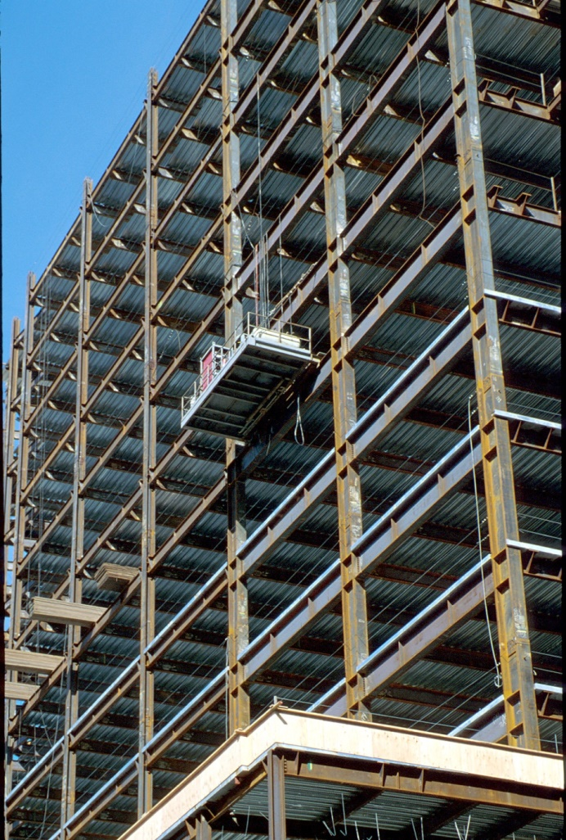
Design of Seismic-Resistant Steel Building Structures
1. Introduction and
Basic Principles
Prepared by:
Michael D. Engelhardt, PhD
University of Texas at Austin
Updated by:
Patricia Clayton, PhD
University of Texas at Austin
with the support of the
American Institute of Steel Construction
Version 2 – June 2020
Version 1 – March 2007
Notes:
This series of PowerPoint presentations covers the fundamentals of the design of seismic-resistant steel building structures. The primary focus of the material is on ductile detailing of steel structures for seismic resistance, rather than on calculation of lateral forces, dynamic analysis, or other general topics on earthquake engineering. The material is intended primarily for use at the graduate level, although many portions of the presentations are appropriate for undergraduates.
The presentations are closely tied to the 2016 AISC Seismic Provisions for Structural Steel Buildings (referred to herein as the AISC Seismic Provisions). The presentations discuss basic principles of the behavior of seismic response of steel structures, and show how these principles are treated in the AISC Seismic Provisions. The presentations are most effective if the students have a copy of the AISC Seismic Provisions. A free copy can be downloaded from the AISC website, at: www.aisc.org.
For basic steel design topics, the presentation refers to the 2016 AISC Specification for Structural Steel Buildings (herein referred to as the AISC Specification). Both the 2016 AISC Seismic Provisions and AISC Specification are written in the combined LRFD - ASD format. These PowerPoint presentations, however, present only the LRFD format. For seismic-resistant design, the LRFD format is preferable, in that it more closely follows the element capacity concepts used seismic design.
For code related seismic-design topics not covered in the AISC Seismic Provisions (seismic design categories, R-factors, seismic overstrength factors, etc.), the presentations refer to ASCE 7-16 (with Supplement 1) - Minimum Design Loads for Buildings and Other Structures.
For questions, comments, corrections, or suggestions on these presentations, please contact:
AISC University Programs
Email: universityprograms@aisc.org
Acknowledgments:
These presentations were prepared by Michael D. Engelhardt (University of Texas at Austin) with support from the AISC Educator Career Enhancement Award. The author also gratefully acknowledges contributions and review provided by the AISC Task Group for this project:
Mark Bowman - Purdue University
Steve Mahin - University of California at Berkeley
Brett Manning - PMB 200
Carol Pivonka - AISC
Larry Reaveley - University of Utah
Rafael Sabelli - Dasse Design, San Francisco
Tom Sabol - Englekirk & Sabol Consulting Engineers, Los Angeles
Chia-Ming Uang - University of California at San Diego
The module on Special Plate Shear Walls was prepared by Rafael Sabelli - Dasse Design, San Francisco. The contributions of Prof. Sharon Wood of the University of Texas at Austin to Module 1 are also gratefully acknowledged.
Version 2 (Updates to 2016 AISC Seismic Design Provisions):
Patricia Clayton – University of Texas at Austin
Larry Fahnestock – University of Illinois at Urbana-Champaign
Matthew Eatherton – Virginia Tech
Paul Richards – DuraFuse Frames

Slide 2
Design of Seismic-Resistant
Steel Building Structures
Introduction and Basic Principles
Moment Resisting Frames
Concentrically Braced Frames
Eccentrically Braced Frames
Buckling-Restrained Braced Frames
Special Plate Shear Walls
Notes:
This PowerPoint series is dividing into 6 modules. This is the first module on: "Introduction and Basic Principles."

Slide 3
1 - Introduction and Basic Principles
Performance of Steel Buildings in Past Earthquakes
Codes for Seismic Resistant Steel Buildings
Building Code Philosophy and Approach
Overview of AISC Seismic Provisions
AISC Seismic Provisions - General Requirements Applicable to All Steel Systems
Notes:
These are the major topic areas to be covered in the first module.

Slide 4
1 - Introduction and Basic Principles
Performance of Steel Buildings in Past Earthquakes
Codes for Seismic Resistant Steel Buildings
Building Code Philosophy and Approach
Overview of AISC Seismic Provisions
AISC Seismic Provisions - General Requirements Applicable to All Steel Systems
Notes:
The next section of this module will briefly examine the performance of steel buildings in past earthquakes.

Slide 5
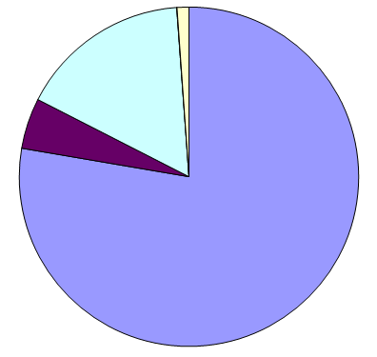
Missing
Tsunami
Landslides
Shaking
(partial or total building collapse)
Earthquake Fatalities: 1968 - 2008
1,442,342 Fatalities
(Marano et al., 2010)
Earthquake Fatalities: 1950 - 1990
583,000 Fatalities
(Coburn et al., 1992)
Causes of Earthquake Fatalities
Notes:
Performance of Steel Buildings in Past Earthquakes:
When considering the performance of steel buildings in past earthquakes, it is instructive to first look at what causes fatalities in earthquakes. This slide shows an analysis of the cause of fatalities in earthquakes in the latter half of the 20th century, and into the 21st century.
The figure on the left shows the proportions of earthquake fatalities from 1968-2008 broken down by primary causes due to shaking (e.g., partial or total building collapse) and other secondary causes.
Some observations:
The primary cause of earthquake fatalities (78%) is collapse or partial collapse of buildings. Consequently, Structural Engineers play a leading role in preventing earthquake fatalities.
Other causes of fatalities include landslides (5%), tsunamis (16%), other causes (0.03%), and those listed as missing or presumed dead (1%). Note that of the 238,385 tsunami deaths in this dataset, 227,000 (95%) were from the December 26, 2004 Great Sumatra–Andaman Islands earthquake and tsunami.
The figure on the right shows a different dataset from fatalities from 1950 to 1990, where the deaths due to shaking are broken down into different types of structural systems, such as reinforced concrete (RC) buildings, masonry buildings, and timber buildings.
Some observations:
- Among building collapses, the primary cause of fatalities is collapse of masonry buildings. These are primarily unreinforced masonry or non-engineered masonry buildings (adobe, etc.).
- When reinforced concrete and reinforced masonry structures are designed and detailed for seismic resistance per current building codes, their performance in earthquakes is very good. The data in these slides reflects masonry and RC buildings that are not well engineered for seismic resistance.
- Steel structures have historically performed well in earthquakes, and little loss of life can be attributed to collapse of steel buildings in earthquakes. This good track record can likely be attributed to several causes:
a. Steel structures are generally lighter than masonry or RC. Lower weight translates to lower seismic forces.
b. Steel structures typically show good ductility, even when they are not specifically designed or detailed for seismic resistance.
c. Many of the highly destructive earthquakes around the world have occurred in areas where there are very few steel structures. Thus, the exposure of steel structures to strong earthquakes has been perhaps somewhat less than other types of construction.
Despite showing overall good performance in past earthquakes, modern welded steel buildings have shown an increasing number of problems in recent earthquakes. The next few slides illustrate some examples.
References:
Marano, K.D., Wald, D.J., and Allen, T.I., (2010) “Global earthquake casualties due to secondary effects: a quantitative analysis for improving rapid loss analyses,” Natural Hazards, 52:319-328. DOI: 10.1007/s11069-009-9372-5.
Coburn, A.W., Spence, R.J.S. and Pomonis, A., "Factors Determining Human Casualty Levels in Earthquakes: Mortality Prediction in Building Collapse," Proceedings of the 10th World Conference on Earthquake Engineering, Madrid, Spain, 1992

Slide 6
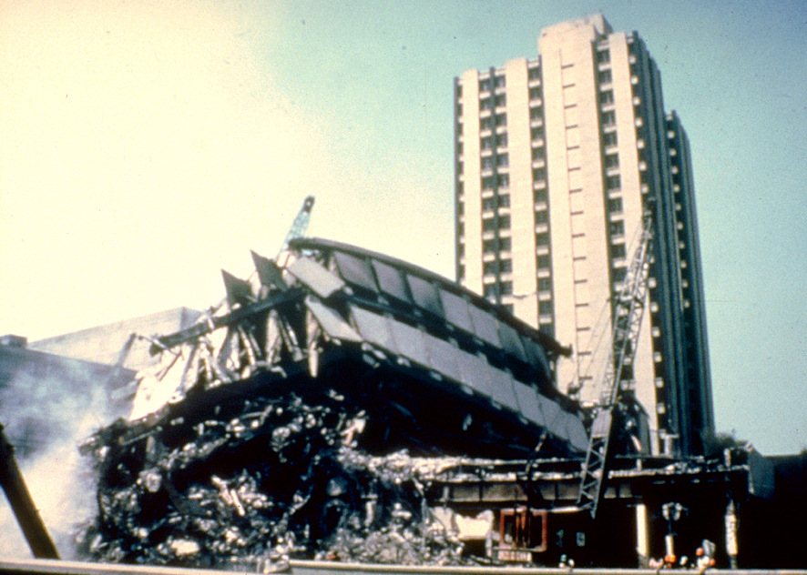
Notes:
1985 Mexico City Earthquake.
The Pino Suarez Complex in Mexico City consisted of 5 steel buildings: three 21-story buildings and two 14-story buildings. One of the 21-story steel buildings completed collapsed on the adjacent 14-story building.
This case illustrates that modern steel buildings are not invulnerable to collapse in earthquakes.
Photo source:
National Geophysical Data Center - Hazard Slides http://www.ngdc.noaa.gov/seg/hazard/slideset/
Original photo credit: E.V. Leyendecker, National Bureau of Standards

Slide 7
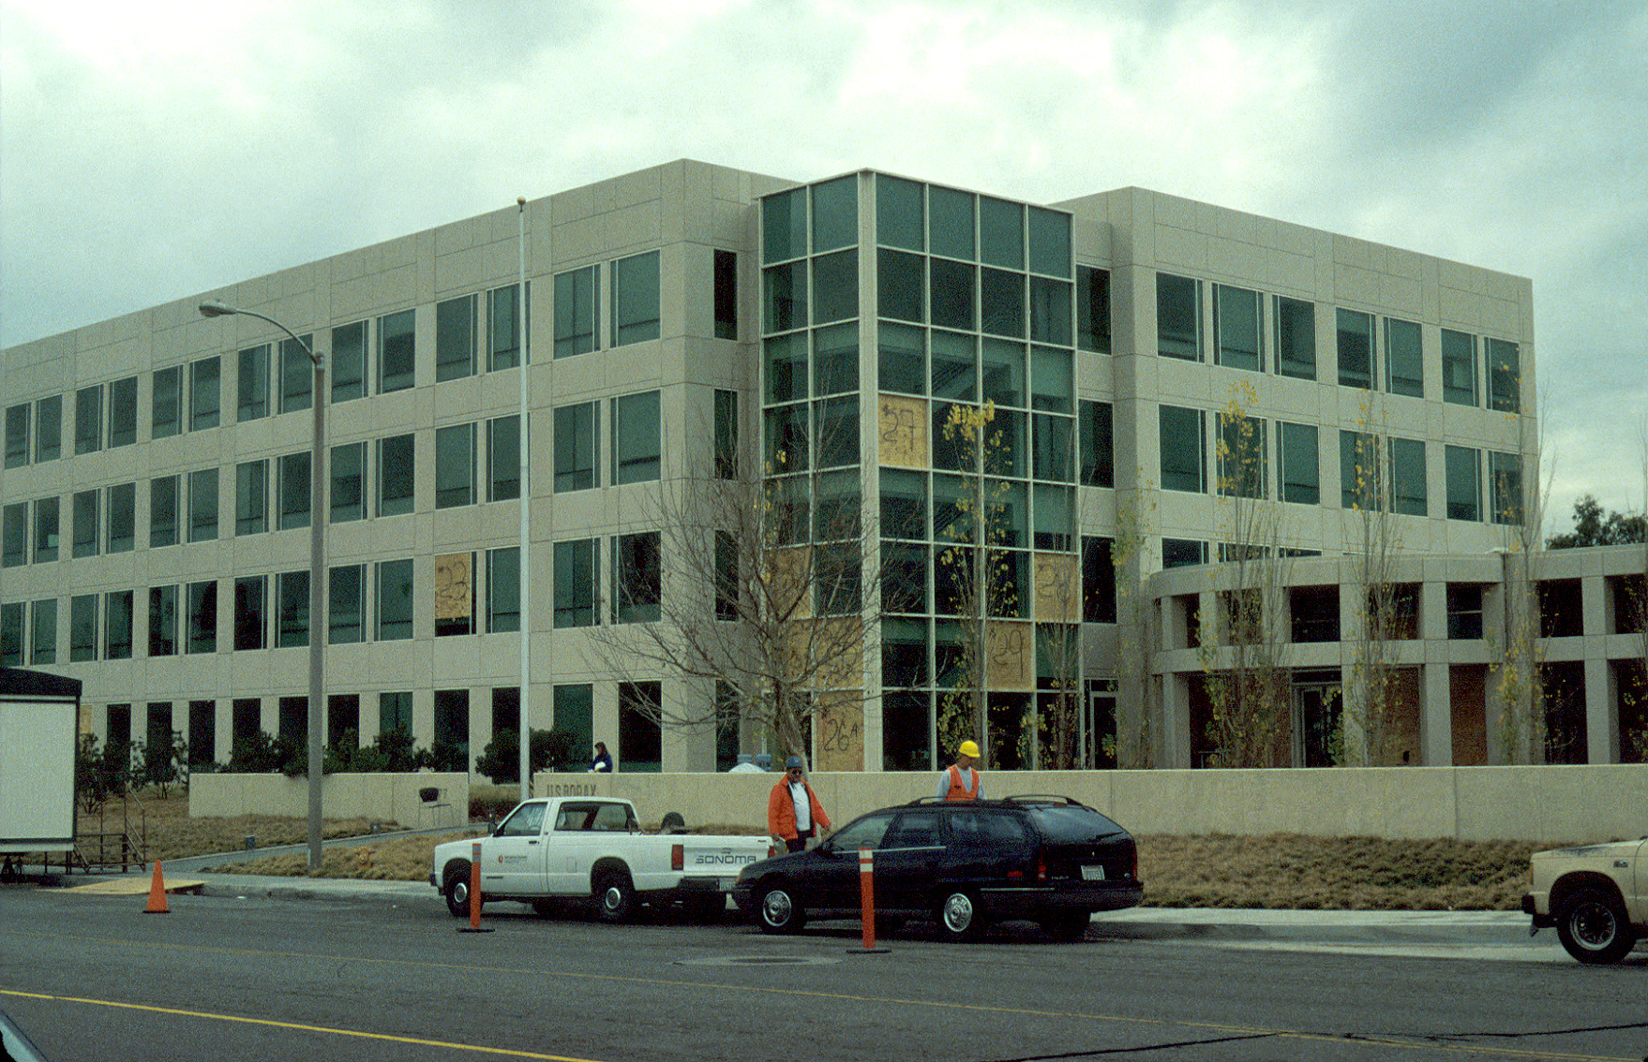
Notes:
1994 Northridge Earthquake.
The January 17, 1994 earthquake caused widespread damage to steel moment frame structures in the Los Angeles area. While no steel buildings collapsed, many modern steel buildings exhibited unexpected damage. The unexpected damage was the widespread occurrence of fractures at moment-resisting beam-to-column connections.
The design intent for a seismic-resistant steel moment frame is that in the event of a strong earthquake, ductile flexural yielding develop at the beam ends without the occurrence of fracture at the connections. The fractures observed after the Northridge Earthquake was clearly contrary to the design intent of a ductile moment frame.
Shown above is a four-story steel office building that was constructed shortly before the Northridge Earthquake. Although there was little damage apparent from the outside, the majority of beam-to-column moment connections in this building experienced fracture.
Photo by M.D. Engelhardt

Slide 8
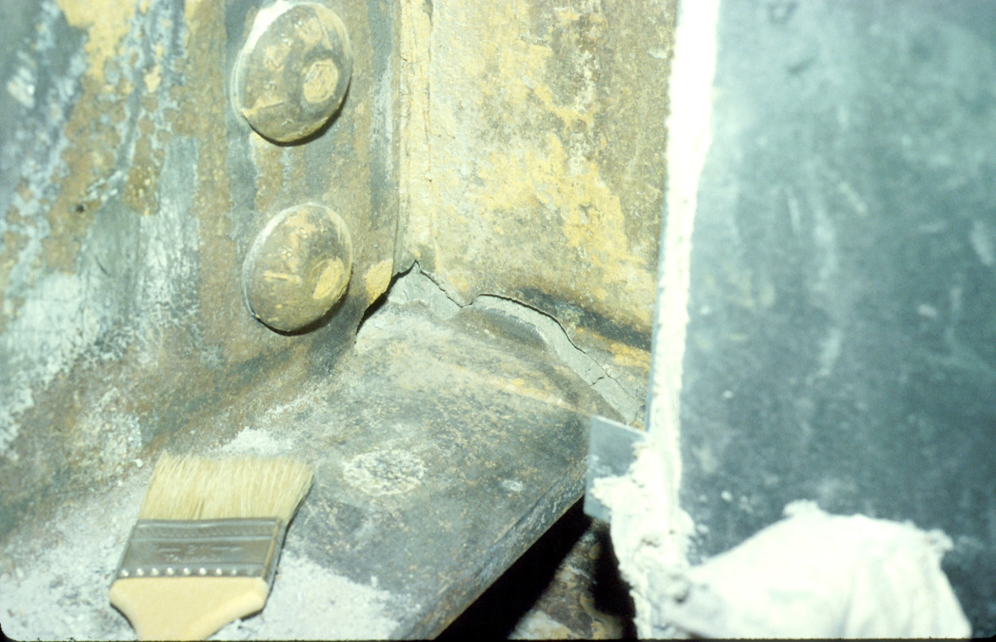
Notes:
1994 Northridge Earthquake
Typical example of a fracture at a moment connection. The paint brush is sitting on top of the bottom flange of a moment frame beam. The fracture is in the area of the groove weld that connects the beam bottom flange to the column flange.
Photo by: M.D. Engelhardt

Slide 9
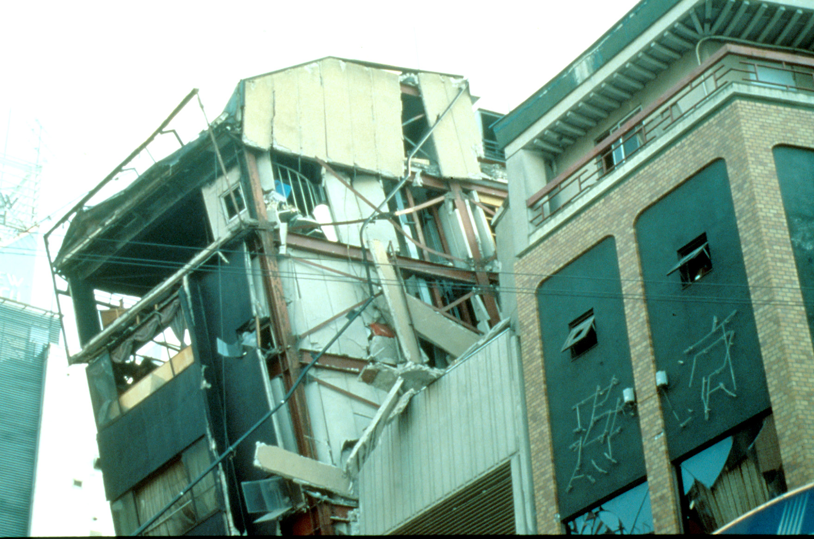
Notes:
1995 Hyogoken-Nanbu (Kobe) Earthquake.
The January 17, 1995 Hyogoken-Nanbu Earthquake caused large loss of life (about 6000 fatalities) and extensive damage and collapse of many engineered structures.
Many steel buildings were heavily damaged in this earthquake, and approximately 90 steel buildings collapsed. This slide shows a heavily damage steel building.
The steel buildings that were most heavily damaged and those that collapsed were constructed before Japan's current seismic design code was adopted in 1981. Modern steel buildings constructed after 1981 showed much better performance (showing that buildings codes can make an important difference).
Nonetheless, even very modern steel buildings showed unexpected damage in the 1995 Hyogoken-Nanbu. This included the discovery of fractures at welded beam-to-column connections in moment frames, similar to the US experience in the 1994 Northridge Earthquake.
References:
Nakashima, M., Inoue, K., and Tada, M., "Classification of Damage to Steel Buildings Observed in the 1995 Hyogoken-Nanbu Earthquake," Engineering Structures , Vol 20, No 4-6, Apr-June 1998, p 271-281
"Reconnaissance Report on Damage to Steel Building Structures Observed from the 1995 Hyogoken-Nanbu (Hanshin/Awaji) Earthquake," by the Steel Committee of the Kinki Branch, Architectural Institute of Japan (AIJ), May 1995.
"Preliminary Reconnaissance Report of the 1995 Hyogoken-Nanbu Earthquake - English Edition," Architectural Institute of Japan, April 1995.
"A Survey Report for Building Damages Due to the 1995 Hyogoken Nanbu Earthquake," Published by the Building Research Institute, Ministry of Construction, Japan, March 1996.
Photo credit: "A Survey Report for Building Damages Due to the 1995 Hyogoken Nanbu Earthquake," Published by the Building Research Institute, Ministry of Construction, Japan, March 1996.

Slide 10
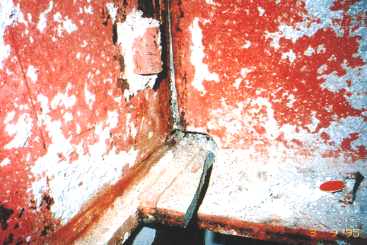
Notes:
1995 Hyogoken-Nanbu (Kobe) Earthquake.
Fracture at welded beam-to-column connection in steel moment frame.
Photo credit: "Reconnaissance Report on Damage to Steel Building Structures Observed from the 1995 Hyogoken-Nanbu (Hanshin/Awaji) Earthquake," by the Steel Committee of the Kinki Branch, Architectural Institute of Japan (AIJ), May 1995.

Slide 11
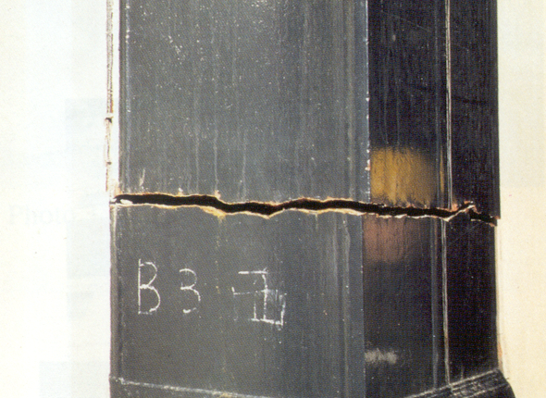
Notes:
1995 Hyogoken-Nanbu (Kobe) Earthquake.
Fracture of steel box column in modern steel high rise building.
Photo credit: "Preliminary Reconnaissance Report of the 1995 Hyogoken-Nanbu Earthquake - English Edition," Architectural Institute of Japan, April 1995.
While the performance of steel buildings in earthquakes has historically been quite good, recent earthquakes (1985 Mexico City; 1994 Northridge; 1995 Hyogoken-Nanbu) have exposed problems with modern welded steel structures, particularly in regard to our understanding of fracture phenomena.
Further, it is clear that care in the design, detailing, and construction of steel structures is needed to assure satisfactory performance in strong earthquakes. This has led to the development of building code regulations that specifically address seismic detailing of steel building structures. The development of seismic detailing regulations in the US is discussed next.

Slide 12
1 - Introduction and Basic Principles
Performance of Steel Buildings in Past Earthquakes
Codes for Seismic Resistant Steel Buildings
Building Code Philosophy and Approach
Overview of AISC Seismic Provisions
AISC Seismic Provisions - General Requirements Applicable to All Steel Systems
Notes:
The next slide will discuss the historical development building code provisions in the US for seismic detailing of steel building structures.

Slide 13
US Seismic Code Provisions for Steel
Structural Engineers Association of California (SEAOC)
Blue Book – 1988
  First comprehensive detailing provisions for steel
American Institute of Steel Construction (AISC) Seismic Provisions
1st ed. 1990
2nd ed. 1992
3rd ed. 1997
  Supplement No. 1: February 1999
  Supplement No. 2: November 2000
4th ed. 2002
5th ed. 2005
6th ed. 2010
7th ed. 2016
Notes:
This slide shows the development of building code provisions for seismic detailing of steel building structures.
Prior to 1988, there was very little in US building codes that covered seismic detailing requirements for steel building structures. (Note that seismic lateral force provisions for buildings have been in codes for a long time. However, specific design and detailing provisions for steel buildings are very recent.)
The first set of comprehensive seismic detailing requirements for steel buildings were developed by SEAOC (Structural Engineers Association of California) and were published in the 1988 edition of the SEAOC "Recommended Lateral Force Requirements and Commentary" (commonly known as the "Blue Book"). The steel seismic detailing requirements of the 1988 Blue Book were then adopted by the 1988 Uniform Building Code, and subsequently by other model building codes in the US.
After release of the 1988 SEAOC Blue Book, the responsibility for maintaining and updating seismic detailing requirements for steel building structures was taken over by AISC.
AISC subsequently created the "Seismic Provisions for Structural Steel Buildings." (hereafter referred to as the AISC Seismic Provisions).
The first edition of the AISC Seismic Provisions were released in 1990. This first edition was very similar to the 1988 Blue Book steel detailing provisions. The AISC Seismic Provisions were written in LRFD format (whereas the Blue Book was largely based on ASD).
A second edition of the AISC Seismic Provisions were released in 1992, with only minor changes from the 1990 edition.
Next came the 1994 Northridge and 1995 Hyogoken-Nanbu Earthquakes. Modern steel buildings showed extensive damage in both earthquakes, particularly in regard to fracture at welded beam-to-column connections. This damage motivated the development of intensive research efforts in the US, Japan and many other countries to understand the causes of this damage, and to develop the needed improvements in design and construction practices to prevent such damage in future earthquakes.
The research following the Northridge and Hyogoken-Nanbu Earthquakes led to a greater understanding of the performance of steel structures in strong earthquakes, and indicated the need for major changes to the AISC Seismic Provisions.
The 3rd edition of the AISC Seismic Provisions (released in 1997) began to incorporate many of the lessons learned from Northridge and Kobe. The rapid pace of research and learning also led to the need for frequent updates to the Seismic Provisions. Consequently, two supplements (February 1999 and November 2000) were issued for the 3rd Edition of the Seismic Provisions, in order to rapidly adopt new research findings.
The AISC Seismic Provisions continue to be updated, with the 4th Edition released in 2002, the 5th Edition in 2005, and the 6th Edition in 2010.
The 7th Edition (2016) is the most current version of the AISC Seismic Provisions.

Slide 14
1 - Introduction and Basic Principles
Performance of Steel Buildings in Past Earthquakes
Codes for Seismic Resistant Steel Buildings
Building Code Philosophy and Approach
Overview of AISC Seismic Provisions
AISC Seismic Provisions - General Requirements Applicable to All Steel Systems
Notes:
The next slide will discuss the historical development building code provisions in the US for seismic detailing of steel building structures.

Slide 15
Conventional Building Code Philosophy for Earthquake-Resistant Design
Objective:
Prevent collapse in the extreme earthquake likely to occur at a building site.
Objectives are not to:
    limit damage
    maintain function
    provide for easy repair
Notes:
Before going further, it is instructive to review the basic philosophy of building codes for seismic design of ordinary structures. The basic intent is to prevent collapse of a structure in the event of an extreme earthquake, in order to prevent loss of life.
More specifically, the performance goal of current codes for most ordinary structures is to produce an acceptably low likelihood of collapse in the risk-adjusted maximum considered earthquake (MCE_{R}), which is based on the maximum considered earthquake (MCE). In most of the western US, the MCE is based on the largest earthquake that can be generated by known faults. In the rest of the US, the MCE is defined as an earthquake with a 2-percent probability of exceedance in 50 years (which translates to a recurrence interval of about 2500 years). The “risk-adjusted” MCE_{R} was introduced in building codes in 2010 to target a uniform collapse probability of 1% likelihood of collapse in 50 years. The MCE_{R} ground shaking values used in modern building codes are similar to the MCE shaking levels previously used, with some minor reduction in the central and eastern US, and some slight increases in the western US.
More information on the risk-adjusted MCE values used in design can be found in:
Luco, N., Ellingwood, B.R., Hamburger, R.O., Hooper, J.H., Kimball, J.K., Kircher, C.A. (2007) “Risk-targeted versus Current Seismic Design Maps for the Conterminous United States,” Structural Engineers Association of California (SEAOC) 2007 Convention Proceedings.
In the event of the MCE, the objective is to prevent collapse in order to prevent loss of life. The objectives are not to limit damage to the building, maintain the function of the building, or to provide for easy repair of the building. Thus, the primary goal is to protect lives, not property.
If a code-compliant building sees a very strong earthquake, one would expect substantial and costly damage to the structure. If a higher level of performance is desired, then it is necessary to go beyond a basic code design.
A useful analogy is as follows......
We design buildings for extreme (but rare) events like strong earthquakes like a car manufactures designs a vehicle for an extreme event like a head-on collision. In the event of a major collision, the design goal is to protect the occupants of the car; not to protect the car itself. In fact, for a major collision, the car is used in a sacrificial manner to absorb the energy of the impact, thereby protecting the occupants. In a similar way, in the event of a major earthquake, a building is used in a sacrificial manner to absorb the energy of the earthquake, in order to prevent collapse and protect the occupants.
If we designed cars to withstand a head-on collision without damage to the car, probably most of us could not afford to buy a car. Similarly, if we designed buildings to withstand an extreme earthquake without damage, we couldn't afford to construct most buildings.
Additional comment.....
This slide discusses building code philosophy for seismic resistant design from a highly simplified perspective. A more comprehensive view of seismic design philosophy is considered under the broad field of "performance-based" earthquake engineering. See, for example:
"Vision 2000 - Performance Based Seismic Engineering of Buildings," Final Report, Structural Engineers Association of California, April 3, 2005.
“FEMA P-58: Seismic Performance Assessment of Buildings,” Federal Emergency Management Agency (FEMA), December 2018.

Slide 16
To Survive Strong Earthquake
without Collapse:
Design for Ductile Behavior
Notes:
In order to economically design a building to withstand a very strong earthquake, the key is not provide to a building with high strength, but rather to provide a building with high ductility.
Ductility is the key to building survival in strong earthquakes. The key objective of the AISC Seismic Provisions is to provide steel building structures with high ductility.

Slide 17
H
Ductility = Inelastic Deformation
H
Notes:
This slide reviews the basic concept of ductility.
Ductility is the ability of a structure (or element of a structure) to withstand large inelastic deformations without significant loss of strength.
Ductility = inelastic deformation capacity

Slide 18
H
H
Δ_{yield}
Δ_{failure}
Δ_{failure}
Ductility Factor μ =
Δ_{yield}
Notes:
For a simple, elastic - perfectly plastic structure subject to monotonic loading, ductility can be quantified using the ductility factor, μ. In the definition of μ, Δ_{yield} is the displacement when the structure yields (i.e. when the structure has reached its plastic lateral capacity), and Δ_{failure} is the displacement at which the structures begins to lose lateral load carrying capacity.

Slide 19
H
H
H_{elastic}
3/4 *H_{elastic}
1/2 *H_{elastic}
Strength
Req’d Ductility
1/4 *H_{elastic}
MAX
Notes:
A basic concept of seismic-resistant design is the trade-off between strength and ductility. This concept is illustrated (in a highly simplified manner) by this slide.
The plot shows the relationship between lateral force and lateral displacement for a simple single-degree-of-freedom structure, with an elastic-perfectly plastic response. The plot can be viewed as the force-displacement response of the structure for a half-cycle of loading during an earthquake.
The solid line represents the response of a structure that remains elastic during the earthquake. The maximum lateral force experienced by the elastic structure is H_{elastic} and the maximum displacement experienced by the structure is Δ_{max.} Thus, if we wanted the structure to remain elastic during the earthquake, we would need to design our structure to remain elastic under a lateral load equal to H_{elastic}.
Say we designed the structure to have a lateral strength of only 3/4*H_{elastic}. If the structure sees the same earthquake as above (which will generate a force of H_{elastic} in an elastic structure), the structure will yield when the lateral force reaches 3/4*H_{elastic}. At this point, the lateral force on the structure can no longer increase. Rather, the effect of the earthquake on the structure beyond this point will be to impose inelastic displacement. That is, the earthquake will demand ductility of the structure rather than strength. The earthquake will continue to deform the structure in the inelastic range until the total displacement is about the same as for the elastic structure. Thus, a structure with a lateral strength less than H_{elastic} can still survive the earthquake, as long as the structure can supply the needed inelastic deformation. i.e., can supply the needed ductility.
Similarly, we can design our structure with even lower levels of lateral strength, say 1/2 or 1/4 of the lateral force that an elastic structure would see. In each case, when the lateral strength of the structure ( 1/2*H_{elastic} or 1/4*H_{elastic} ) is reached, the structure will be incapable of resisting any additional lateral force. As before, the effect of the earthquake beyond this point will be to impose additional displacement upon the structure, rather than additional force. In each case, the maximum displacement will be about same as for the structure that remains elastic. That is, regardless of the structure's lateral strength, Δ_{max} will be approximately the same.
Some observations on seismic response......
A structure can be designed with a lateral strength significantly less than that which will be seen by an elastic structure in an earthquake. However, to survive the earthquake without collapse, the structure must supply ductility. In the plot, ductility (inelastic deformation capacity) is represented by the horizontal dotted lines).
As illustrated by the plot, the lower the lateral strength of the structure, the greater will be the required ductility. Thus, in seismic design, we can trade strength for ductility. We can give our structure a high lateral strength, in which case we need to provide little ductility. Alternatively, we can give our structure very low lateral strength (by designing for very low lateral forces), but then we must detail our structure to supply high levels of ductility. Building codes permit us (within a limited extent) to make this trade off between strength and ductility.
Ductility means damage. That is, when we use ductility to survive an earthquake, we have to expect damage.
For a structure that is designed to yield in an earthquake (the usual case), the maximum lateral force that the structure will see during the earthquake is defined by the structure's own lateral strength.
Code specified seismic lateral forces are generally much smaller than would be required for the structure to remain elastic. That is, they are usually much less than H_{elastic}. Thus, a typical code based design uses ductility to survive an earthquake. In this sense, the code specified seismic lateral forces do not represent the actual lateral force that an earthquake would generate in an elastic structure. Thus, in cases where code specified wind forces are greater than code specified earthquake forces, it is still necessary to provide ductility. Even though the lateral strength of the structure will be larger as a result of the fact that "wind controls," the resulting lateral strength of the structure is still likely well below H_{elastic}, and therefore ductility will be needed. Thus, even when code specified wind forces are larger than code specified earthquake forces, ductile detailing requirements in building codes must still be satisfied.
Note: The concept that Δ_{max} remains the same, regardless of the lateral strength of the structure, and regardless of whether the structure responds elastically or inelastically, is a simplification. It is a useful simplification to understand the basic concept of trading strength for ductility in seismic design.
More extensive discussions of the relationship between strength and ductility demand can be found in the literature. A useful reference is: "The Seismic Design Handbook," Edited by Farzad Naeim, 2nd Edition, Kluwer Academic Publishers, 2001.

Slide 20
Ductility in Steel Structures: Yielding
Nonductile Failure Modes: Fracture or Instability
H
Ductility = Yielding
Failure =
Fracture
or
Instability
Notes:
As discussed in the previous slides, detailing structures to supply ductility is a basic objective in seismic resistant design.
In the case of steel structures, ductility is usually achieved by yielding of selected elements of the frame. Yielding of steel is a ductile phenomenon. That is, when steel yields, it can maintain it's yield strength through large inelastic deformations.
Thus, to obtain a ductile global response of a steel structure (i.e. to make the plateau in the load-deflection curve above as long as possible), we want to obtain as much yielding as possible, before non-ductile limit states occur.
For steel structures, non-ductile limits states are associated with fracture or instability. These are the limit states that will cause a steel element or structure to lose load carrying capacity.
Note that yielding will not cause a steel structure to collapse. Yielding will only cause a plateau in the load-deformation curve. For the load capacity to decline, fracture or instability must occur.
Thus, a goal in seismic resistant design is to permit as much yielding to occur in the frame as possible, while preventing or delaying fracture or instability limit states until sufficient ductility is achieved.

Slide 21
Developing Ductile Behavior
Choose frame elements (“fuses”) that will yield in an earthquake (e.g. beams in moment resisting frames, braces in concentrically braced frames, links in eccentrically braced frames, etc.)
Detail "fuses" to sustain large inelastic deformations prior to the onset of fracture or instability (i.e. detail fuses for ductility).
Design all other frame elements to be stronger than the fuses, (i.e. design all other frame elements to develop the plastic capacity of the fuses).
Notes:
Ductile response of a steel frame is achieved by yielding of steel. Nonductile response of steel systems is the result of fracture or instability. Consequently, a key design objective is to maximize the yielding of steel frame elements, while at the same time delaying the onset of fracture or instability until large inelastic deformations are achieved. To achieve this objective, it is first necessary to choose the frame locations where yielding is intended to occur, i.e., the locations of plastic hinges. This is typically the beam ends in moment resisting frames, links in eccentrically braced frames, and the braces in braced frames.
It is possible to control the location of yielding in a steel frame by assuring that the element where the yielding is intended to occur is the weakest element in the frame. Conversely, this can be achieved by assuring that all other frame elements (i.e. elements where inelastic action should not occur) are stronger, through the application of capacity design concepts. With this approach, the element in which yielding is intended to occur is designed based on code specified lateral forces. All other frame elements are then designed to develop the capacity of the yielding element. For example, in a steel moment frame, the beams are typically the frame element intended to yield during an earthquake. Thus, the beams are sized based on code level forces. However, the beam-to-column connections and the columns are designed for the maximum forces that can be generated by the fully yielded and strain hardened beams. That is, the beam-to-column connections and the columns are designed to develop the capacity of the beams. This design approach assures that the desired mechanism, i.e., a mechanism with yielding in the beams, will actually form.
The concept of capacity design can also be understood through an analogy to electrical wiring in a building. Electrical wiring is protected by a fuse, so that in case of an electrical overload, the fuse burns out before the wiring is damaged, thereby protecting the wiring. This protection can only be achieved if the fuse is weaker than the wiring. In a seismic-resistant steel frame, the plastic hinge locations serve as a fuse to protect against overload. In an earthquake, the plastic hinge “fuses” (beams in moment frames, links in EBFs, etc.) limit the forces that can be transferred to the remainder of the frame, thereby protecting the remainder of the frame. However, this can only be achieved if the plastic hinge locations are the weakest elements of the frame, to assure ductile yielding occurs in the beam ends, before say fracture of a connection or buckling of a column.
The fundamental goal of the designer is to understand and control the inelastic response of a steel frame, to permit the development of a plastic mechanism under lateral load that is capable of sustaining large inelastic deformations, i.e., possessing large ductility. Effective seismic-resistant design requires an understanding of inelastic frame behavior. To this end, an understanding of classical methods of plastic analysis and design is highly beneficial.

Slide 22
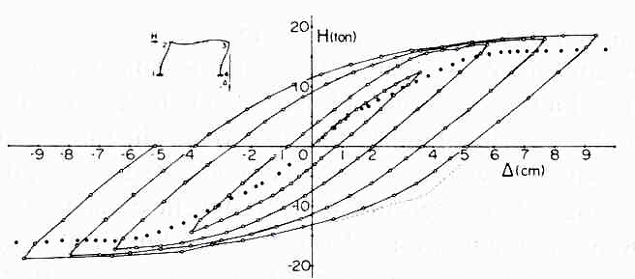
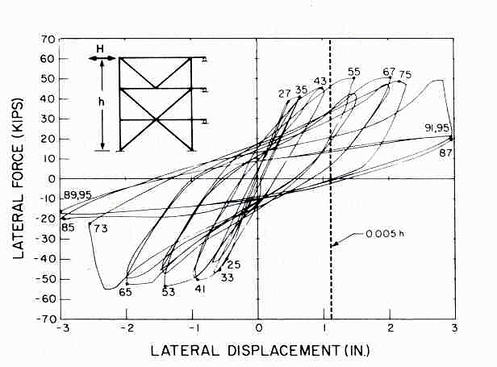
(a)
(b)
Examples of:
  More Ductile Behavior
  Less Ductile Behavior
Notes:
The degree to which lateral design forces can be reduced (from the level required to remain elastic) depends on the ductility of the structure. As described earlier, for a simple elastic perfectly plastic structure, ductility can be characterized by the ductility factor μ. The response of real steel frames under cyclic lateral load is more complex than an elastic perfectly plastic system. Consequently, it is more difficult to quantify the ductility of real frames.
The difficulty in quantifying ductility is illustrated by the experimental lateral load versus lateral deflection plots for a concentrically braced frame (on the right) and a moment resisting frame (on the left). It is difficult to quantify the ductility of these frames using a simple parameter such as ductility factor. Thus, we often treat ductility in a qualitative and comparative manner. For example, the moment frame is considered to be "more ductile" than the braced frame, due to its fuller "hysteretic loops." The braced frame exhibits deterioration in strength and stiffness, and shows "pinching" in the hysteretic loops (indicating less energy dissipation).

Slide 23
Key Elements of Seismic-Resistant Design
Required Lateral Strength
ASCE-7:
Minimum Design Loads for Buildings
and Other Structures
Detailing for Ductility
AISC:
Seismic Provisions for Structural Steel Buildings
Notes:
As described in the previous slides, in seismic resistant design, we trade strength for ductility. Consequently, the lateral strength of a frame (as determined by the design lateral forces), must be consistent with the ductility provided in the frame. Higher lateral strength means we need less ductility; and conversely, lower lateral strength means we need to provide more ductility.
In US building standards, one set of documents specify the design lateral forces, while another set specify ductile detailing requirements.
Design seismic lateral forces are specified in ASCE 7 (Minimum Design Loads for Buildings and Other Structures). The design seismic lateral forces in ASCE 7 are typically adopted by building codes, such as the IBC (International Building Code).
Note that the source document for the design seismic lateral forces in ASCE 7 are the NEHRP Provisions. (National Earthquake Hazard Reduction Program - Recommended Provisions for Seismic Regulations for New Buildings and Other Structures). The NEHRP Provisions have an extensive commentary on the background to the development of seismic lateral force requirements, and are very useful in understanding the seismic requirements in ASCE 7.
Whereas ASCE 7 specifies design seismic lateral loads, materials organizations (AISC, ACI, Masonry Society, etc) prepare detailing requirements that are intended to provide structures with a level of ductility consistent with the lateral forces specified in ASCE 7.
In the case of steel building structures, AISC prepares the ductile detailing requirements. These ductile detailing requirements are what is found in the AISC Seismic Provisions. Note that the AISC Seismic Provisions only contains rules for how to achieve ductility in steel structures. They do not specify design seismic lateral forces.
Even though different organizations prepare the standards that specify design seismic lateral forces than those that specify ductile detailing requirements, all of these standards must be coordinated. This coordination is necessary so that the level of lateral strength (established by the design seismic lateral forces) is consistent with the level of ductile detailing. That is, the trade off between strength and ductility must be coordinated by the various standards writing organizations.
The ductile detailing requirements for steel building structures found in the AISC Seismic Provisions have been developed to be consistent with the lateral forces specified in ASCE 7. Consequently, in the remainder of this presentation, all references to design lateral forces will be to ASCE 7-16.
References:
"Minimum Design Loads for Buildings and Other Structures," SEI/ASCE 7-16, American Society of Civil Engineers, Reston, Virginia, 2016.
(This document can be purchased from ASCE at www.asce.org)
"NEHRP Recommended Seismic Provisions for New Buildings and Other Structures (FEMA P-1050)", Building Seismic Safety Council, 2015.
(The NEHRP Provisions and Commentary can be downloaded for free at www.nehrp.gov)

Slide 24

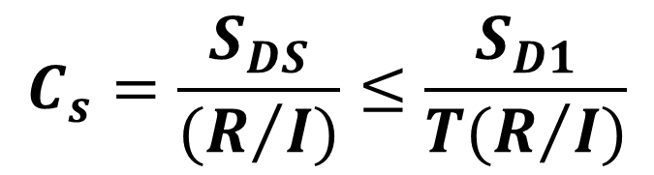
Design EQ Loads – Base Shear per ASCE 7-16
$$V= C_{s}W$$
$$C_{s}=\frac{S_{DS}}{(R/I)}≤\frac{S_{D1}}{T(R/I)}$$
for T ≤ T_{L}
Notes:
As described in the previous slides, in seismic resistant design, we trade strength for ductility. Consequently, the lateral strength of a frame (as determined by the design lateral forces), must be consistent with the ductility provided in the frame. Higher lateral strength means we need less ductility; and conversely, lower lateral strength means we need to provide more ductility.
In US building standards, one set of documents specify the design lateral forces, while another set specify ductile detailing requirements.
Design seismic lateral forces are specified in ASCE 7 (Minimum Design Loads for Buildings and Other Structures). The design seismic lateral forces in ASCE 7 are typically adopted by building codes, such as the IBC (International Building Code).
Note that the source document for the design seismic lateral forces in ASCE 7 are the NEHRP Provisions. (National Earthquake Hazard Reduction Program - Recommended Provisions for Seismic Regulations for New Buildings and Other Structures). The NEHRP Provisions have an extensive commentary on the background to the development of seismic lateral force requirements, and are very useful in understanding the seismic requirements in ASCE 7.
Whereas ASCE 7 specifies design seismic lateral loads, materials organizations (AISC, ACI, Masonry Society, etc) prepare detailing requirements that are intended to provide structures with a level of ductility consistent with the lateral forces specified in ASCE 7.
In the case of steel building structures, AISC prepares the ductile detailing requirements. These ductile detailing requirements are what is found in the AISC Seismic Provisions. Note that the AISC Seismic Provisions only contains rules for how to achieve ductility in steel structures. They do not specify design seismic lateral forces.
Even though different organizations prepare the standards that specify design seismic lateral forces than those that specify ductile detailing requirements, all of these standards must be coordinated. This coordination is necessary so that the level of lateral strength (established by the design seismic lateral forces) is consistent with the level of ductile detailing. That is, the trade off between strength and ductility must be coordinated by the various standards writing organizations.
The ductile detailing requirements for steel building structures found in the AISC Seismic Provisions have been developed to be consistent with the lateral forces specified in ASCE 7. Consequently, in the remainder of this presentation, all references to design lateral forces will be to ASCE 7-16.
References:
"Minimum Design Loads for Buildings and Other Structures," SEI/ASCE 7-16, American Society of Civil Engineers, Reston, Virginia, 2016.
(This document can be purchased from ASCE at www.asce.org)
"NEHRP Recommended Seismic Provisions for New Buildings and Other Structures (FEMA P-1050)", Building Seismic Safety Council, 2015.
(The NEHRP Provisions and Commentary can be downloaded for free at www.nehrp.gov)

Slide 25
R factors for Selected Steel Systems (ASCE 7):
SMF (Special Moment Resisting Frames): R = 8
IMF (Intermediate Moment Resisting Frames): R = 4.5
OMF (Ordinary Moment Resisting Frames): R = 3.5
EBF (Eccentrically Braced Frames): R = 8
SCBF (Special Concentrically Braced Frames): R = 6
OCBF (Ordinary Concentrically Braced Frames): R = 3.25
BRBF (Buckling Restrained Braced Frame): R = 8
SPSW (Special Plate Shear Walls): R = 7
Undetailed Steel Systems in
Seismic Design Categories A, B or C R = 3
(AISC Seismic Provisions not needed)
Notes:
R factors are given in ASCE 7. Shown in this slide are R factors for the major types of steel lateral force resisting systems. Larger R factors imply systems that can supply larger levels of ductility.
Major type of steel seismic lateral force resisting systems:
Moment Frames (Special, Intermediate, and Ordinary)
Concentrically Braced Frames (Special and Ordinary)
Eccentrically Braced Frames
Buckling Restrained Braced Frames
Special Plate Shear Walls
Where the descriptors "Special," "Intermediate," and "Ordinary" are used, these refer to different detailing options for a particular system. "Special" systems (Special Moment Frames and Special Concentrically Braced Frames) provide the highest levels of ductility, and are accordingly assigned larger R factors. They also have the most demanding ductile detailing requirements.
"Ordinary" systems (Ordinary Moment Frames and Ordinary Concentrically Braced Frames) provide lower levels of ductility and are therefore assigned lower R factors (i.e. must be designed for higher lateral forces). The "Ordinary" systems, however, have less onerous ductile detailing requirements.
"Intermediate" systems (Intermediate Moment Frames) are in between Special and Ordinary systems in terms of ductility and design lateral forces.
Eccentrically Braced Frames and Buckling Restrained Braced Frames are assigned R=8.
The system names shown in this slide (SMF, EBF, BRBF, etc.) are the manner in which the requirements of ASCE 7 are coordinated with the AISC Seismic Provisions. For example, if a designer chooses to use a Special Moment Frame as the seismic lateral force resisting system, ASCE 7 specifies the R factor and the design seismic lateral force. The designer must then go to the AISC Seismic Provisions and follow all detailing requirements for Special Moment Frames.
Not all systems shown above can be used in every case. For example, in the higher Seismic Design Categories (buildings with higher seismic risk), ASCE 7 limits the use of the lower ductility systems to buildings with specified heights limits.
For steel buildings in Seismic Design Categories A, B, or C (buildings with lower seismic risk), ASCE 7 provides designers with the option of using R=3 to compute the design seismic lateral force, but then providing no special seismic detailing. In this case, the designer must use a relatively large lateral force, but need not follow the requirements of the AISC Seismic Provisions. The structure can be designed just using the main AISC Specification.
The R=3 option is a very useful alternative in lower seismic areas. This availability of this option reflects the view that a steel structure, even without special seismic detailing, will generally exhibit some reasonable degree of ductility.

Slide 26
1 - Introduction and Basic Principles
Performance of Steel Buildings in Past Earthquakes
Codes for Seismic Resistant Steel Buildings
Building Code Philosophy and Approach
Overview of AISC Seismic Provisions
AISC Seismic Provisions - General Requirements Applicable to All Steel Systems
Notes:
The next slide will discuss the historical development building code provisions in the US for seismic detailing of steel building structures.

Slide 27
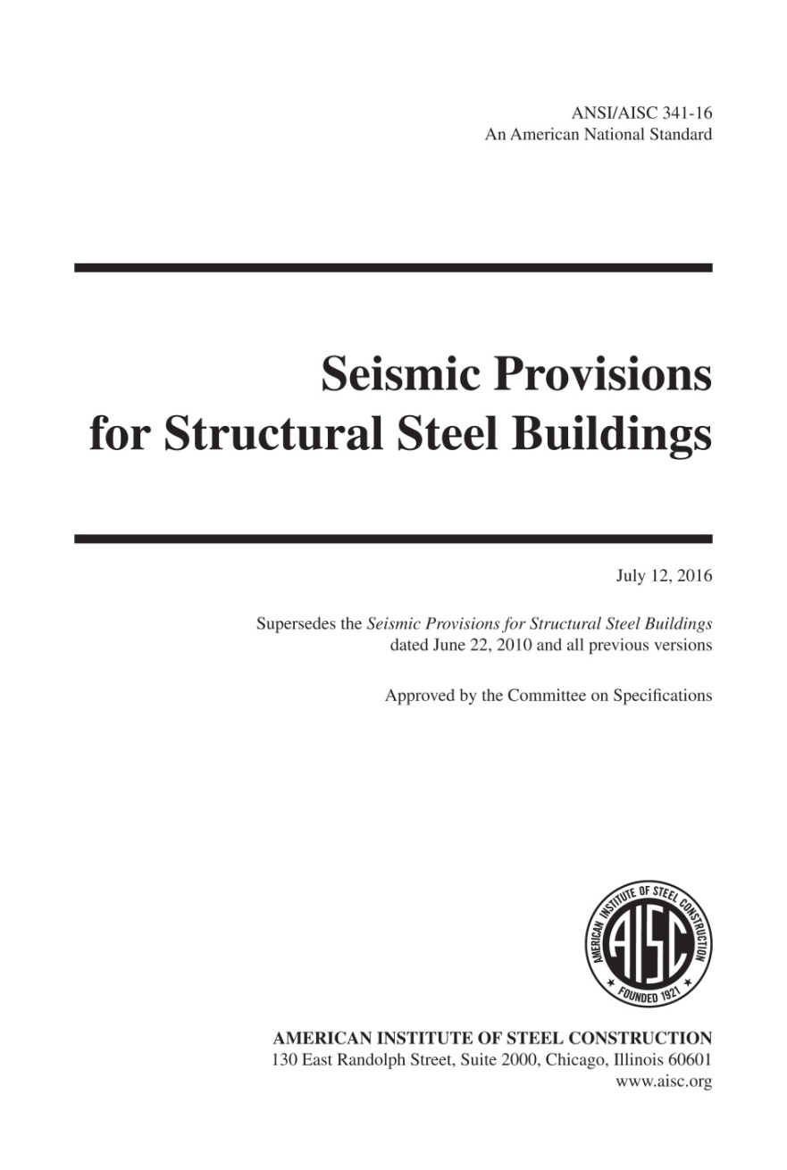
2016 AISC Seismic Provisions

Slide 28
AISC Seismic Provisions for Structural Steel Buildings
Symbols
Glossary
General Requirements
General Design Requirements
Analysis
General Member and Connection Design Requirements
Moment-Frame Systems
Braced-Frame and Shear-Wall Systems
Composite Moment-Frame Systems
Composite Braced-Frame and Shear-Wall Systems
Fabrication and Erection
Quality Control and Quality Assurance
Prequalification and Cyclic Qualification Testing Provisions
Commentary

Slide 29
1 - Introduction and Basic Principles
Performance of Steel Buildings in Past Earthquakes
Codes for Seismic Resistant Steel Buildings
Building Code Philosophy and Approach
Overview of AISC Seismic Provisions
AISC Seismic Provisions - General Requirements Applicable to All Steel Systems
Notes:
The next section of this module will briefly examine the performance of steel buildings in past earthquakes.

Slide 30
2016 AISC Seismic Provisions
General Provisions Applicable to All Systems
Highlights of Glossary
and Sections A to D
Notes:
For the remainder of Module 1, we will looks are selected highlights on the Glossary and of Sections 1 to 8. These sections are applicable to all steel seismic load resisting systems.

Slide 31
AISC Seismic Provisions
Glossary – Selected Terms
Applicable Building Code
Building code under which the structure is designed (the local building code that governs the design of the structure)
Where there is no local building code – use ASCE 7
Notes:
The glossary defines the Applicable Building Code (ABC) as the governing building code. The Seismic Provisions only cover seismic detailing for steel building structures, and must be used in conjunction with the ABC. The ABC defines items such as Seismic Use Groups, Seismic Design Categories, ground motion parameters, R-factors, height limits, etc.
In many locations in the US, the ABC will be the International Building Code (IBC). The seismic design requirements in the IBC are taken from ASCE 7.
In this presentation, the ABC will be taken as ASCE 7.

Slide 32
AISC Seismic Provisions
Glossary – Selected Terms
Seismic Force-Resisting System (SFRS)
Part of the structural system that has been considered in the design to provide the required resistance to the seismic forces prescribed in the applicable building code

Slide 33
AISC Seismic Provisions
Glossary – Selected Terms
Occupancy (ASCE 7-16)
The purpose for which a building or other structure, or part thereof, is used or intended to be used.
Risk Category (ASCE 7-16)
A categorization of buildings and other structures for determination of flood, snow, ice, and earthquake loads based on the risk associated with unacceptable performance.
Notes:
The occupancy, defined in the glossary, is established by the applicable building code. The previously used term "Seismic Use Group" was defined in ASCE 7-02, and reflected the importance of a building.
ASCE 7-16 uses Risk Categories to classify buildings (and other structures) based on the risk associated with their damage/failure by nature of their occupancy. This is illustrated in the table on the next slide.

Slide 34
Risk Categories (ASCE 7-16, Table 1.5-1)
Risk Category | Description | Seismic Importance Factor, I_{e}
IV | Essential facilities (Hospitals, fire and police stations, emergency shelters, etc) Structures containing extremely hazardous materials | 1.5
III | Structures that pose a substantial hazard to human life in the event of failure (buildings with 300 people in one area, day care facilities with capacity more than 150, schools with a capacity more than 250, etc) | 1.25
II | Buildings not in Occupancy Categories I, III, or IV (most buildings) | 1.0
I | Buildings that represent a low hazard to human life in the event of failure (agricultural facilities, temporary facilities, minor storage facilities) | 1.0
Notes:
These are the Risk Categories defined by ASCE 7. Note that most structures would be Risk Category II.

Slide 35
AISC Seismic Provisions
Glossary – Selected Terms
Seismic Design Category (SDC)
Classification assigned to a structure based on its Risk Category and the severity of the design earthquake ground motion at the site
SDCs: A
B
C
D
E
F
Increasing seismic risk
- and -
Increasingly stringent seismic design and detailing requirements
Notes:
The Seismic Design Category (SDC), defined in the glossary, is also established by the applicable building code.

Slide 36
To Determine the Seismic Design Category (ASCE 7-16)
Determine Risk Category
Determine S_{S} and S₁
S_{S} = spectral response acceleration for MCE_{R} at short periods
S₁ = spectral response acceleration for MCE_{R} at 1-sec period
S_{s} and S₁ are read from maps (or from USGS website)
Determine Site Class
Site Class depends on soils conditions - classified according to shear wave velocity, standard penetration tests, or undrained shear strength
Determine S_{MS} and S_{M1}
Spectral response accelerations for MCE_{R} adjusted for the Site Class;
S_{MS} = F_{a} S_{s} S_{M1} = F_{v} S₁
F_{a} and F_{v} depend on Site Class and on S_{s} and S₁
Determine S_{DS} and S_{D1}
Design spectral response accelerations
S_{DS} = 2/3 x S_{MS} S_{D1} = 2/3 x S_{M1}
Notes:
This slide provides a brief review of how an SDC is established for a structure.
MCE_{R} = risk-targeted maximum considered earthquake
USGS website gives S_{s} and S₁ based on zip code or latitude and longitude. MUCH easier than reading values from the maps.
https://doi.org/10.5066/F7NK3C76

Slide 37
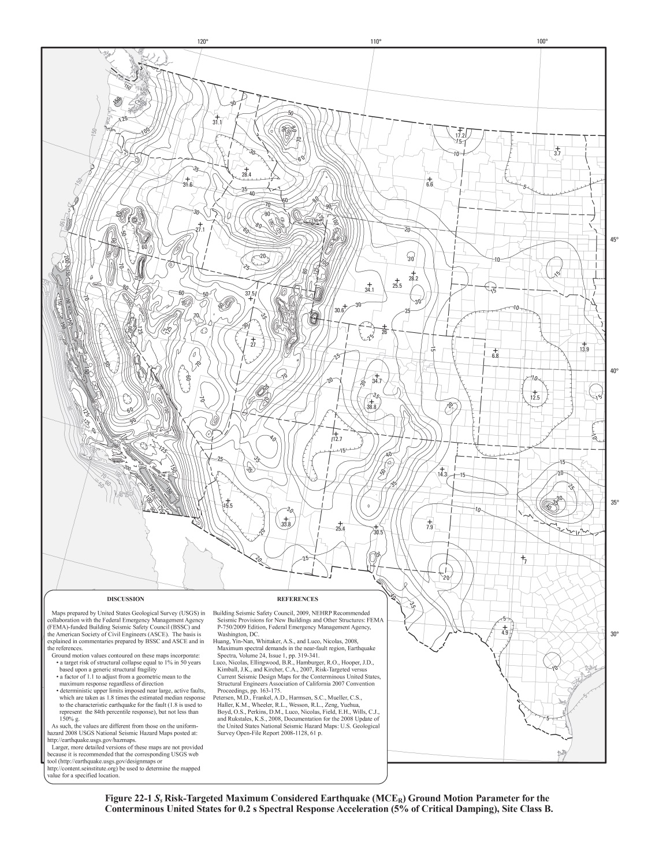
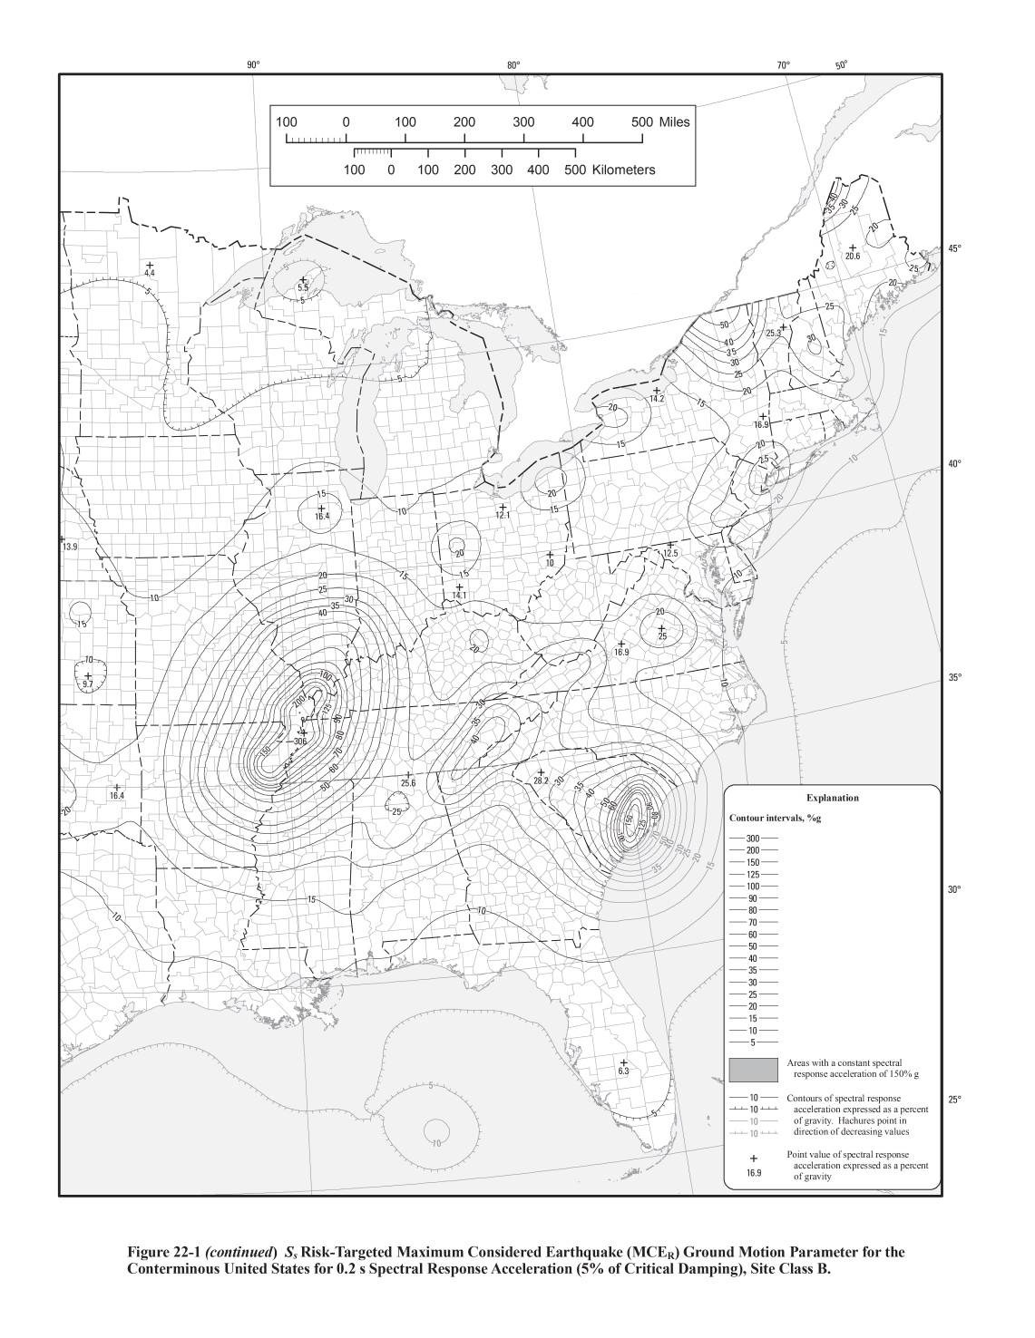
Map for S_{S}
Notes:
This is the map in ASCE 7 for the short period spectral acceleration for the Maximum Considered Earthquake. This map is also available for free download at: https://earthquake.usgs.gov/hazards/designmaps/pdfs/ (source for map shown in slide)
(Note: Map shown in slide is from ASCE 7-10)

Slide 38
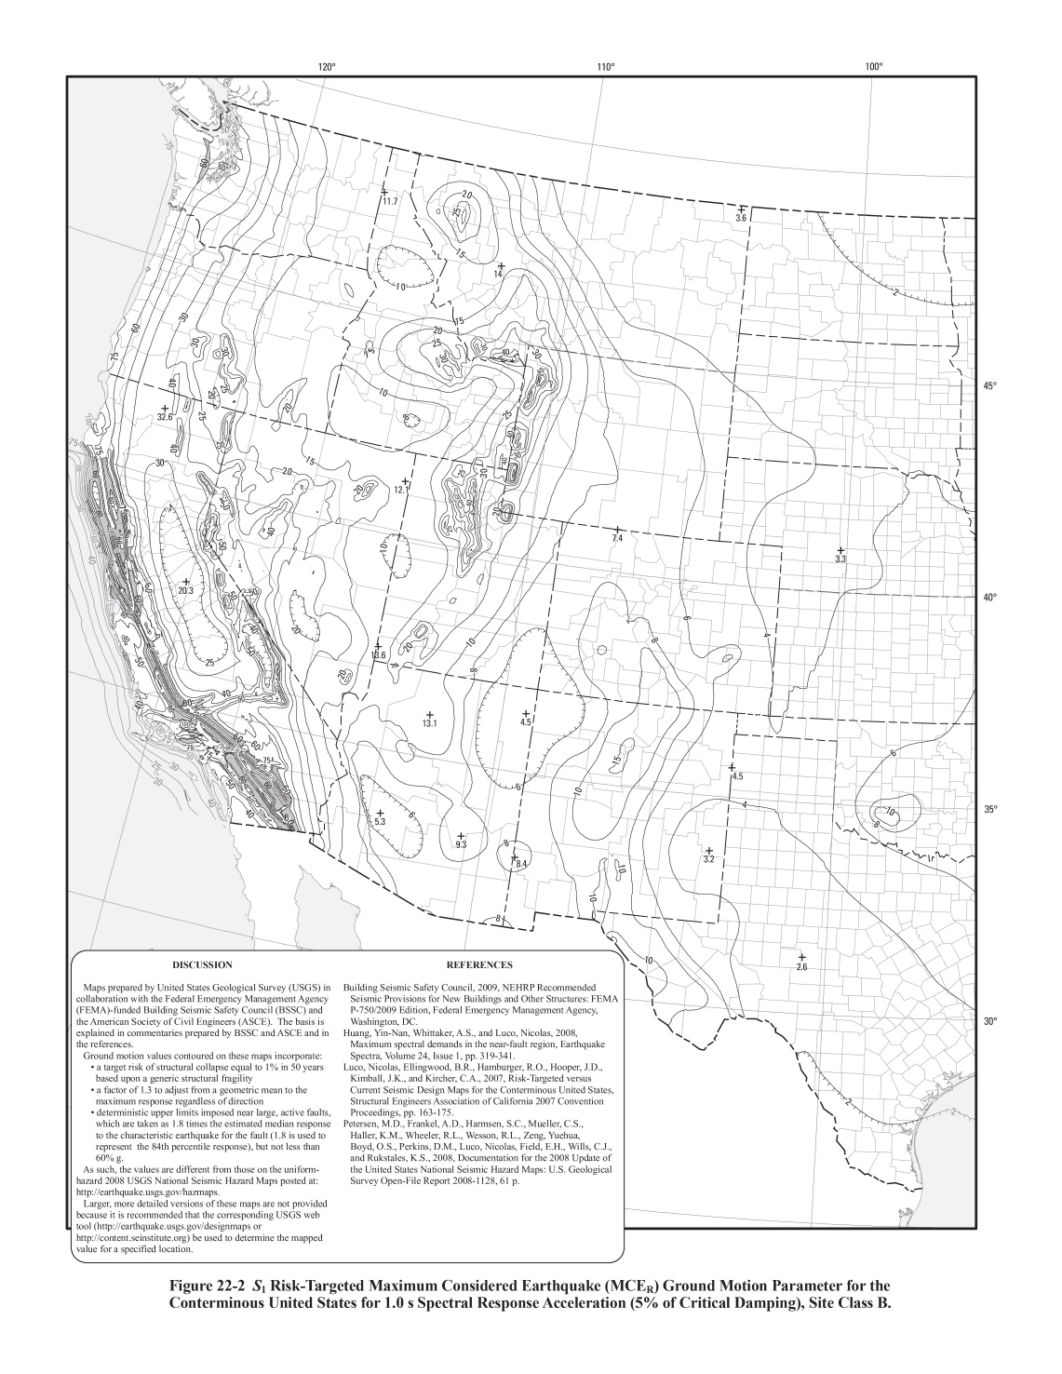
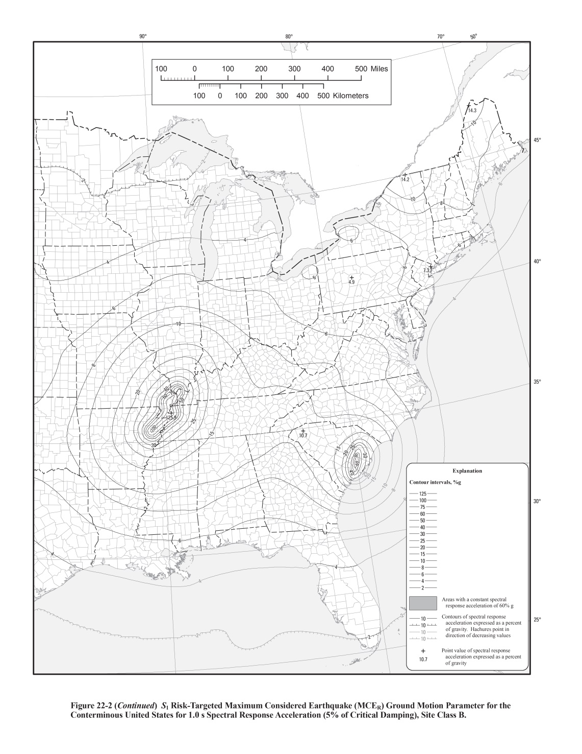
Map for S₁
Notes:
This is the map in ASCE 7 for the 1-second period spectral acceleration for the Maximum Considered Earthquake. This map is also available for free download at: https://earthquake.usgs.gov/hazards/designmaps/pdfs/ (source for map shown in slide)
(Note: Map shown in slide is from ASCE 7-10)

Slide 39
Seismic Hazard Maps
Use interactive programs linked from USGS website below.
  Get seismic design values for buildings
  Input longitude and latitude at site, or zip code
  Output S_{S} and S₁
https://www.usgs.gov/natural-hazards/earthquake-hazards/design-ground-motions
Notes:
Rather than trying to read the values of S_{S} and S₁ from the maps, interactive programs are available that allow one to enter geographic location, either by latitude and longitude, or by zip code. These programs then supply the values of S_{S} and S₁ for that location.
The USGS website that contains information on how and where seismic design values can be obtained, and links to third-party tools: https://www.usgs.gov/natural-hazards/earthquake-hazards/design-ground-motions
The ASCE 7 Hazard Tool (requires a subscription): https://asce7hazardtool.online/
The ATC Hazards by Location Tool (free): https://hazards.atcouncil.org

Slide 40
To Determine the Seismic Design Category (ASCE 7-16)
Evaluate Seismic Design Category according to Tables 11.6-1 and 11.6-2
The Seismic Design Category is the most severe value based on both Tables.
Table 11.6-1
Seismic Design Category Based on Short Period Response Acceleration Parameter
Value of S_{DS} | Risk Category
 | I or II or III | IV
S_{DS}< 0.167 | A | A
0.167 ≤ S_{DS} < 0.33 | B | C
0.33 ≤ S_{DS} < 0.50 | C | D
0.50 ≤ S_{DS} | D | D
For sites with S₁ ≥ 0.75g: Seismic Design Category = E for Risk Category I, II, or III
Seismic Design Category = F for Risk Category IV

Slide 41
To Determine the Seismic Design Category (ASCE 7-16)
Table 11.6-2
Seismic Design Category Based on 1-Second Period Response Acceleration Parameter
Value of S_{D1} | Risk Category
 | I or II or III | IV
S_{D1}< 0.067g | A | A
0.067g ≤ S_{D1} < 0.133g | B | C
0.133g ≤ S_{D1} < 0.20g | C | D
0.20g ≤ S_{D1} | D | D
For sites with S₁ ≥ 0.75g: Seismic Design Category = E for Risk Category I, II, or III
Seismic Design Category = F for Risk Category IV

Slide 42
2016 AISC Seismic Provisions
Section A to D
General Requirements
General Design Requirements
Analysis
General Member and Connection Design Requirements
Notes:
We will now start looking at some important highlights of Sections A to D. The requirements of these sections apply to all systems, and also to items such as collectors, diaphragms, etc.
We will not cover all requirements in Sections A to D. We will only look at selected key highlights.

Slide 43
AISC Seismic Provisions
Scope
A1. Scope
The Seismic Provisions apply to the seismic-force resisting system (SFRS) and to splices and bases of columns not part of the SFRS.
The Seismic Provisions are used in conjunction with the AISC Specification for Structural Steel Buildings
Notes:
The Seismic Provisions are only applicable to the SFRS. The SFRS are the vertical frames that are designed to resist seismic lateral forces (SMF, SCBF, EBF, BRBF, etc). The SFRS also includes elements that deliver forces to the vertical frames: struts, collectors, diaphragms, etc. However, there is little within the Seismic Provisions that directly address items such as diaphragms.
The Seismic Provisions do not apply to the design of the gravity framing in a building. The only exception is that Sections D2.5 (Column Splices) and D2.6 (Column Bases) specify minimum design requirements for columns not part of SFRS.
The 2016 AISC Seismic Provisions are to be used together with the 2016 AISC Specification.
Both the 2016 Seismic Provisions and the 2016 Specification have been prepared in the dual LRFD - ASD format.
In this presentation, we will only be using the LRFD format. (For the ASD equivalent to any equation, see the applicable section of the Seismic Provisions).

Slide 44
AISC Seismic Provisions
Scope
A1. Scope
Use of Seismic Provisions is mandatory as referenced when defining a seismic response modification coefficient, R, per ASCE 7.
  Typically occurs for Seismic Design Category
  D, E, and F where R > 3
For Seismic Design Categories B or C:
  Can design using R=3 and provide no special detailing (just design per main AISC Specification)
  Note: Composite systems are not covered by this exemption
The Seismic Provisions do not apply to Seismic Design Category A.
Notes:
The scope describes when the Seismic Provisions must be used, i.e., when seismic detailing is required.
As noted earlier, in SDC B or C, the Seismic Provisions are not needed if the seismic lateral force is computed based on R=3. In this case, the structure is just designed using the AISC Specification.
When the R=3 option is used, the designer should still consider using some of the requirements of the Seismic Provisions, even though they are not required. For example, it may be prudent to use notch-tough weld metal, as specified in Section E3.6a of the Seismic Provisions (CVN of 20 ft-lbs at 0 deg F).

Slide 45
2016 AISC Seismic Provisions
Chapter B. General Design Requirements
B1. General Seismic Design Requirements
B2. Loads and Load Combinations
B3. Design Basis
B4. System Type
B5. Diaphragms, Chords and Collectors

Slide 46
AISC Seismic Provisions
General Design Requirements
B1. General Seismic Design Requirements
Go to the Applicable Building Code for:
  Risk Category
  Seismic Design Category
  Limits on Height and Irregularity
  Design Story Drift and Limitations
Notes:
Section B1 of the Seismic Provisions are very brief. The designer must go to the applicable building code for the items listed above.

Slide 47
AISC Seismic Provisions
General Design Requirements
B2. Loads and Load Combinations
Go to the Applicable Building Code for Loads and Load Combinations.
The Seismic Provisions give member and element load requirements that supplement those in the applicable building code.
Notes:
The Provisions are intended for use with load combinations given in the applicable building code.
Since they are written for consistency with the load combinations given in ASCE/SEI 7 and the 2018 IBC, consistency with the applicable building code should be confirmed if another building code is applicable.

Slide 48
Basic LRFD Load Combinations (ASCE 7-16)
1.4D
1.2D + 1.6L + 0.5(L_{r} or S or R)
1.2D + 1.6(L_{r} or S or R) + (L or 0.5W)
1.2D + 1.0W + L + 0.5(L_{r} or S or R)
0.9D + 1.0W
1.2D + E_{h} + E_{v} + L + 0.2S
0.9D + E_{h} - E_{v}
Load Combinations Including E
Notes:
These are the basic LRFD load combinations in ASCE 7. The last two load combinations are the ones that include seismic loads. Note that the seismic loading (E) is separated into its horizontal (E_{h}) and vertical (E_{v}) contributions.
Note that in load combination 6, the load factor for “L” is permitted to be taken as 0.5 for all occupancies in which L_{o} < 100psf (with the exception of garages and areas of public assembly)

Slide 49
E = E_{h} ± E_{v}
E = ρ Q_{E} ± 0.2 S_{DS} D
effect of horizontal forces
effect of vertical forces
E = the effect of horizontal (E_{h}) and vertical (E_{v}) earthquake-induced forces
Q_{E} = effect of horizontal earthquake-induced forces
S_{DS} = design spectral acceleration at short periods
D = dead load effect
ρ = reliability factor
(depends on extent of redundancy in the seismic lateral resisting system; ρ varies from 1.0 to 1.5)
Notes:
The portion of E that is 0.2S_{DS}D is intended to account, in a simplified manner, for the effects of vertical ground accelerations.

Slide 50
Substitute E into basic load combinations:
For Load Combination: 1.2D + E_{h} + E_{v} + L + 0.2S
substitute: E_{h} + E_{v} = ρ Q_{E} + 0.2 S_{DS} D
(1.2 + 0.2 S_{DS}) D + 1.0 ρ Q_{E} + L + 0.2S
Note: The load factor on L is permitted to equal 0.5 for occupancies in which L_{o} <= 100psf
For Load Combination: 0.9D + E_{h} - E_{v}
substitute: E_{h} - E_{v} = ρ Q_{E} - 0.2 S_{DS} D
(0.9 - 0.2 S_{DS}) D + 1.0 ρ Q_{E}
Notes:
"E" can be substituted into the load combinations as shown. Note that the 0.2S_{DS} term simply modifies the load factor for dead load.
Again, note that in load combination 6, the load factor for “L” is permitted to be taken as 0.5 for all occupancies in which L_{o} < 100psf (with the exception of garages and areas of public assembly)

Slide 51
AISC Seismic Provisions
General Design Requirements
B2. Loads and Load Combinations
Where the required strength defined in the AISC Seismic Provisions refers to the overstrength seismic load:
The horizontal portion of the earthquake load, E_{mh}, shall be determined using the overstrength factor Ω_{o} prescribed by the load combinations in applicable building code.
Notes:
Section B2 also sends the designer to the applicable building code to determine the Overstrength Factor.

Slide 52
Seismic Load Effects Including Overstrength (ASCE 7)
For Load Combination: 1.2D + E_{h} + E_{v} + L + 0.2S
Seismic Load Effects Including Overstrength:
E_{h} + E_{v} = Ω_{o} Q_{E} + 0.2 S_{DS} D
For Load Combination: 0.9D + E_{h} - E_{v}
Seismic Load Effects Including Overstrength:
E_{h} - E_{v} = Ω_{o} Q_{E} - 0.2 S_{DS} D
Notes:
Shown here is the definition of the Seismic Load Effects including Overstrength in ASCE 7. Note that the redundancy factor ρ is replaced by the Overstrength Factor Ω_{o}.

Slide 53
Basic load combinations incorporating
seismic load effects including overstrength:
For Load Combination: 1.2D + E_{h} + E_{v} + L + 0.2S
substitute: E_{h} + E_{v} = Ω_{o} Q_{E} + 0.2 S_{DS} D
(1.2 + 0.2 S_{DS}) D + Ω_{o} Q_{E} + L +0.2S
For Load Combination: 0.9D + E_{h} - E_{v}
substitute: E_{h} - E_{v} = Ω_{o} Q_{E} - 0.2 S_{DS} D
(0.9 - 0.2 S_{DS}) D + Ω_{o} Q_{E}
Notes:
Shown here is the Seismic Load Effect including Overstrength incorporated into the basic load combinations.
It is important to note that the Seismic Load Effect including Overstrength is only used where called for in the Seismic Provisions. There are only a few locations in the Seismic Provisions where the Seismic Load Effect including Overstrength is called for.

Slide 54
Seismic Overstrength Factor: Ω_{o}
Per ASCE 7-16, Table 12.2-1:
System | Ω_{o}
Moment Frames (SMF, IMF, OMF) | 3
Concentrically Braced Frames (SCBF, OCBF) | 2
Eccentrically Braced Frames (EBF) | 2
Special Plate Shear Walls (SPSW) | 2
Buckling Restrained Braced Frames (BRBF) | 2.5
Notes:
The Overstrength Factor is system dependent, as shown in this Table.

Slide 55
Seismic Load Effect Including Overstrength
Ω_{o} Q_{e}
Lateral Seismic Force
Q_{e}
Frame Lateral Deflection
The seismic load effect including overstrength, Ω_{o}Q_{e}, is intended to provide an estimate of a frame's plastic lateral strength.
Notes:
The Seismic Load Effect including Overstrength is intended to provide a very approximate estimate of the plastic lateral strength of a frame.
As an example, the Overstrength Factor for moment frames is 3. This implies that the plastic lateral strength of a moment frame, on average, will be three times larger than the design lateral force Q_{e}. There are typically several reasons why a frame is considerably stronger than the design lateral force. These include:
- the use of resistance factors when computing design strength;
- actual yield stress higher than minimum specified;
- members larger than need for strength to satisfy drift limits;
- members larger than needed for strength to simplify design and construction (e.g. using same size beam for several floors, even though smaller beams could be used as you move up in the building);
- increase in strength in going from first plastic hinge (Q_{e} is based on the required strength at first significant yield of the frame....i.e., first plastic hinge) to formation of a plastic mechanism.
Recall from a previous slide that the maximum lateral force that a structure will see during the earthquake is defined by the structure's own lateral strength. Thus Seismic Load Effect Including Overstrength therefore provides an estimate of this value.
Wherever the Seismic Provisions require that an element or connection must be designed for the Seismic Load Effect including Overstrength it is also permitted to conduct a plastic analysis to determine the maximum force the element will see, instead of using the Seismic Load Effect including Overstrength.
The Seismic Load Effect including Overstrength can be viewed as a highly simplified substitute for plastic analysis.

Slide 56
2016 AISC Seismic Provisions
Chapter A. General Requirements
A3. Materials
    A3.1 Material Specifications
    A3.2 Expected Material Strength
    A3.3 Heavy Sections
    A3.4 Consumables for Welding
    A3.5 Concrete and Steel Reinforcement
Notes:
Section A3 covers requirements for the structural steel materials used in the SFRS.

Slide 57
AISC Seismic Provisions
General Requirements
A3.1 Material Specifications
For members in which inelastic behavior is expected:
Specified minimum F_{y} ≤ 50 ksi
Exceptions:
Members in OMFs, OCBFs, C-OMFs, C-OBFs, and C-OSWs (permitted to use up to F_{y} = 55 ksi)
Notes:
The members of the frame that are designed to yield in an earthquake, i.e. the "fuses" in the frame (beams in moment frames, braces in SCBF and OCBF, links in EBF, etc) must be made of steel with a specified minimum yield stress of 50 ksi or less.
The reason for this restriction is that the majority of experiments conducted on seismic frame elements (much of the Seismic Provisions are based on experimental research) has been on steels with a specified yield stress of 50 ksi and less (A36, A572 Gr 50, A992, A500 Gr B, etc). While elements made of higher strength steels may show satisfactory seismic performance, experimental evidence would first be needed to establish the suitability of such steels.
There is reason to be cautious of higher strength steels. In general, as the strength of steel increases, its ductility decreases. That is, higher strength steels tend to be more brittle than lower strength steels. Since the key the good seismic performance is ductility, lower strength steels are, in general, preferred for yielding elements of the frame.
Note that most construction materials follow this same trend. For example, higher strength concrete is generally more brittle than lower strength concrete.
The requirement of F_{y} ≤ 50 ksi generally has little impact on design, since our common structural steels (A992, A36, etc) satisfy this requirement.
There are exceptions where higher strength steels are permitted up to F_{y} up to 55 ksi in yielding elements the following systems. This exception is provided to accommodate materials that are commonly used in metal building systems.
OMF (Section E1)
OCBF (Section F1)
C-OMF (Section G1)
C-OBF (Section H1)
C-OSW (Section H4)

Slide 58
AISC Seismic Provisions
General Requirements
A3.2 Expected Material Strength
Expected Yield Strength = R_{y} F_{y}
Expected Tensile Strength = R_{t} F_{u}
F_{y} = minimum specified yield strength
F_{u} = minimum specified tensile strength
R_{y} and R_{t} are based on statistical analysis of mill data.
Notes:
This section defines "expected yield strength," R_{y}F_{y} and "expected tensile strength," R_{t}F_{u}
The concept of expected yield strength was added to the Seismic Provisions following the widespread failure of moment connections in the 1994 Northridge Earthquake.
The expected yield stress recognizes that fact that the actual yield stress of steel is usually higher than the minimum specified value. For example, for A36 steel, the minimum specified yield stress is 36 ksi. However, if you run a coupon test on a piece of A36 steel, it will usually show an actual yield stress in excess on 50 ksi.
In non-seismic design, having steel with an actual yield stress greater than the minimum specified value is usually not a problem. In fact, the higher yield strength provides additional reserve strength.
In seismic design, however, having a higher than expected yield stress can be detrimental. We design a seismic frame so that certain elements will yield in the earthquake. These "fuses" (beams in moment frames, braces in concentrically braced frames, links in EBFs, etc) are then detailed to provide highly ductile response. However, if these fuse elements are stronger than expected, they may no longer yield in the earthquake. Instead, some other, often more brittle element, will fail before the fuse element ever yields.
Consider, for example, an SMF. For this system, one of the key design requirements is that the beam-to-column connections should be stronger than the beams. That is, when the earthquake hits the frame, plastic hinges should form at the beam ends. The connections must be strong enough to permit the beam to form plastic hinges, without failure of the connection (something that did not happen in the Northridge Earthquake). For this design intent to be realized, the connections must be stronger than the actual beam, not the "theoretical" beam. Note that no matter how strong the beam is, it will still yield in the earthquake. Consequently, the moment developed at the end of the beam will reflect the actual yield stress of the beam.
The expected yield stress is used to define the required strength of elements that adjoin the fuse elements in the frame, to assure that the adjoining elements are stronger than the fuse elements. For example, the beam end connections in moment frames are designed for 1.1R_{y}F_{y}Z . The value of R_{y}F_{y}Z is the plastic moment of the beam based on the expected yield stress (the expected plastic moment). The "1.1" factor accounts for additional moment generated at the end of the beam due to strain hardening of the beam.
As another example of the use of expected yield stress, bracing connections in SCBF are required to be designed for an axial tension for of R_{y}F_{y}A_{g} of the brace. During an earthquake, a bracing member (the fuse in an SCBF) is expected to yield in tension. In order to obtain ductile response of an SCBF, the brace must be able to yield in tension without failure of the connection. Thus, the connection is designed for an axial tension force of R_{y}F_{y}A_{g.} (There is no 1.1 factor in this case, because braces exhibit little strain hardening).
The expected tensile strength, R_{t}F_{U} was added in the 2005 edition of the Seismic Provisions. The expected tensile strength is only used when checking fracture limit states in the same member for which the expected yield stress was used. This concept will be explained further with an upcoming example.

Slide 59
Table A3.1
R_{y} and R_{t} Values for Steel and Steel Reinforcement Materials
Application | R_{y} | R_{t}
Hot-Rolled Shapes and Bars
ASTM A36 | 1.5 | 1.2
ASTM A992; A572 Gr 50 or Gr 55; ASTM A913 Gr 50, 60, 65 or 70; ASTM A588; | 1.1 | 1.1
ASTM A1043 Gr 36 | 1.3 | 1.1
ASTM A1043 Gr 50 | 1.2 | 1.1
ASTM A529 Gr 50 | 1.2 | 1.2
ASTM A529 Gr 55 | 1.1 | 1.2
Hollow Structural Sections (HSS)
ASTM A500 Gr B; ASTM A501 | 1.4 | 1.3
ASTM A500 Gr C | 1.3 | 1.2
ASTM A53 | 1.6 | 1.2
Plates
ASTM A36 | 1.3 | 1.2
ASTM A572 Gr50; ASTM A588 | 1.1 | 1.2
Notes:
Table A3.1 in the Seismic Provisions specify values of R_{y} and R_{t}. These values are based on statistical analysis of mill test report data.

Slide 60
Example: A36 angles used for brace in an SCBF
F_{y} = 36 ksi
F_{u} = 58 ksi
R_{y} F_{y} = 1.5 × 36 ksi = 54 ksi
R_{t} F_{u} = 1.2 × 58 ksi = 70 ksi
Example: A992 wide flange used for beam in an SMF
F_{y} = 50 ksi
F_{u} = 65 ksi
R_{y} F_{y} = 1.1 × 50 ksi = 55 ksi
R_{t} F_{u} = 1.1 × 65 ksi = 72 ksi
Notes:
Values of R_{y} and R_{t} are mean values. Thus, the expected yield stress for a particular grade of steel does not represent an upper bound on yield stress.
For example, for A36 shapes, the minimum specified yield stress is 36 ksi, and the expected yield stress is 54 ksi. However, the ASTM A36 standard places no upper bound on yield stress. Consequently, the actual yield stress of an A36 shape could still be considerably greater than 54 ksi.

Slide 61
AISC Seismic Provisions
General Requirements
A3.2 Expected Material Strength
Where specified in the Seismic Provisions, the required strength of a member or connection shall be based on the Expected Yield Strength, R_{y} F_{y} of an adjoining member.
The Expected Tensile Strength, R_{t} F_{u} and the Expected Yield Strength, R_{y} F_{y} may be used to compute the nominal strength for rupture and yielding limit states within the same member.
Notes:
It is important to understand when minimum specified yield strength (F_{y}), minimum specified tensile strength (F_{u}), expected yield strength (R_{y}F_{y}) and expected tensile strength (R_{t}F_{u}) are used in the design process. The next few slides provide an example of how these values should be used in the design of a brace and brace connection in an SCBF.

Slide 62
Example: SCBF Brace and Brace Connection
To size brace member:
Required Strength defined by code specified forces (using ASCE-7 load combinations)
Design Strength of member computed using minimum specified F_{y}
Notes:
In an SCBF, the brace is the "fuse," i.e. the member that is designed to yield in the event of an earthquake. The required strength of the brace is determined from an analysis (typically an elastic analysis) of the frame using code specified loads and ASCE-7 LRFD load combinations.
To size the brace for the required strength computed above, the design strength of the brace is computed using the minimum specified F_{y}.
Note that, while on average, the actual yield stress will be greater than the minimum specified value, it is in fact still possible to have the minimum specified value. Thus, when sizing the brace for code specified loads, it is conservative to assume the yield strength of the brace material is the minimum specified value.

Slide 63
Example: SCBF Brace and Brace Connection
R_{y} F_{y} A_{g}
Required Axial Tension Strength of brace connection is the expected yield strength of bracing member = R_{y} F_{y} A_{g}
Notes:
Once the brace member has been chosen, the required axial tension strength of the brace connection is defined as the R_{y}F_{y}A_{g} of the brace member. Thus, the brace connection is not designed based on code specified earthquake loads. Rather, the brace connection is designed to be stronger than the brace, to assure that the brace connection will not fail before the brace yields.
To provide a reasonable level of confidence that the brace connection will not fail, we consider the possibility that the yield strength of the brace is higher than the minimum specified value. That is, we assume the yield stress of the brace is the expected yield stress.
Note that when we sized the brace for code specified earthquake loads, we assumed the brace material yields at its minimum specified value, as this assumption is conservative for the brace. However, when designing the brace connection to be stronger than the brace, we assume the brace material yields at its expected value, as this assumption is conservative for the brace connection.

Slide 64
Example: SCBF Brace and Brace Connection
R_{y} F_{y} A_{g}
Gusset Plate:
Compute design strength using min specified F_{y} and F_{u} of gusset plate material
Notes:
The required strength of the gusset plate is R_{y}F_{y}A_{g} of the brace. When sizing the gusset plate for this force, the design strength of the gusset is computed using the minimum specified F_{y} and F_{u} of the gusset plate material. Since the goal is to assure that the brace connection does not fail under the R_{y}F_{y}A_{g} force, using minimum specified F_{y} and F_{u} for the gusset plate material is the conservative choice, since this material may, in fact, be at its minimum specified values.

Slide 65
Example: SCBF Brace and Brace Connection
R_{y} F_{y} A_{g}
Bolts:
Compute design shear strength using min specified F_{u} of bolt
Notes:
Similarly, when sizing bolts and welds, minimum specified material properties are used for the bolts and welds.

Slide 66
Example: SCBF Brace and Brace Connection
R_{y} F_{y} A_{g}
Net Section Fracture and Block Shear Fracture of Bracing Member:
Compute design strength using expected yield strength, R_{y}F_{y} and expected tensile strength, R_{t} F_{u} of the brace material.
Notes:
As part of the connection design, the engineer must check net section fracture and block shear failure of the brace member itself. That is, in order to obtain ductile response of the brace member, the gross section of the brace must yield before net section fracture or block shear fracture of the brace.
Thus, the required strength of the brace for limits states of net section fracture and block shear fracture is defined as R_{y}F_{y}A_{g} of the brace itself.
In this case, when checking net section fracture and block shear fracture of the brace, it is permissible to use the expected yield stress and expected tensile strength of the brace material. Thus, for example, the design strength of the brace for net section fracture would be computed as:
φ A_{e} R_{t}F_{u}. The design strength of the brace for block shear fracture would be computed as: φ[A_{nt} R_{t}F_{u} + A_{nv} 0.6 R_{t}F_{u}] ≤ φ[A_{nt} R_{t}F_{u} + A_{gv} 0.6 R_{y}F_{y}].
Just as in this example, whenever the required strength is based on the expected yield strength of an element, then the design strength of that same element can be computed using expected yield and tensile strength. Since it is the same element, if the yield strength of the element is higher than the minimum specified value, the tensile strength will also likely be higher than the minimum specified value (although the tensile strength is usually not as elevated as the yield strength.)

Slide 67
2016 AISC Seismic Provisions
Chapter D. General Member and Connection Design Requirements
D2. Connections
    D2.1 General
    D2.2 Bolted Joints
    D2.3 Welded Joints
    D2.4 Continuity Plates and Stiffeners
    D2.5 Column Splices
    D2.6 Column Bases
    D2.7 Composite Connections
    D2.8 Steel Anchors
Notes:
Section D2 has general requirements for bolted and welded connections, that are applicable to all seismic lateral resisting frames (SMF, IMF, OMF, SCBF, OCBF, EBF, etc). These requirements are also applicable to portions of the SFRS other than the main frames, i.e., collectors, struts, diaphragms, etc.

Slide 68
AISC Seismic Provisions
General Member and Connection Design Requirements
D2.1 Connections - General
Connections, joints and fasteners that are part of the seismic force-resisting system (SFRS) shall comply with the AISC Specification Chapter J, and with the additional requirements in this section.
Notes:
In general, bolted and welded connections are designed in accordance with Chapter J of the main AISC Specification. Section D2 of the Seismic Provisions specifies requirements that are in addition to Chapter J of the main Specification.

Slide 69
AISC Seismic Provisions
General Member and Connection Design Requirements
D2.2 Connections – Bolted Joints
All bolts must be high strength (A325 or A490)
Bolted joints may be designed as bearing type connections, but must be constructed as slip critical
  bolts must be pretensioned
  faying surfaces must satisfy Class A surface requirements
Holes: standard size or short-slots perpendicular to load
(exception: oversize holes are permitted for diagonal brace connections, but the connection must be designed as slip-critical and the oversize hole is permitted in one ply only)
Notes:
Section D2.2 specifies requirements for bolted joints that are in addition to the requirements of Chapter J of the main AISC Specification.
In general, for any bolted joint in the SFRS, the joint can be designed as a bearing type connection, but must be constructed as slip-critical. Thus, the bolts must be pretensioned, and the faying surface must meet at least Class A requirements (Class B and C faying surface requirements would also be acceptable). This requirement is intended to limit movement at the joint during an earthquake.
In addition, for any bolted joint in the SFRS, only standard holes or short slotted holes with the slot perpendicular to the load are permitted. This is, again, intended to limit movement at the joint during an earthquake.
The only exception to this requirement is for bolted joints at diagonal brace connections. In this case, oversize holes are permitted. However, if oversize holes are used, the connection must be designed as slip-critical. This exception was added to the 2005 AISC Seismic Provisions based on feedback from erectors, who indicated that fit-up of bolted brace connections was very difficult with standard holes.

Slide 70
AISC Seismic Provisions
General Member and Connection Design Requirements
D2.2 Connections – Bolted Joints (continued)
Nominal bolt bearing and tearout equations where deformation at the bolt hole at service load is a design consideration shall be used.
  Exception: where the required strength of a connection is based upon the expected strength of a member or element
Bolts and welds shall not be designed to share force in a joint, or the same force component in a connection.
Notes:
For any bolted joint in the SFRS, the nominal bearing and tearout strengths are limited to the option where deformation is a design consideration (AISC Specification Section J3.10). This is to prevent excessive deformations of bolted joints due to bearing on the connected material. An exception is permitted for those bolted connections where the required force is determined by the capacity of a member or an adjacent one. For this condition, the connection force is unlikely to be exceeded significantly.
In general, bolts and welds do not share force in a predictable manner. This is because welded joints are very stiff, and will resist load immediately upon application. Bolted joints, in general, are more flexible, and require that some deformation occur before their resistance is fully developed. Because of the stiffness mis-match between bolted and welded joints, they don't share force in an effective or predictable manner. Consequently, the Seismic Provisions prohibit designers from designing bolted bad welded joints to share the same force.

Slide 71
Bolts and welds sharing same force:
Not Permitted
Notes:
This is a simple example of a connection in which an attempt is made to use both bolts and welds to resist the same force.

Slide 72
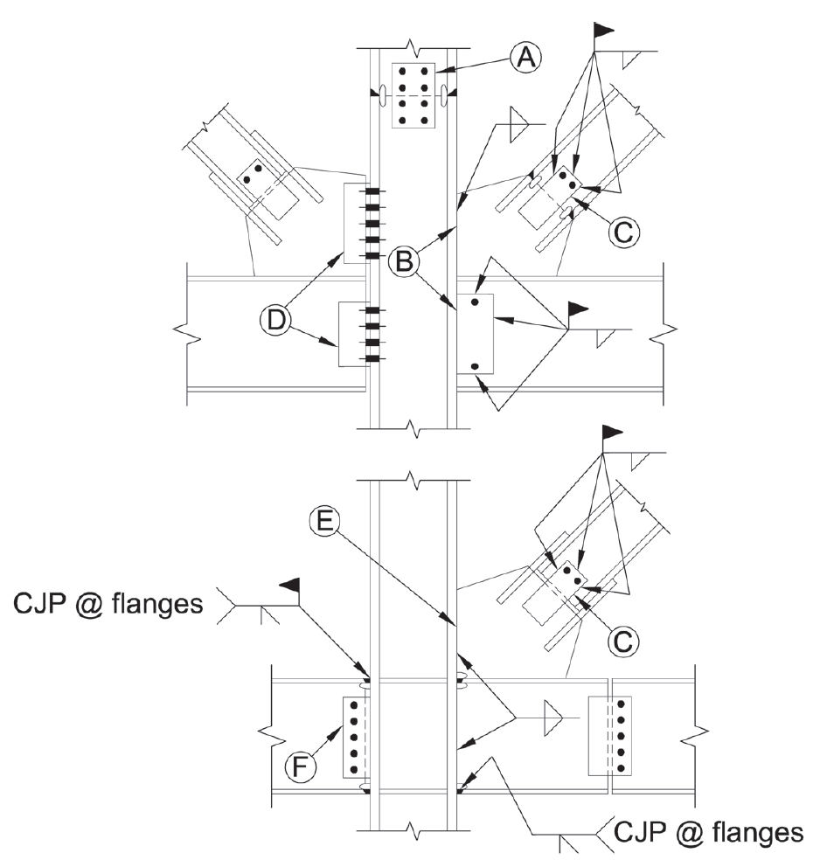
Fig. C-D2.1. Desirable details that avoid shared forces between welds and bolts.
Notes:
This figure is taken from the Commentary. It provides some example of connections configured so that bolts and welds are not sharing the same force or force component.

Slide 73
AISC Seismic Provisions
Fabrication and Erection
I2.3 Welded Joints
Welding shall be performed in accordance with a welding procedure specification (WPS) as required in AWS D1.1 and approved by the engineer of record.
All welding should be in accordance with AWS D1.8, which provides additional requirements for welding in the SFRS.
Notes:
Section I2.3 specifies requirements for welded joints in the SFRS that are in addition to Chapter J of the main AISC Specification and that are in addition to (or supplement) the requirements of the American Welding Society (AWS) Standard D1.1 - Structural Welding Code - Steel. (Note that Chapter J of the main AISC Specification requires, with a few exceptions, that all welding on structural steel buildings follow AWS D1.1).
During the 1994 Northridge Earthquake, a large number of welded joints fractured at beam-to-column connections in steel moment frames. Subsequently, a great deal of research and testing was conducted to understand why these welded joints performed so poorly in the earthquake, and how to improve welded joints to avoid a similar experience in future earthquakes. A number of the results and recommendations of these studies are incorporated into AWS D1.1. (There will be an in-depth discussion of welding issues associated with the Northridge failures later in the section on moment resisting frames).
The first item in Section I2.3 indicates that all welding must be in accordance with AWS D1.8 - Structural Welding Code – Seismic Supplement, which covers a number of items that supplement AWS D1.1, including required qualifications of welding inspectors and nondestructive testing technicians, nondestructive testing procedures, maximum interpass temperatures, special requirements for weld tabs, beam bottom flange welding sequence, and other items. AWS D1.8 replaces Appendix W of the 2005 and earlier AISC Seismic Provisions.
The next item in Section I2.3 requires that all welding on the SFRS must follow a Welding Procedure Specification (WPS). A WPS is a short document (usually one page) that provides a welder with basic instructions on how to make a weld. It includes item such as required preheat, various welding parameters and welding machine settings (voltage, current, wire feed speed, etc), weld bead placement sequence, and other items. AWS D1.1 requires that all welding follow a WPS. The intent is that a welder in the field or in the shop refer to the WPS whenever placing a weld.
Post-Northridge investigations of weld failures revealed that the AWS D1.1 requirement that all welding follow a WPS was not always followed. Thus, this requirement in Section I2.3 of the Seismic Provisions is emphasizing the importance of the WPS.
The final item in this section reinforces that all welding requirements apply to welding done in shop fabrication and field erection.

Slide 74
AISC Seismic Provisions
Materials
A3.4a Seismic Force-Resisting System Welds
All welds in the SFRS shall have a minimum
Charpy V-Notch (CVN) toughness of:
  20 ft-lbs at 0°F for 70 ksi and 80 ksi weld metal
  25 ft-lbs at -20°F for 90 ksi weld metal
CVN rating of filler metal may be determined using AWS classification test methods.
Notes:
In the investigation of weld fractures following the 1994 Northridge Earthquake, one of the factors identified as a significant contributing cause to the fractures was inadequate fracture toughness of the weld metal. Fracture toughness is a measure of a materials resistance to brittle fracture.
Prior to the Northridge Earthquake, fracture toughness requirements were not typically specified for weld metal. Instead, most engineers simply specified that E70 electrodes be used. This means that the tensile strength of the weld metal (as tested in a standard tension coupon) be at least 70 ksi. However, material with a low fracture toughness may experience brittle fracture at stresses much less than 70 ksi.
The fracture toughness of a material can be assessed by the Charpy V-Notch (CVN) test. Prior to the Northridge Earthquake, it was not common practice to require Charpy V-Notch testing of weld metal. However, since the Northridge Earthquake, the importance of fracture toughness of weld metal in seismic resistant steel construction has been recognized. Consequently, any weld in the SFRS is now required to have a minimum level of fracture toughness, as measured by the Charpy V-Notch test. This minimum value is 20 ft-lbs at 0 deg. F for weld material of 70 ksi and 80 ksi strength, and minimum value of 25 ft-lbs at -20 deg. F for 90 ksi weld material.
To meet this requirement, the CVN rating of an electrode can be determined by standard test methods established by AWS.
Electrodes that meet this CVN requirement are widely available from welding electrode manufacturers.

Slide 75
AISC Seismic Provisions
Materials
A3.4b Demand Critical Welds
  Welds designated as Demand Critical shall have a
  minimum Charpy V-Notch (CVN) toughness of:
  40 ft-lbs at 70°F for 70 ksi and 80 ksi weld metal
  40 ft-lbs at 50°F for 90 ksi weld metal
Notes:
Some welds in the SFRS are classified as "demand critical," by the Seismic Provisions. These are welds that are subject to very high demands (large stresses on the weld and large inelastic strains in the base metal adjacent to the weld) and/or welds that are considered particularly important to the seismic performance of the frame. Examples of demand critical welds include beam flange groove welds at beam-to-column connections in SMF and in link-to-column connections in EBF, and column splice welds in SMF.
For welds identified as demand critical in the Seismic Provisions, there is a more restrictive requirement for toughness, as shown on this slide.

Slide 76
AISC Seismic Provisions
General Member and Connection Design Requirements
D1. Member Requirements
      D1.3 Protected Zones
Discontinuities specified in Section I2.1 resulting from fabrication and erection procedures and from other attachments are prohibited in the area of a member or a connection element designated as a protected zone.
Notes:
For any seismic lateral resisting frame, portions of the frame are expected to yield and undergo large inelastic strains during an earthquake. These portions of a frame are designated as "protected zones."

Slide 77
AISC Seismic Provisions
Protected Zone
I2.1 Protected Zone
Portions of the SFRS designated as a Protected Zone, shall comply with the following:
No welded shear studs are permitted.
No decking attachments that penetrate the beam flange are permitted (except power-actuated fasteners up to 0.18in. Diameter), but decking arc spot welds are permitted.
No welded, bolted, or screwed attachments or power-actuated fasteners for perimeter edge angles, exterior facades, partitions, duct work, piping, etc. are permitted.
Discontinuities from fabrication or erection operations (such as tack welds, erection aids, etc.) shall be repaired.
Notes:
Section I2.1 of the Seismic Provisions states that essentially nothing can be welded, bolted or shot pin attached in the protected zone. The reason for this prohibition is that welds, bolts or shot-in attachments in the highly strained protected zones may serve as fracture initiation sites.
The protected zones for each seismic framing system (SMF, SCBF, etc.) are identified in the section of the Seismic Provisions for that framing system.
The next three slides provide examples of protected zones.

Slide 78
Examples of Protected Zones
Special Moment Frame (SMF)
Protected Zones
Notes:
For SMF systems, yielding during an earthquake is expected to occur at the ends of the beams. Consequently, the beam ends are designated as protected zones.

Slide 79
Examples of Protected Zones
Special Concentrically Braced Frame (SCBF)
Protected Zones
Notes:
For an SCBF, very large inelastic strains are expected in the middle portion and at the ends of the braces, as the braces undergo cyclic buckling. Consequently, these regions are designated as protected zones.

Slide 80
Examples of Protected Zones
Eccentrically Braced Frame (EBF)
Protected Zones
Notes:
As a final example, yielding in an EBF is expected to occur within the links. The links in EBFs are therefore designated as protected zones.

Slide 81
2016 AISC Seismic Provisions
Chapter D. General Member and Connection Design Requirements
D1. Member Requirements
    D1.1 Classification of Sections for Ductility
    D1.2 Stability Bracing of Beams
    D1.3 Protected Zones
    D1.4 Columns
    D1.5 Composite Slab Diaphragms
    D1.6 Built-Up Structural Steel Members
Notes:
Section D1 specifies requirements for members (members = beams, columns, braces, links, etc.) that are in addition member design requirements in the main AISC Specification.

Slide 82
AISC Seismic Provisions
General Member and Connection Design Requirements
D1. Member Requirements
      D1.1 Classification of Sections for Ductility
Local buckling of members can significantly affect both strength and ductility of the member.
Members of the SFRS that are expected to experience significant inelastic action (e.g. beams in SMF, braces in SCBF, links in EBF, etc), must satisfy strict width-thickness limits to assure adequate ductility can be developed prior to local buckling.
Such members must be either moderately ductile members or highly ductile members (depends on the system requirements)
Notes:
A key factor that can limit the ductility of a steel member is the development and growth of local buckling. Consequently, for members of the SFRS that are expected to see significant inelastic action and to exhibit large ductility, the Seismic Provisions specify very restrictive width-thickness limits, so that local buckling is delayed until adequate ductility is achieved.
Members which satisfy these restrictive width-thickness limits are either called “moderately ductile” or “highly ductile” as designated by the requirements for systems defined in Chapters E, F, G, H and Section D4.
Controlling local buckling is one of the most critical factors for achieving ductile response of steel structures.
The next few slides show examples of local buckling.

Slide 83
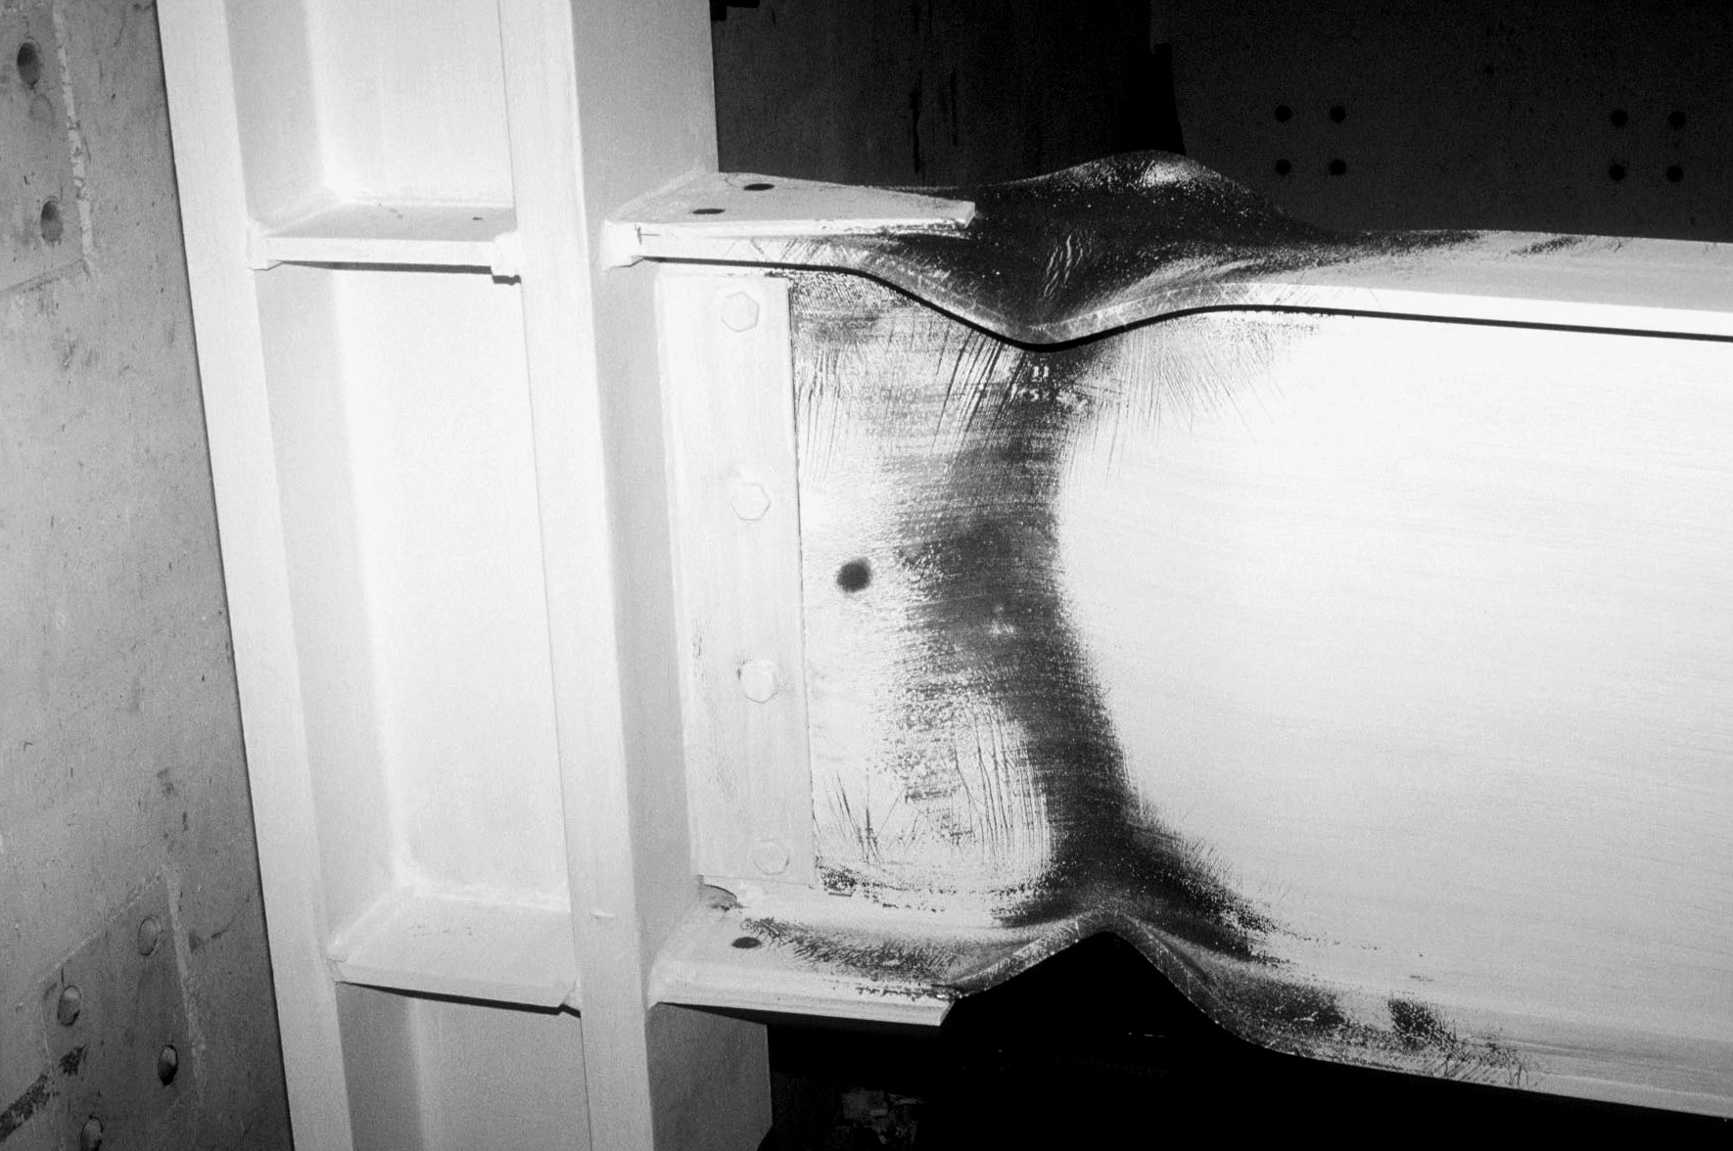
Local buckling of a moment frame beam.....
Notes:
This is a moment frame beam (W36x150 section) that was subject to cyclic inelastic loading in a laboratory test. The dark portions of the beam where the whitewash flaked off are areas where yielding occurred, i.e., the plastic hinge region of the beam. The severe local flange buckling and local web buckling are apparent.
This beam section was seismically compact. Note that being seismically compact does not mean that local buckling is prevented. It is not possible to prevent local buckling. Local buckling can only be delayed. This specimen developed the full plastic flexural strength of the beam, and maintained that strength through large inelastic deformations (i.e., the specimen developed very large ductility) before local buckling developed and the flexural resistance of the beam began to degrade. The ductility of this beam was therefore ultimately limited by local buckling. However, by using a seismically compact section, this beam developed very large ductility before it lost strength due to local buckling.
Photo by: M.D. Engelhardt

Slide 84
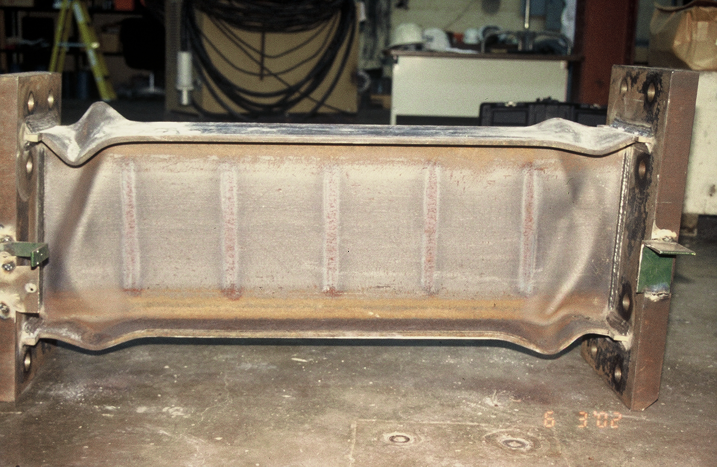
Local buckling of an EBF link.....
Notes:
This is an EBF link (W16x36 section) subject to severe cyclic inelastic loading in a laboratory test. Local flange and web buckling is clearly visible at the member ends.
This link section is also seismically compact. As with the moment frame beam in the previous slide, satisfying seismic compact limits does not prevent local buckling. However, because this link section was seismically compact, it developed very large inelastic deformations before ultimately failing by local buckling.

Slide 85
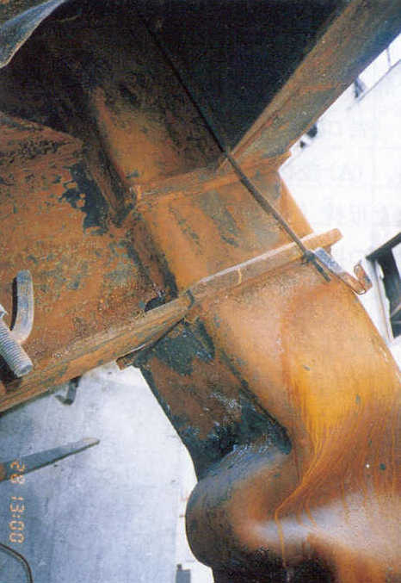
Local buckling of an HSS column....
Notes:
This is an example of a square HSS column that failed by local buckling in a building in the 1995 Hyogoken-Nanbu (Kobe) Earthquake.
Photo credit: "A Survey Report for Building Damages Due to the 1995 Hyogoken Nanbu Earthquake," Published by the Building Research Institute, Ministry of Construction, Japan, March 1996.

Slide 86
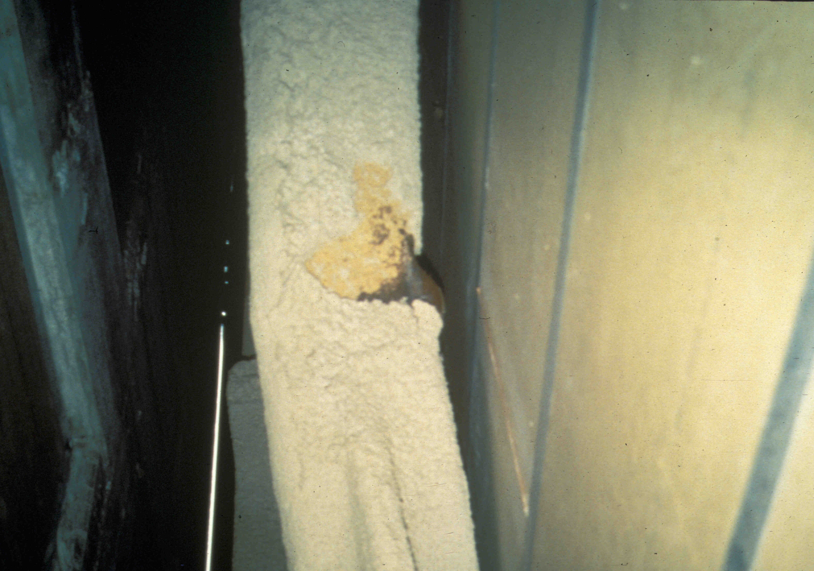
Local buckling of an HSS brace.....
Notes:
This is an HSS brace that experienced local buckling in the 1994 Northridge Earthquake.
Photo credit: James O. Malley, Degenkolb Associates

Slide 87
Effect of Local Buckling on Flexural Strength and Ductility
θ
M
M
M_{p}
Increasing b / t
θ
Notes:
This slide illustrates, qualitatively, how local buckling affects flexural strength and ductility.

Slide 88
Effect of Local Buckling on Flexural Strength and Ductility
Plastic Buckling
M_{p}
Inelastic Buckling
Moment Capacity
0.7M_{y}
Elastic Buckling
λ_{ps}
λ_{p}
λ_{r}
Width-Thickness Ratio
Ductility
Notes:
This slide further illustrates how local buckling affects flexural strength and ductility. Note that in going from compact to seismically compact, the flexural capacity of the beam does not increase (except for a small amount due to strain hardening). However, in going from compact to seismically compact, the ductility of the member increases significantly.

Slide 89
AISC Seismic Provisions
General Member and Connection Design Requirements
D1. Member Requirements
      D1.1b Width-to-Thickness Limitations of Steel and Composite Sections
For moderately ductile members, the width-to-thickness ratios of compression elements shall not exceed λ_{md} from Table D1.1.
For highly ductile members, the width-to-thickness ratios of compression elements shall not exceed λ_{hd} from Table D1.1.

Slide 90
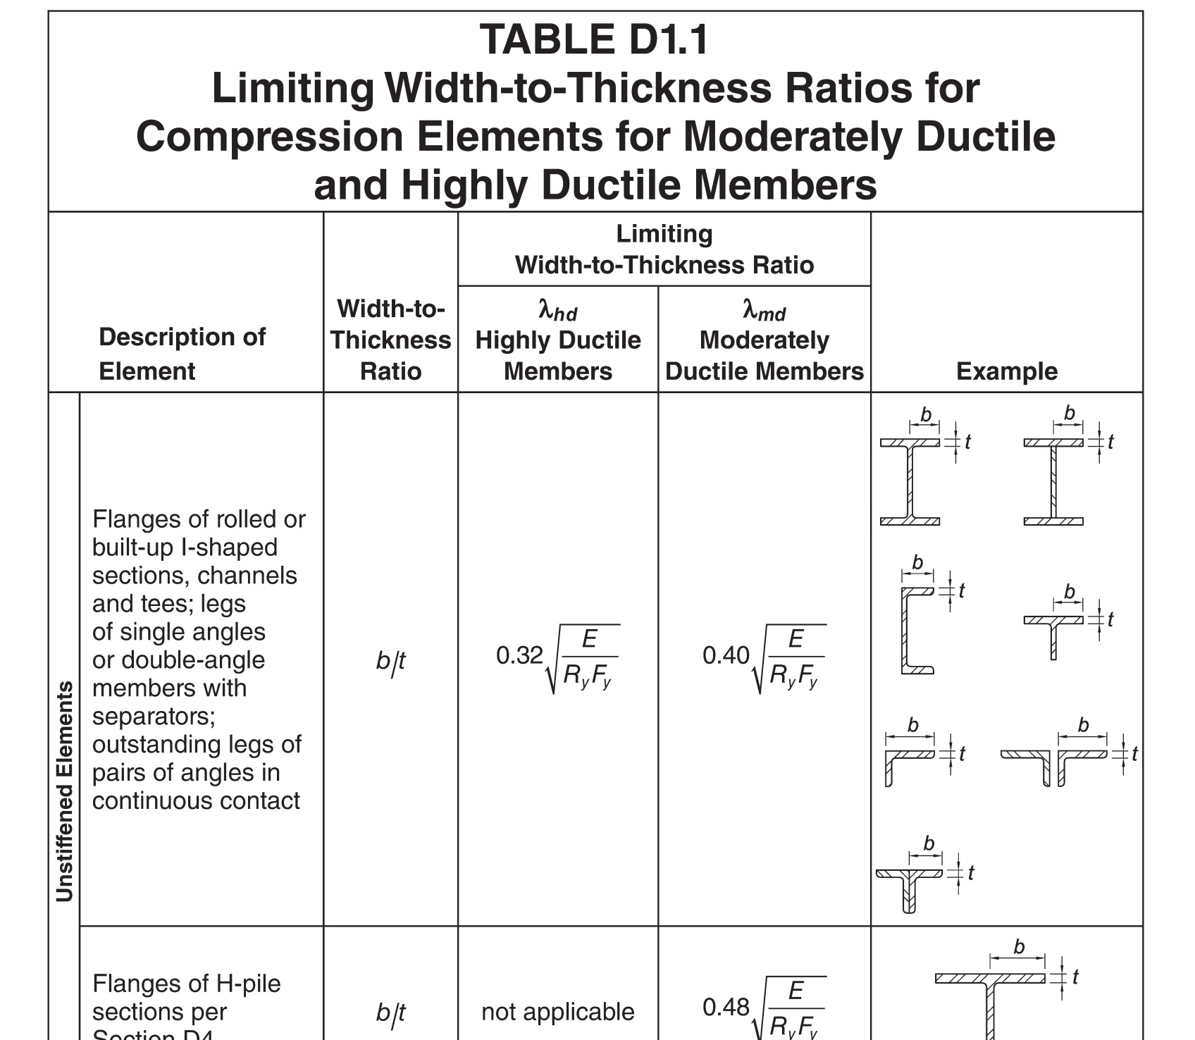
AISC Seismic Provisions
Notes:
Table D1.1 specifies limiting width-thickness ratios for moderately and highly ductile member.
Shown on this slide are the limits for unstiffened elements of the cross-section, and the next slide shows limits for stiffened elements. The footnotes of the Table (see next slide) indicated which members must satisfy these limits.
There are many standard shapes listed in the AISC Manual that do not satisfy seismically compact limits. Thus, it is important to check these limits early in the design process when selecting members of the SFRS.

Slide 91
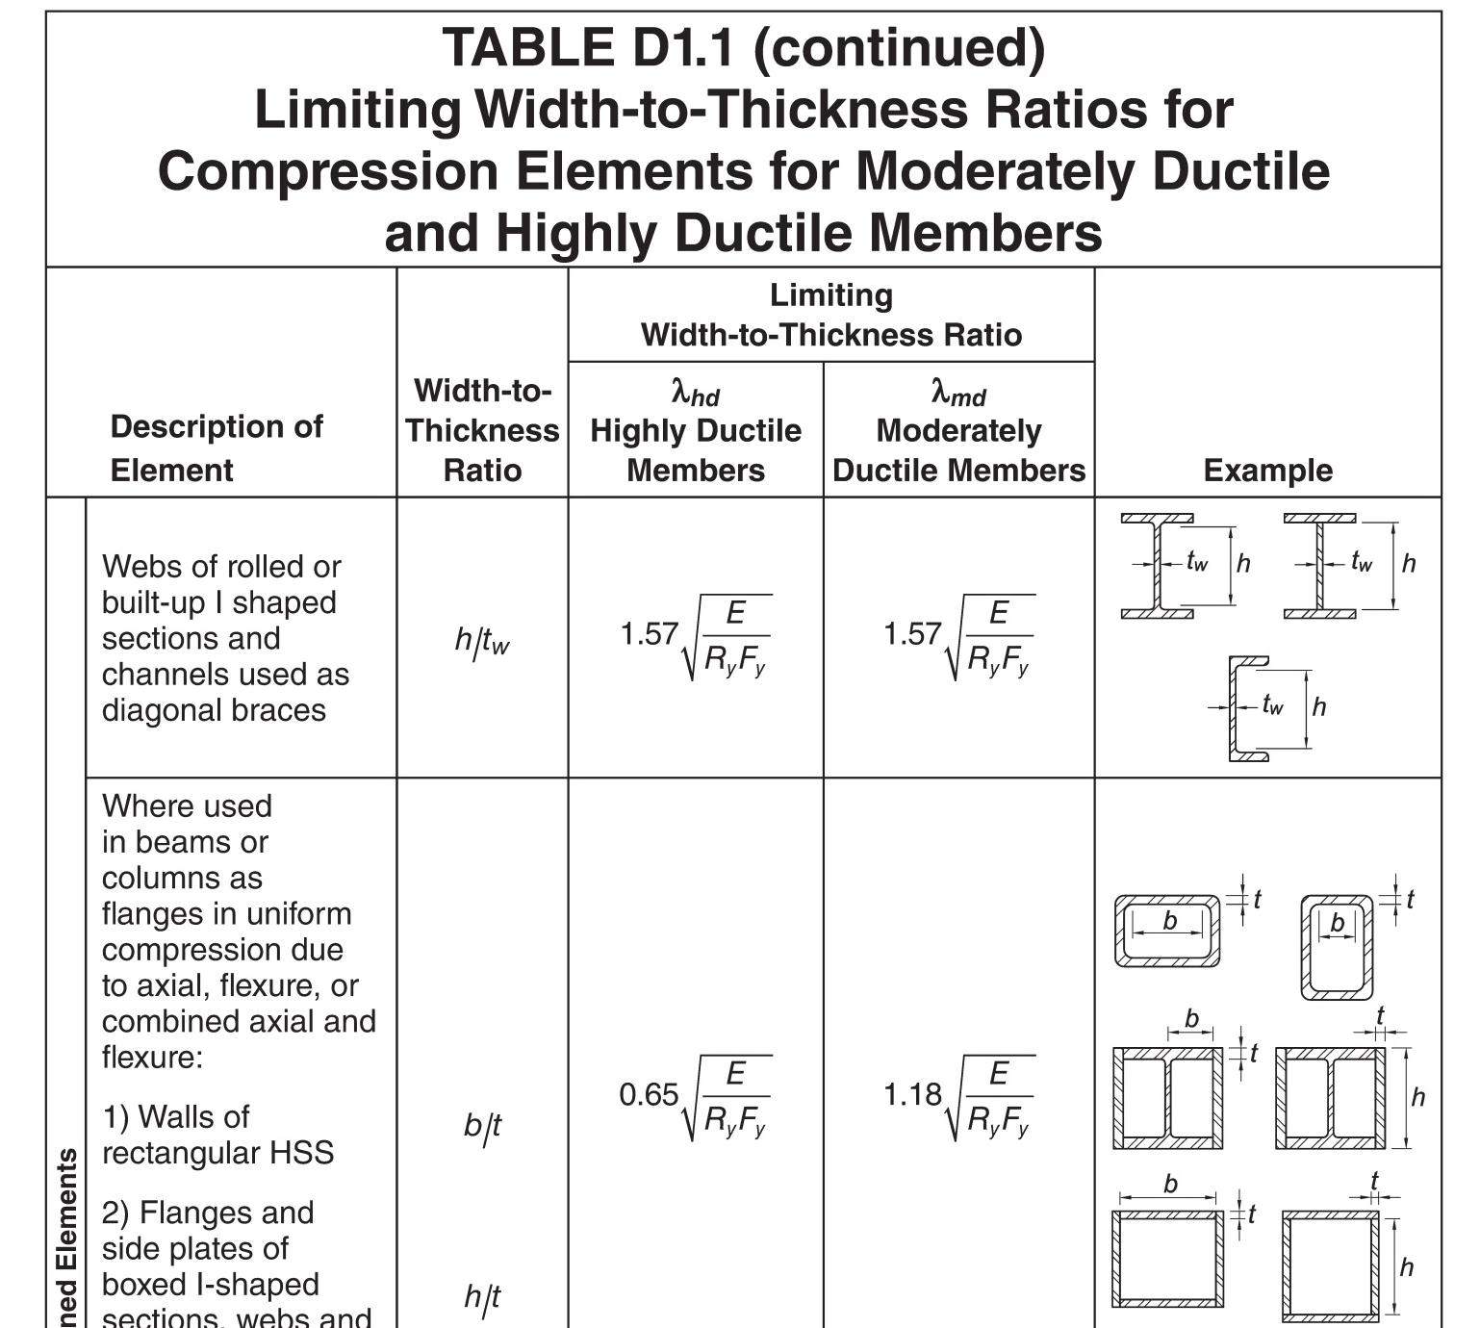
AISC Seismic Provisions

Slide 92
AISC Seismic Provisions
General Member and Connection Design Requirements
D1. Member Requirements
      D1.4a Column Strength
The required strength of columns in the SFRS shall be determined from the greater of:
The load effect resulting from the analysis requirements for the applicable system per Chapters E, F, G, and H.
The compressive axial strength and tensile strength as determined using the overstrength seismic load. It is permitted to neglect applied moments in this determination unless the moment results from a load applied to the column between points of lateral support.
(1.2 + 0.2 S_{DS}) D + Ω_{o} Q_{E} + L +0.2S
(0.9 - 0.2 S_{DS}) D + Ω_{o} Q_{E}
Notes:
When designing a column in a seismic lateral frame, an engineer must first check that the column's design strength exceeds the required strength based on the loading requirements specified in the applicable system chapter (E, F, G, or H). Where the chapter does not have specific requirements, the columns must be adequate for the load combinations of the applicable building code.
Beyond the design calculations described above, Section D1.4 a(b) of the Seismic Provisions requires that columns in any seismic lateral frame be further checked for the axial forces generated using the load combinations that include the overstrength seismic load.
This additional check is intended to assure that columns have sufficient strength to resist the axial forces that will be generated when the frame reaches it plastic lateral capacity. Recall that the actual lateral force a frame is likely to see in an earthquake is defined by the frame's own plastic lateral strength (since the earthquake is expected to drive the frame to a plastic mechanism condition), which is typically much greater than the design seismic lateral load. Thus, the actual axial forces generated in the columns during an earthquake will normally be much greater than the forces computed from the design seismic lateral load, Q_{E}.
Recall that the amplified seismic load, Ω_{o}Q_{e} is intended to provide an estimate (a very approximate estimate) of a frame's plastic lateral strength, and therefore provides an estimate of the actual lateral force the frame will see in an earthquake. Thus, the axial forces generated in the columns by the amplified seismic load are an approximation of the actual forces the columns will see in an earthquake. Columns must be checked for both tension and compression generated by the amplified seismic load. Normally, the compression case will control. Buckling of a column during an earthquake would likely be disastrous for the frame. The requirements of Section D1.4 are intended to prevent column failure during an earthquake.
When checking columns for the overstrength seismic loads, Section D1.4a(b) permits the applied moments to be neglected -- unless the moment results from a load applied to the column between points of lateral support.

Slide 93
AISC Seismic Provisions
General Member and Connection Design Requirements
      D2.5 Column Splices
Notes:
Section D2.5 specifies requirements for column splices.

Slide 94
AISC Seismic Provisions
General Member and Connection Design Requirements
      D2.5b Column Splices – Required Strength
Column splices in the SFRS must satisfy requirements of Section D2.5b
Additional requirements for columns splices are specified for:
  Moment Frame Systems (Chapter E)
  Braced-Frame and Shear-Wall Systems (Chapter F)
  Composite Moment Frame Systems (Chapter G)
  Composite Braced-Frame and Shear-Wall Systems (Chapter H)
Notes:
Section D2.5 covers column splices in the SFRS. These splice requirements apply to all systems: moment frames, concentrically braced frames, eccentrically braced frames, etc.
The systems listed in this slide (SMF, IMF, SCBF, BRBF) impose additional, more stringent, column splice requirements. These additional requirements are covered in later sections of the AISC Seismic Provisions, in the chapters that cover these systems (Chapters E, F, G, and H).
Note that a fundamental goal for ductile detailing of any seismic-resistant steel frame is that the splices should not fail. Splice failure, in general, will not likely be a ductile failure, and can endanger the columns and overall stability of the frame. The, the basic goal of the column splice requirements in the AISC Seismic Provisions is to avoid column splice failure as the frame is loaded into the inelastic range.
There has not been a great deal of research in the US on splice behavior and design requirements for seismic-resistant steel frames. Consequently, many of the splice design requirements in the AISC Seismic Provisions are based on judgment.

Slide 95
AISC Seismic Provisions
General Member and Connection Design Requirements
      D2.5b Column Splices – Required Strength
P_{u - splice}
The required strength of column splices shall be determined using the load combinations of the applicable building code including the overstrength seismic load.
M_{u - splice}
V_{u - splice}
Notes:
The first part of Section D2.5b specifies the required strength of column splices.
The required strength of the splice shall be determined using the applicable load combinations including the overstrength seismic load, and should not be less than the column design requirements in Section D1.4a. The column splice required strength need not exceed capacity-limited loads that can be transferred to the splice by the system.

Slide 96
AISC Seismic Provisions
General Member and Connection Design Requirements
      D2.5b Column Splices – Required Strength
Welded column splices subjected to net tension when subjected to overstrength seismic loads, shall satisfy both of the following requirements:
If partial joint penetration (PJP) groove welded joints are used, the design strength of the PJP welds shall be at least 200-percent of the required strength.
And....
The design strength of each flange splice shall be at least 0.5 R_{y} F_{y} b_{f} t_{f} /α_{s} for the smaller flange
Notes:
Section D2.5b specifies additional requirements for welded splices, when analysis of the frame under the load combinations that include the amplified seismic load show there is tension at the splice location. Since it is difficult to predict the actual forces that may occur at a splice during an earthquake (as discussed in the previous slide), it may be prudent to follow these additional requirements, regardless of whether or not calculations show tension at the splice.
The additional requirements are as follows:
1. If PJP welds are used at the splice, the required strength of the welds is taken as two times the required strength of the splice, as defined in the earlier part of Section D2.5b, discussed in the previous slide.
2. For any type of welded flange splice (PJP, CJP, fillet welds), the required strength of each flange splice must equal at least 50-percent of the expected yield strength of the smaller flange at the splice. A flange splice with CJP welds will also satisfy this requirement.
Both of these requirements are rather arbitrary, and are intended to assure some reasonable, minimum level of strength at the splice.

Slide 97
AISC Seismic Provisions
General Member and Connection Design Requirements
      D2.5b Column Splices – Required Strength
PJP Groove Weld
Stress concentration: Fracture initiation point.
Design PJP groove weld for 200 % of required strength
Notes:
Partial joint penetration (PJP) groove welds may not perform well when loaded in tension. The unwelded portion of the column flange acts as an edge crack at the root of the weld, and may initiate a brittle fracture. A one-sided PJP weld, as shown in this figure, may be particularly prone to fracture if loaded in tension. This potentially poor behavior of PJP welds in tension is why Section D2.5b requires that the required strength of PJP welds be doubled.

Slide 98
AISC Seismic Provisions
General Member and Connection Design Requirements
      D2.5b(c) Column Splices – Required Strength
Where Complete Joint Penetration (CJP) groove welds are used and when tension stress at any location in the smaller flange exceeds 0.3F_{y}/α_{s}, tapered transitions are required between flanges of unequal thickness or width.
Notes:
The tapered transitions shall be in accordance with AWS D1.8/D1.8M, clause 4.2.
Whenever PJP groove welds are used in a column splice, it is not necessary to provide a beveled transition in the thicker flange (as shown here). Nonetheless, providing a beveled transition may reduce stress concentrations at the PJP weld, and may be beneficial, even though not required.

Slide 99
AISC Seismic Provisions
General Member and Connection Design Requirements
      D2.5c Column Splices – Required Shear Strength
For all building columns, including those not design as part of the SFRS, the required shear strength of column splices with respect to both orthogonal axes of the columns shall be M_{pc}/H (LRFD), where M_{pc} is the lesser plastic flexural strength of the column sections for the direction in question, and H is the height of the story.
Notes:
Section D2.5c states that all column splices, whether part of the SFRS or not, must have a shear strength in each orthogonal direction equal to the column plastic moment divided by the story height in the corresponding direction. The minimum required shear strength is to account for the large bending moments and shears that can develop in columns due to non-uniform drifts in adjacent stories.
For columns in a SFRS, the greater of the required shear strength determined using the above requirement or the required shear strength determined from Section D2.5b shall be used.

Slide 100
AISC Seismic Provisions
General Member and Connection Design Requirements
      D2.5d Structural Steel Splice Configurations
Column web splices shall be bolted or welded, or welded to one column and bolted to the other.
Notes:
Section D2.5d states that the column web splice can be bolted or welded. Using a pair of splice plates on the web, as shown in the figure, may be beneficial in the event that the column flange splices fail. This issue is discussed further in the commentary to Section D2.5d in the AISC Seismic Provisions

Slide 101
AISC Seismic Provisions
General Member and Connection Design Requirements
      D2.5a Location of Splices
Splices shall be located at least 4-ft. from beam-to-column connections
4 ft. min
Notes:
Section D2.5a states that splices should be located at least 4-ft from the beam-to-column connection. This presumably moves the splice away from the highest moment region of the column, and also typically locates the splice at a convenient spot for fabrication by an iron worker in the field.

Slide 102
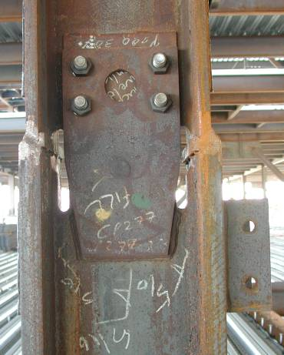
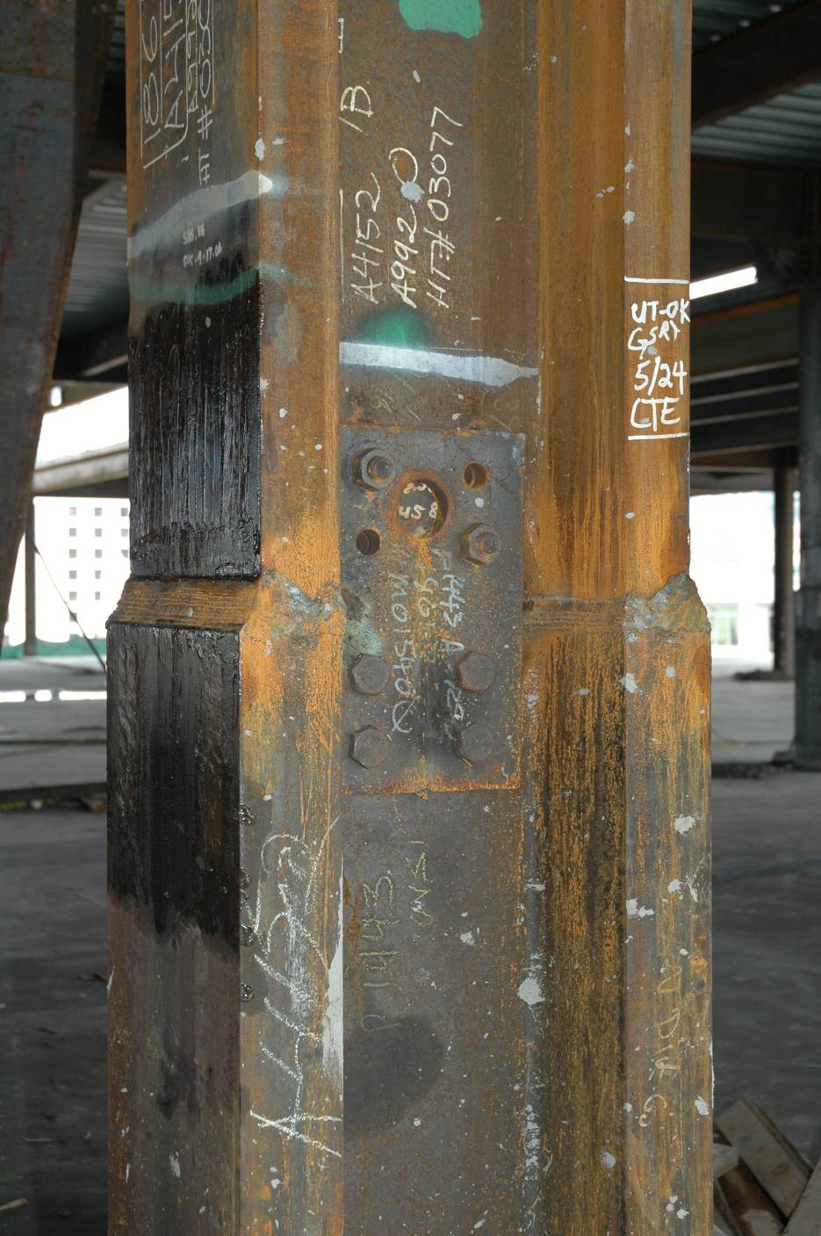
Notes:
Examples of column splices.
Photos courtesy of Prof. Chia-Ming Uang - University of California at San Diego

Slide 103
2016 AISC Seismic Provisions
Section A to D
General Requirements
General Design Requirements
Analysis
General Member and Connection Design Requirements
Notes:
This completes our overview of the initial Sections of the AISC Seismic Provisions. The requirements of these first Sections are applicable to any seismic resistant steel framing system covered by the AISC Seismic Provisions.
The remaining modules will look at the system specific requirements in the AISC Seismic Provisions for Moment Resisting Frames (Module 2), for Concentrically Braced Frames (Module 3), for Eccentrically Braced Frames (Module 4), for Buckling-Restrained Braced Frames (Module 5), and for Steel Plate Shear Walls (Module 6).

